Slide 1
New DDI Activities @ ICPSR
Sanda Ionescu, Jennifer Zeiger, Andrew Wirzburger, Jared Lyle
Metadata & Preservation Unit Monthly Presentation
20 October 2025

Slide 2
Agenda
What is DDI?
How does ICPSR use DDI?
New DDI projects
  Variable descriptions and search
  Variable-level metadata
  Controlled vocabularies
  Interoperability
Get involved in the DDI Alliance!

Slide 3
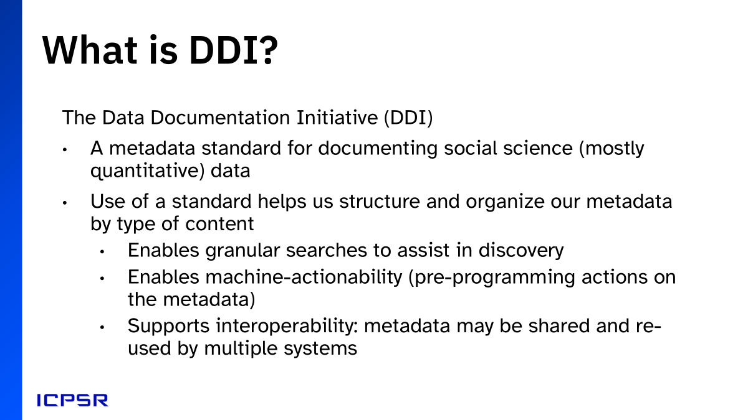
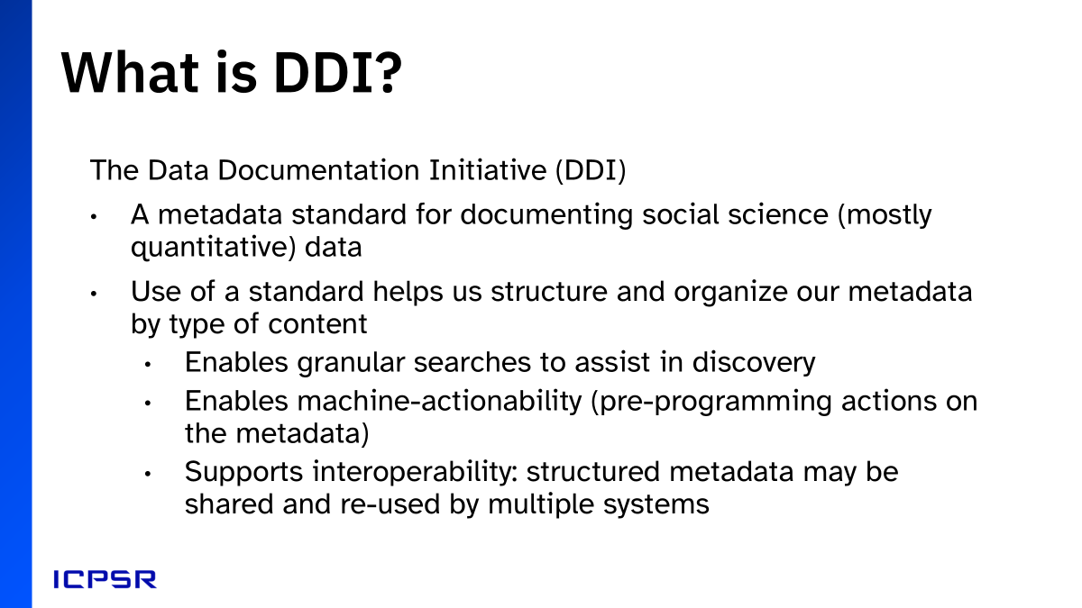
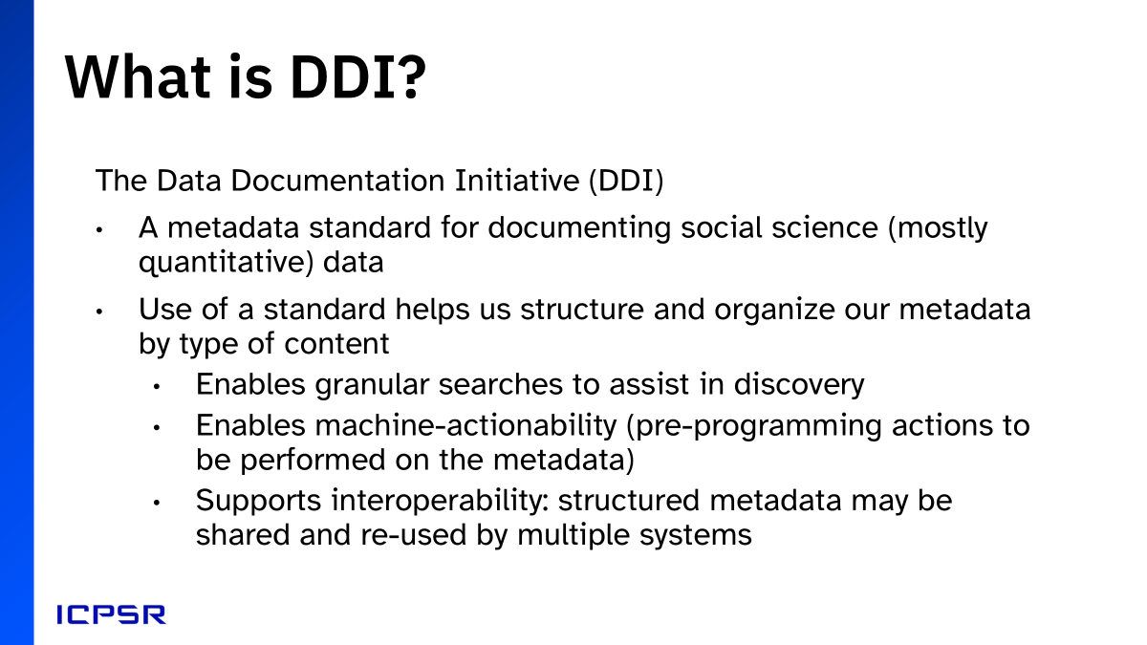
What is DDI?

Slide 4
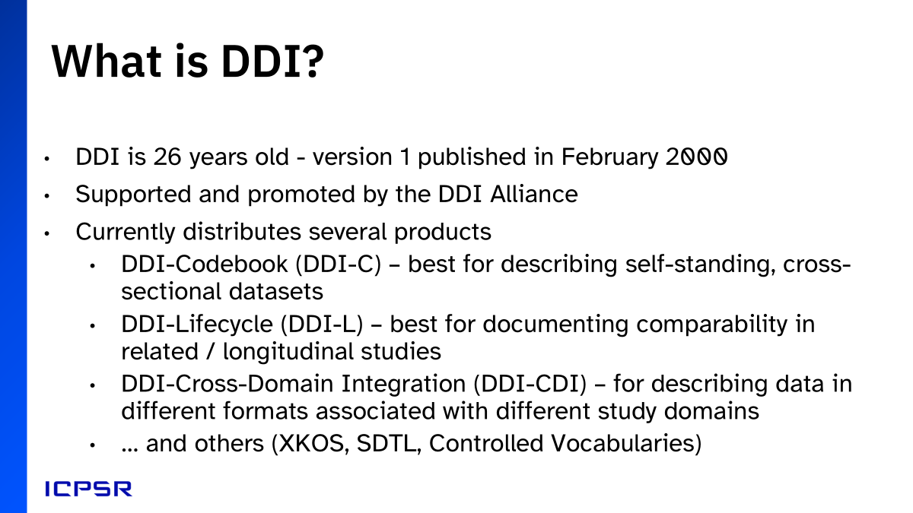
How does ICPSR use DDI?

Slide 5
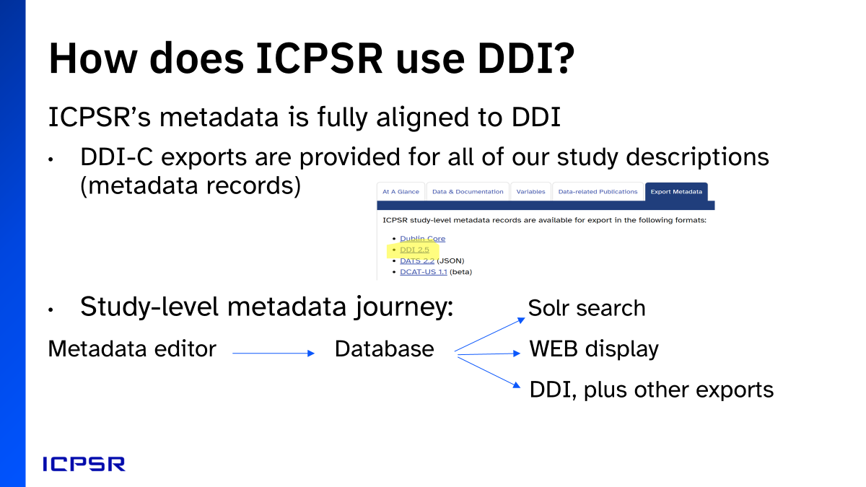
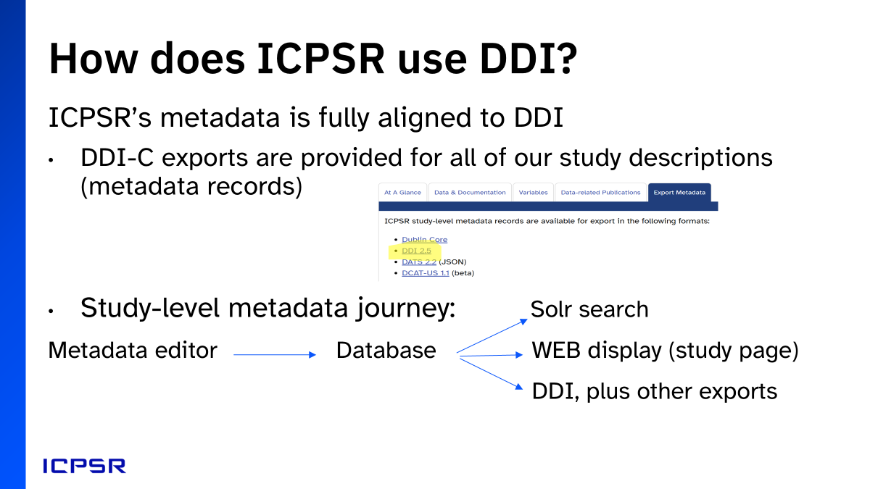

Slide 6
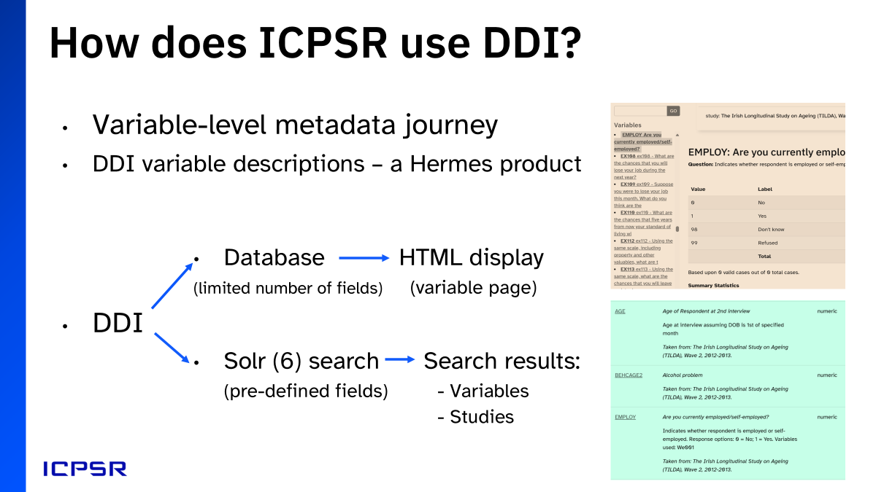


Slide 7
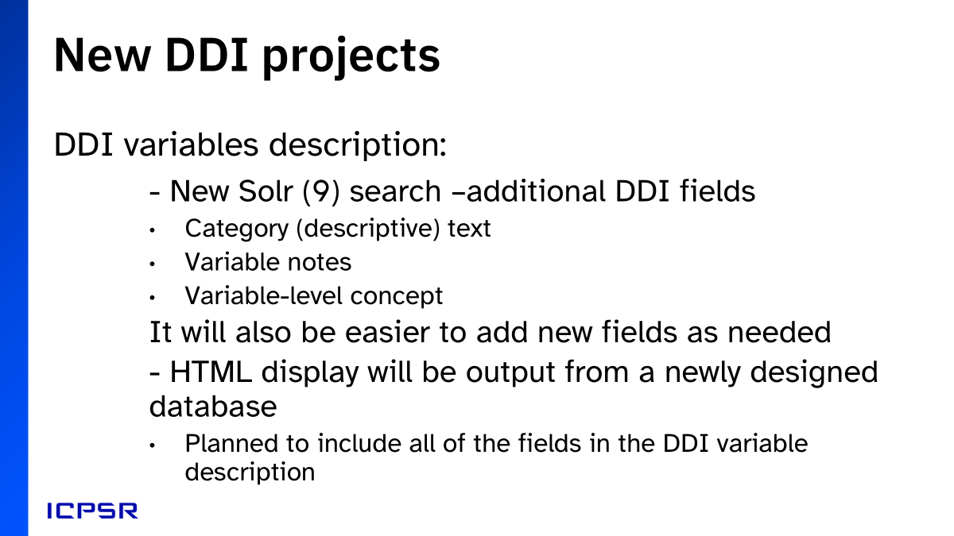
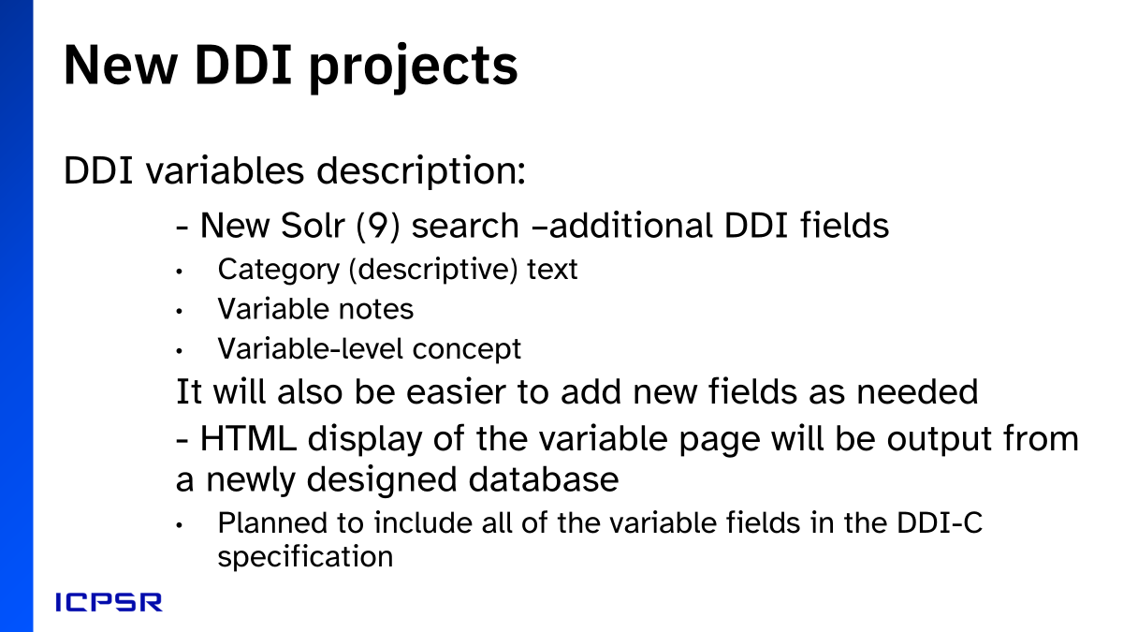

Slide 8
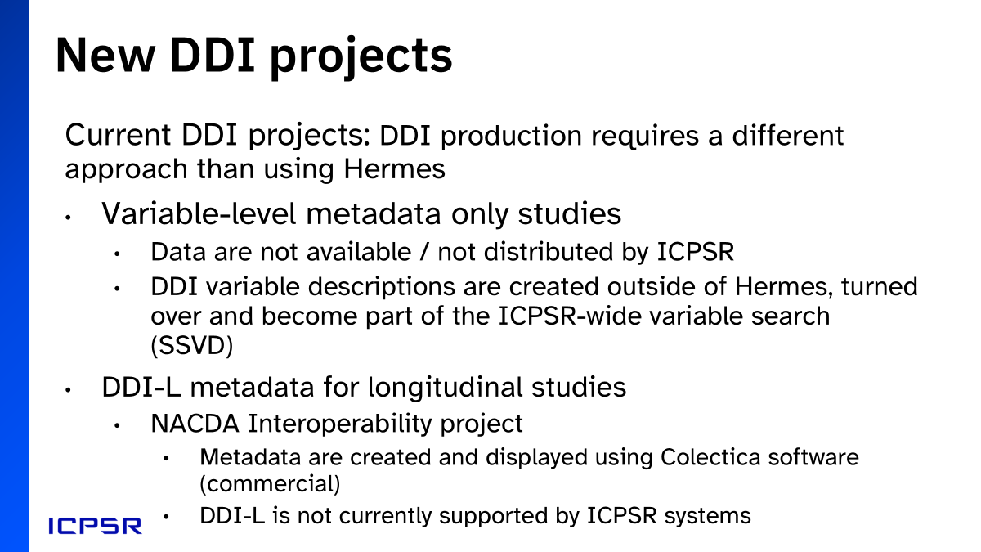

Slide 9
“Variable-level metadata only” studies
ICPSR 39191
Panel Study of Income Dynamics (PSID): Transition into Adulthood Supplement, 2021
Summary in study description includes note indicating that data are not available from ICPSR, and a link to the data distributor
The “Data and documentation” tab does not link to any data files
The Variables tab lists and searches variables within study
Variable descriptions are also searched and retrieved by ICPSR’s general “Find Data” search

Slide 10
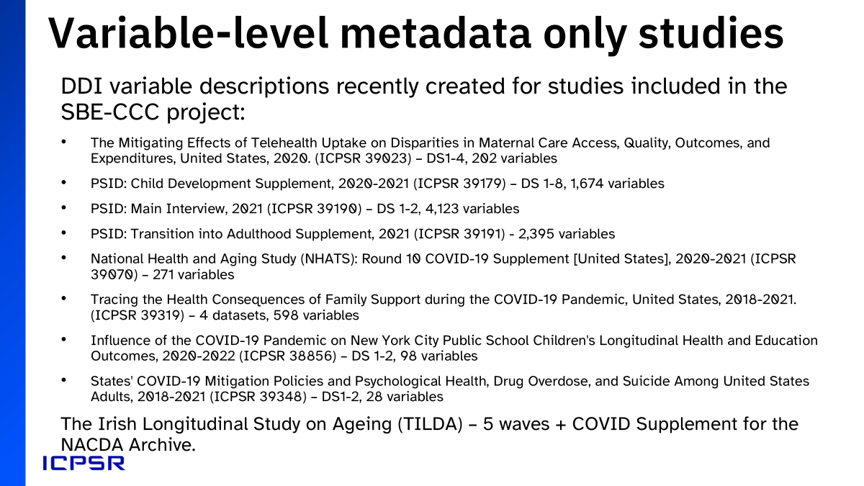

Slide 11
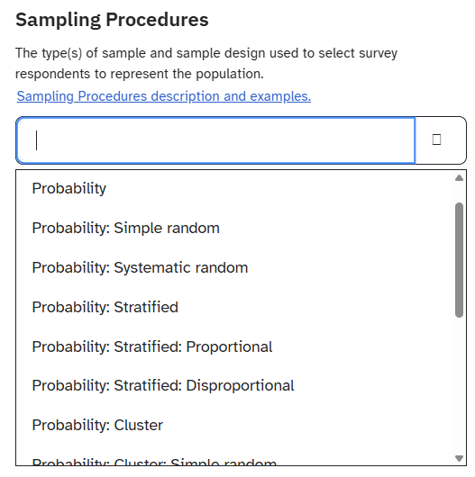
New DDI Projects - Controlled Vocabularies
Notes:
Another new DDI project is related to Controlled Vocabularies. As you know, controlled vocabularies are essential for consistency—helping us describe data in a way that’s interoperable, discoverable, and reusable across systems. They prevent free-text chaos, and they make metadata more powerful.
As part of the RDE project, we are working to strengthen our use of controlled vocabularies, especially those maintained by DDI, so that our descriptions of data and metadata are both richer and more standardized. This includes incorporating new vocabularies such as Sampling Procedures and using complete lists rather than maintaining local copies.
In cases where an existing vocabulary did not meet our needs, we partnered with the DDI Alliance’s Controlled Vocabulary Working Group— chaired by Sanda— to propose updates and extensions. That way, the solutions we develop for ICPSR also enhance the global standard. Our goal is not only to meet local needs but to contribute back to the broader metadata community.

Slide 12

New DDI Projects - Interoperability project
•An initiative of the NACDA archive, with funding from the NIA
•Started in 2018 with a pilot project
•Current team: Sanda Ionescu, Jennifer Zeiger, and Andrew Wirzburger with Kathryn Lavender as project manager for NACDA
•Uses DDI-Lifecycle to document variable comparability across longitudinal data
•Uses Colectica software and user support
•Colectica Designer – DDI editor / converter
•Colectica Portal – publication and dissemination
•Link to Portal from the NACDA site:
Home - NACDA-ICPSR

Slide 13
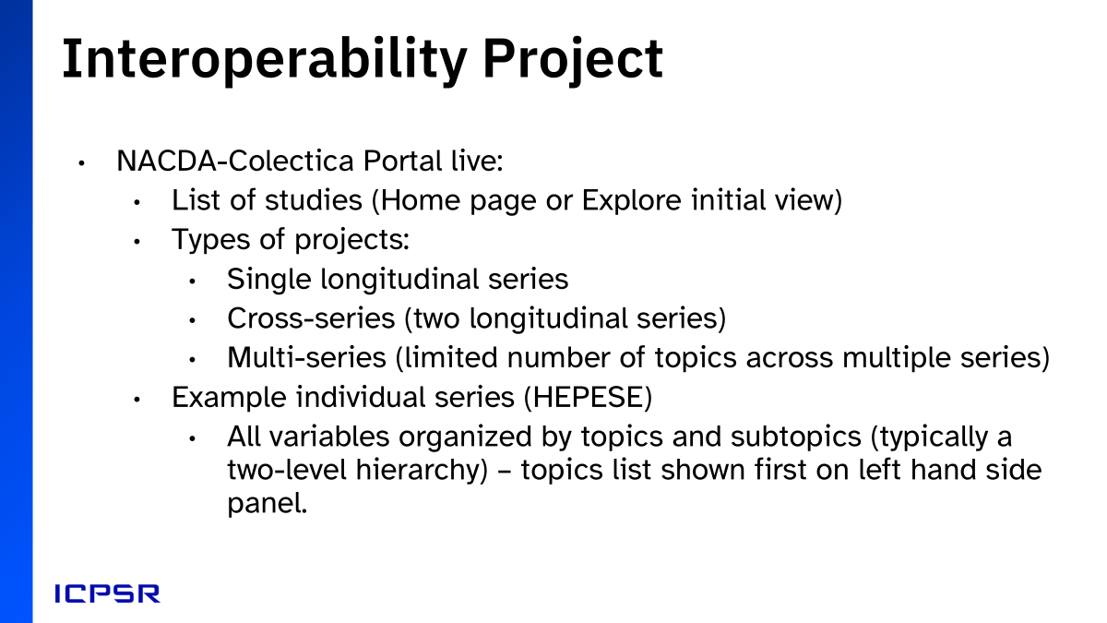
Interoperability Projects

Slide 14
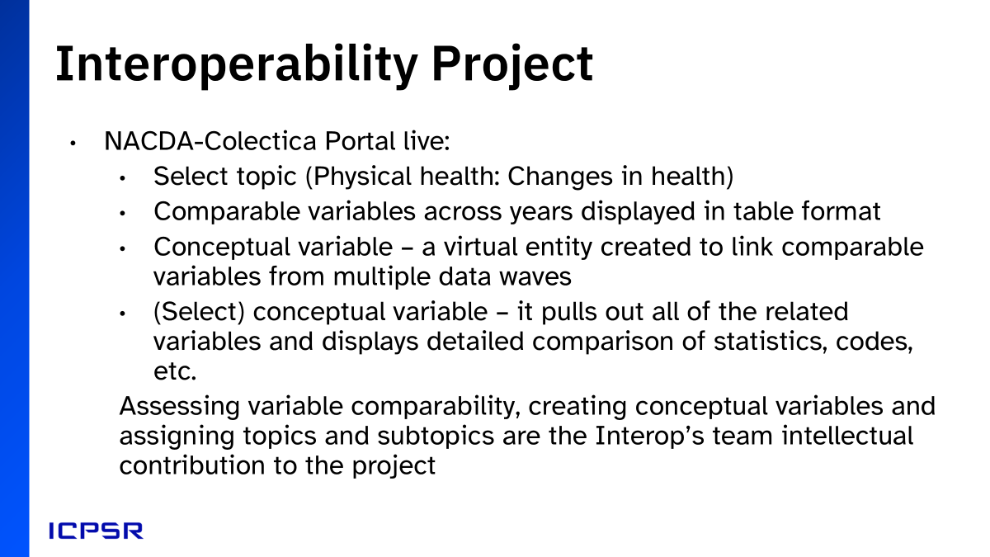


Slide 15
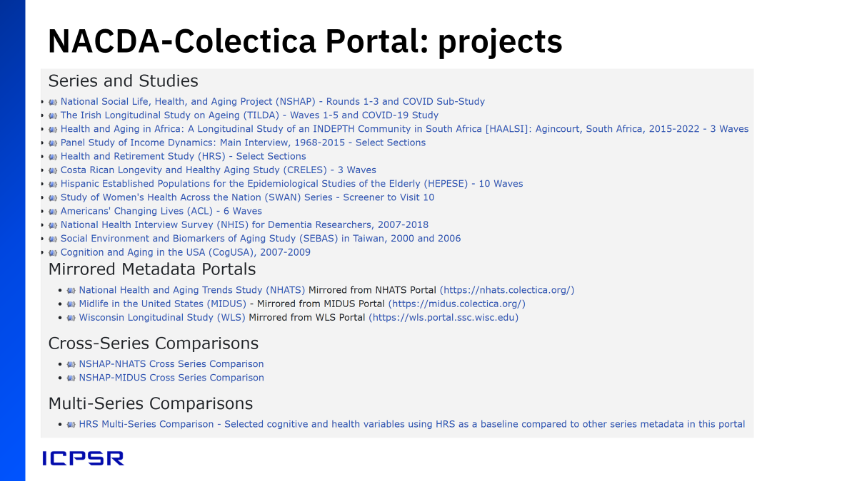

Slide 16
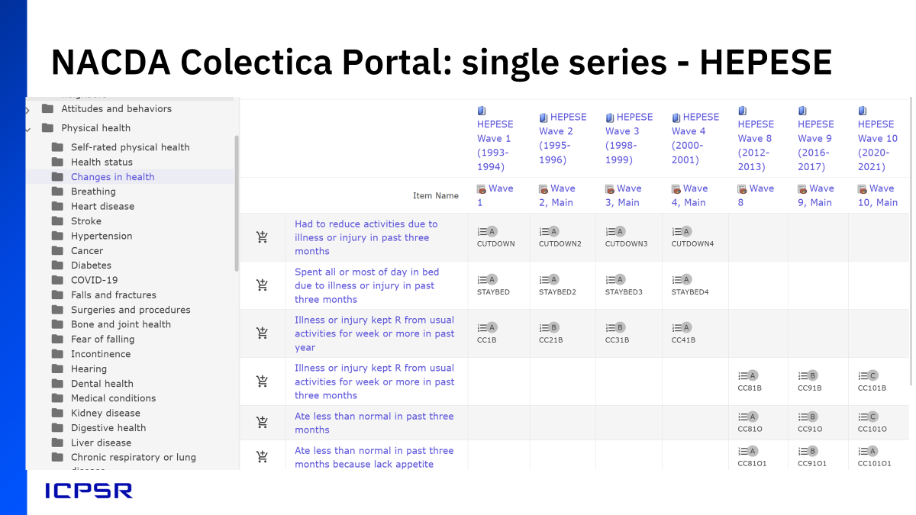

Slide 17
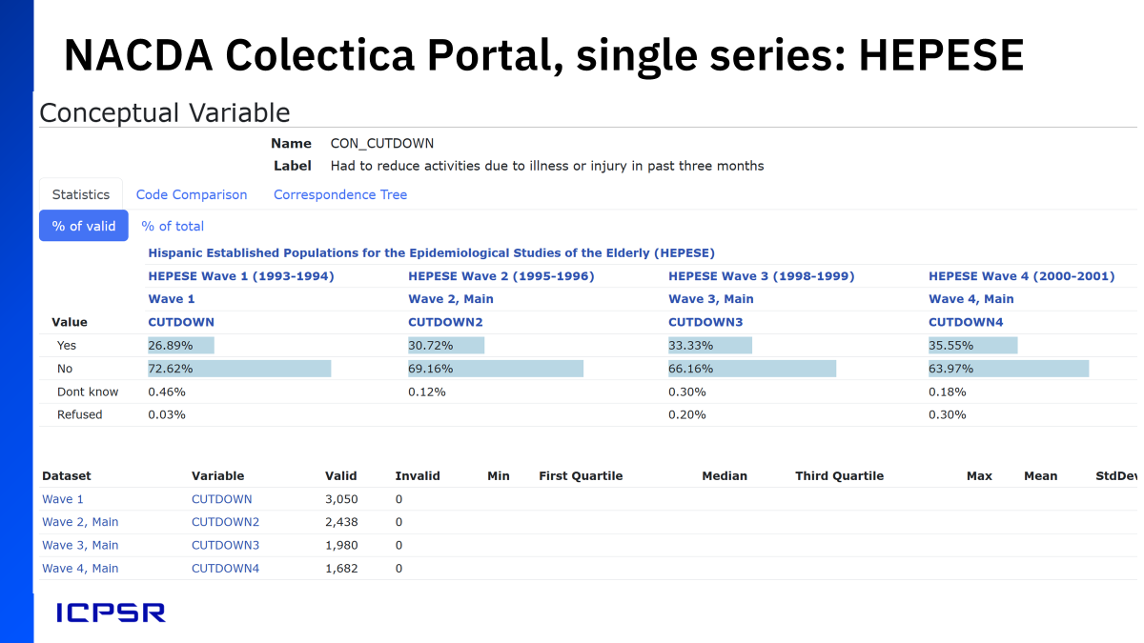

Slide 18
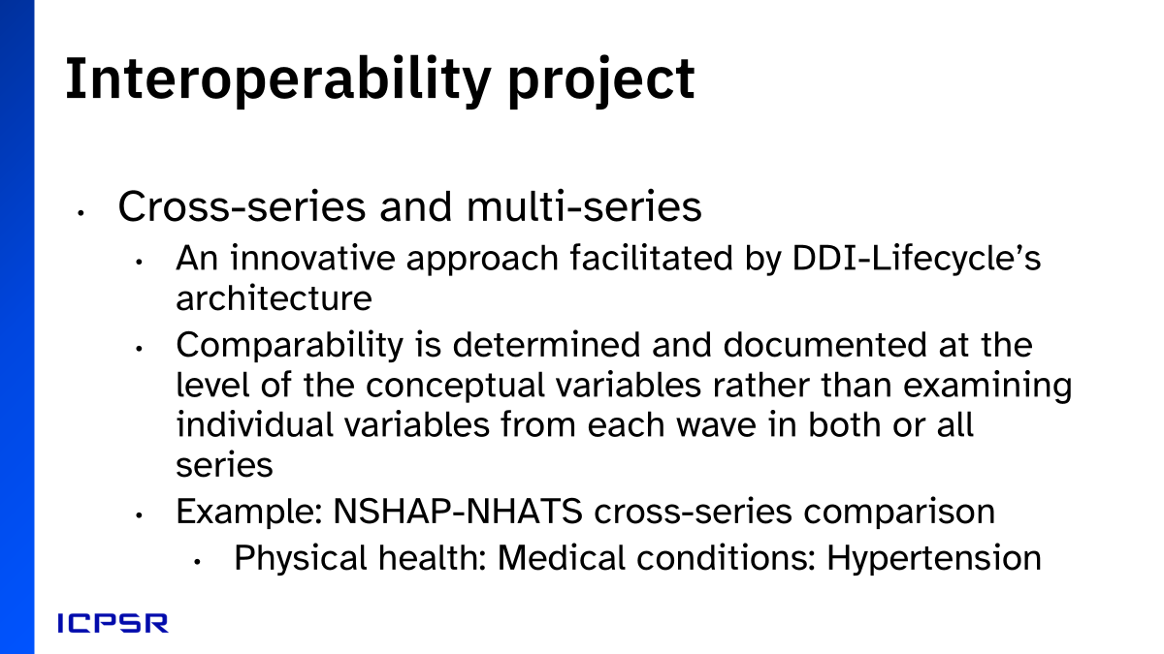

Slide 19
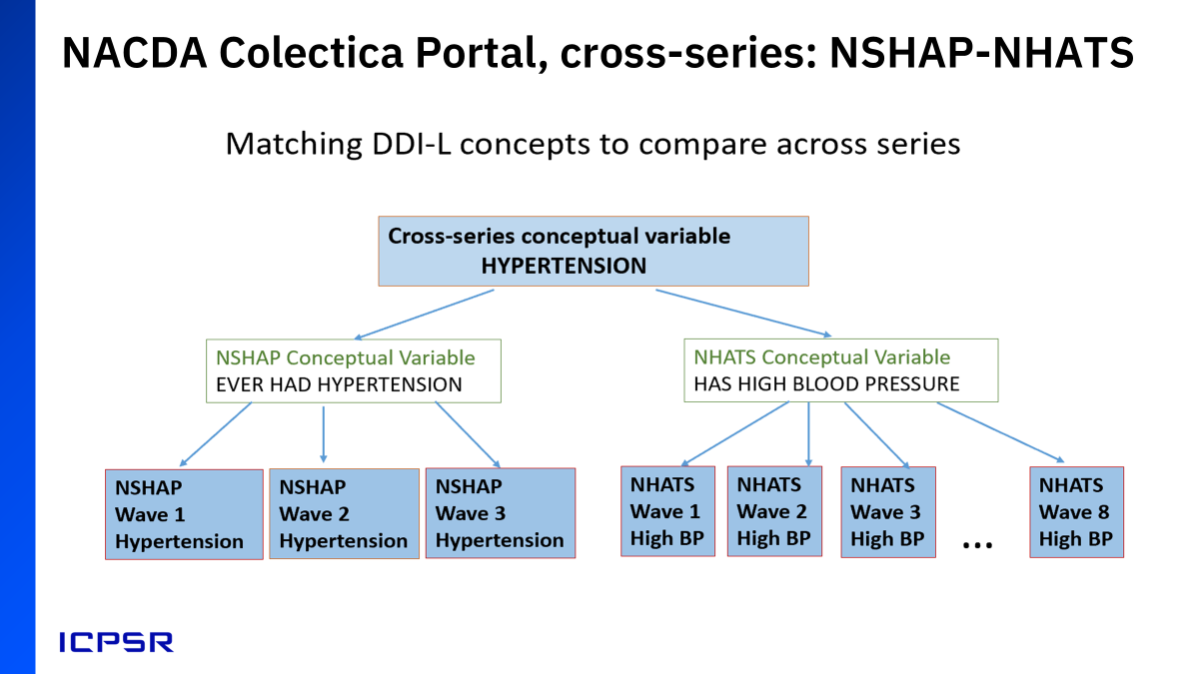

Slide 20
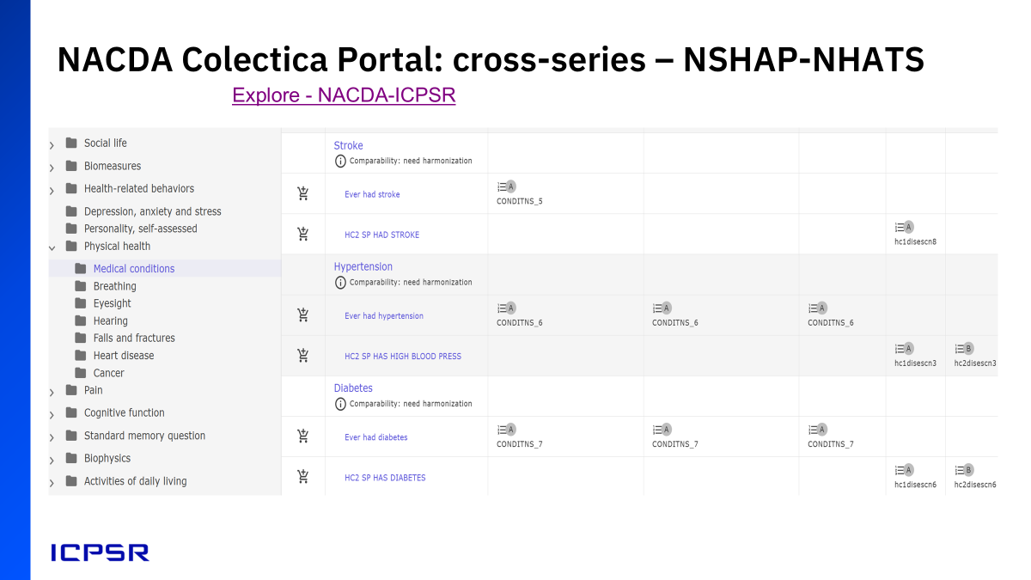

Slide 21
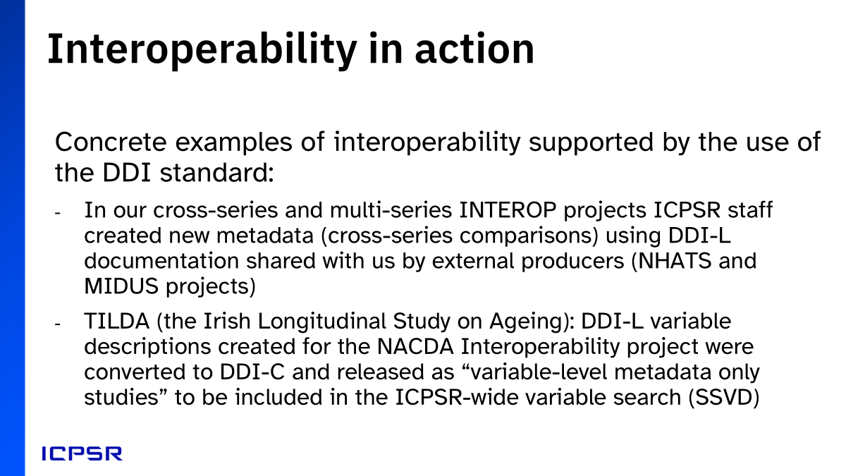

Slide 22
Creating DDI-Lifecycle for the NACDA Portal

Slide 23
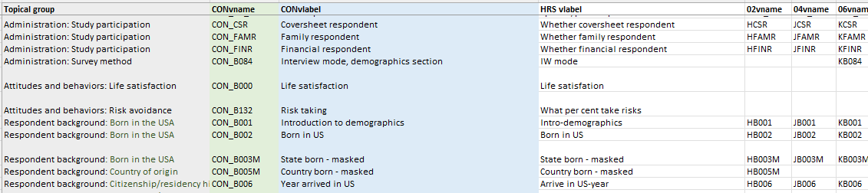
Step 1 - Construct a Concordance
Created:
Pulled from existing documentation:
Concepts (topics)
Conceptual variable name
Conceptual variable label
Instance (single wave) variable label
Instance variable names
(in columns by data file)
Section of the Health and Retirement Study (HRS) concordance

Slide 24
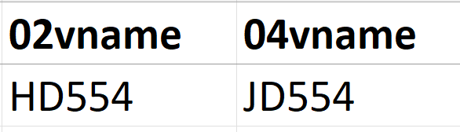
Step 1a - Compare Variables
Wave | 2002 | 2004
Name | HD554 | JD554
Label | GET LOST IN FAMILIAR PLACES- PC | GET LOST IN FAMILIAR PLACES- PC
Question text | Now, thinking about some current behaviors, does [he/she] ever get lost in a familiar environment? | Now, thinking about some current behaviors, does [he/she] ever get lost in a familiar environment?
=
Two instance variables from the Health and Retirement Study (HRS)

Slide 25
Step 1b - Create Entities to Link Variables
Concept: Subconcept (topic: subtopic)
Conceptual variable name
Conceptual variable label
Conceptual variables are sorted into concepts and subconcepts.
We call the taxonomy
as a whole a
Concept System
A conceptual variable name is based on the instance variable name(s), with “CON_” added to differentiate.
A conceptual variable label is created based on the instance variables’ content (e.g. qtext) and context.

Slide 26
Concept System Structure
Instance variable
Instance variable
Conceptual variable
Sub-concept (subtopic)
Instance variable
Instance variable
Concept (topic)
Conceptual variable
Instance variable
Sub-concept (subtopic)
Conceptual variable
Instance variable
Concept system
Instance variable
Instance variable
Concept (topic)
Sub-concept (subtopic)
Conceptual variable
Instance variable
Instance variable
Conceptual variable
Instance variable
Notes:
Something about the variable cascade

Slide 27
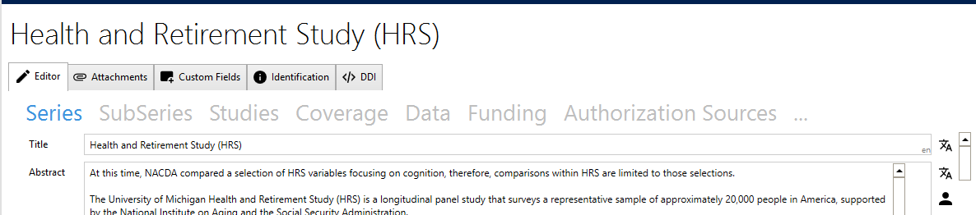
Step 2 - Put Everything in Designer
Series and study information
(from ICPSR study pages)
Data files (metadata only)
(SPSS or DDI-C)
Concept list (Excel)
Question text (Excel or DDI-C)
Concordance (Excel)
Health and Retirement Study (HRS) in Designer
Notes:
Once we have a complete concordance and concept system, we put all our information into software called Designer. Designer is a program specifically designed to compile and publish DDI-Lifecycle onto a Colecitica portal.

Slide 28
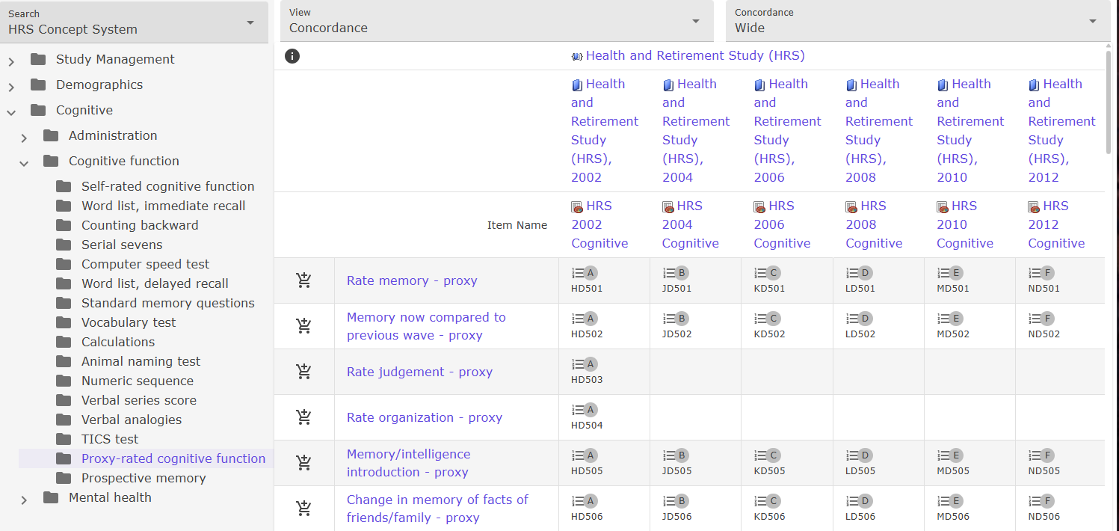
Step 3 - Publish
Health and Retirement Study (HRS) concordance view on the NACDA-Colectica Portal

Slide 29
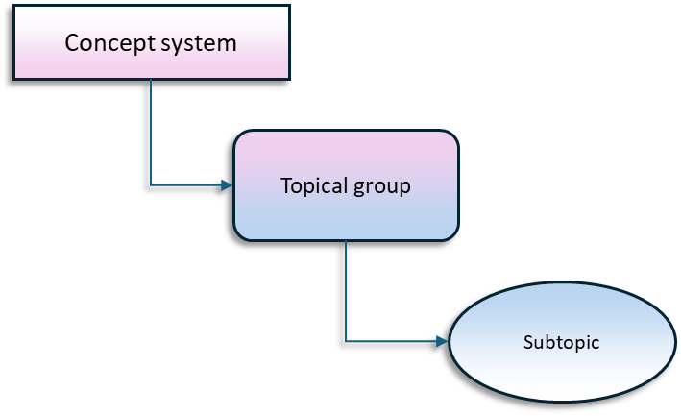
Interop Project’s Common Concepts
We create a unique concept system for each project on the Portal.
We pull topics and subtopics from a master list of common concepts whenever possible, so users can find the same topics across projects
The result:
  Increased browsability in the Portal’s Explore feature
  Eases the work of variable-level comparison among projects

Slide 30
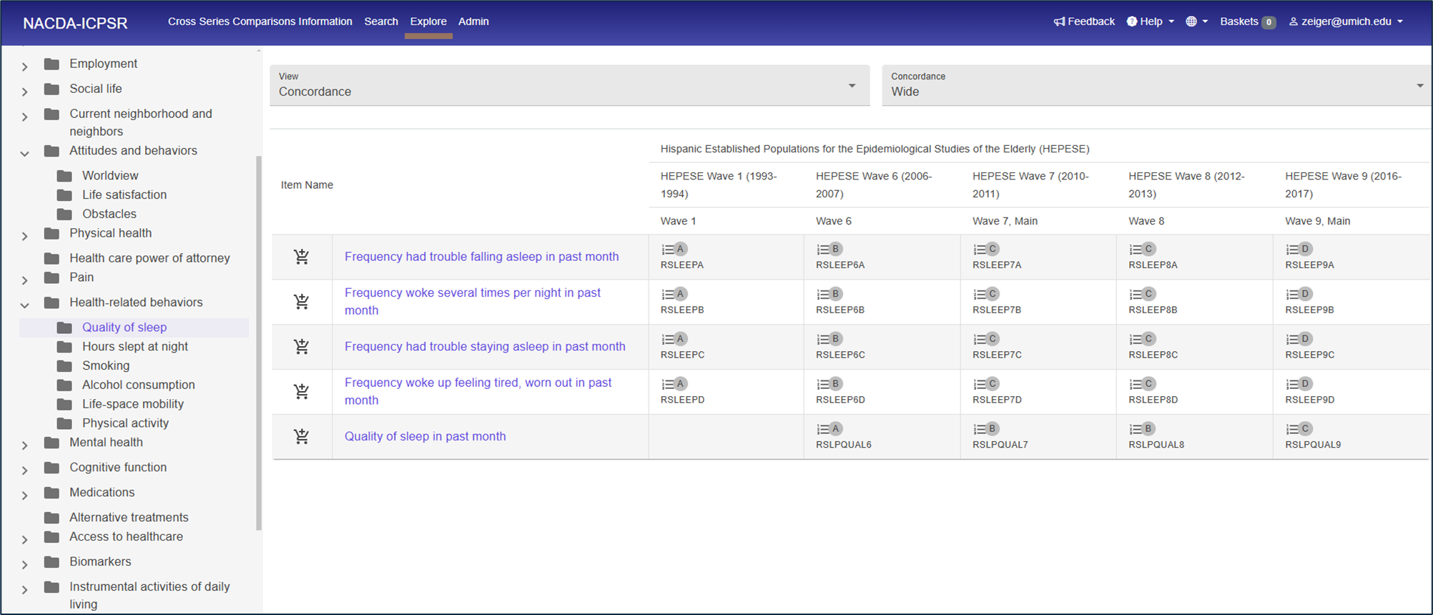
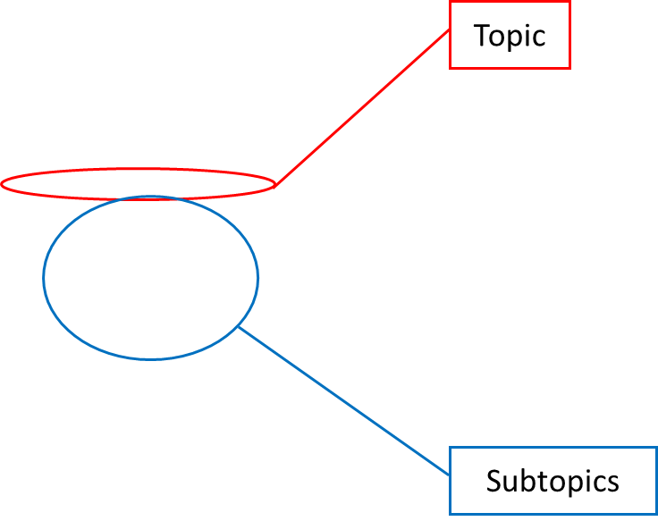
A Concept System in the Portal

Slide 31
Before the Common Concepts List
2018: Added NSHAP to the Portal
  Concept system based directly on the series’ original organization
2020/2021: Created cross-series comparisons of NSHAP to NHATS, and NSHAP to MIDUS
  Demonstrated that series have many concepts in common – GOOD!
  Concepts are worded differently across series, so variables under different concepts may not appear in the same search even when comparable – BAD!

Slide 32
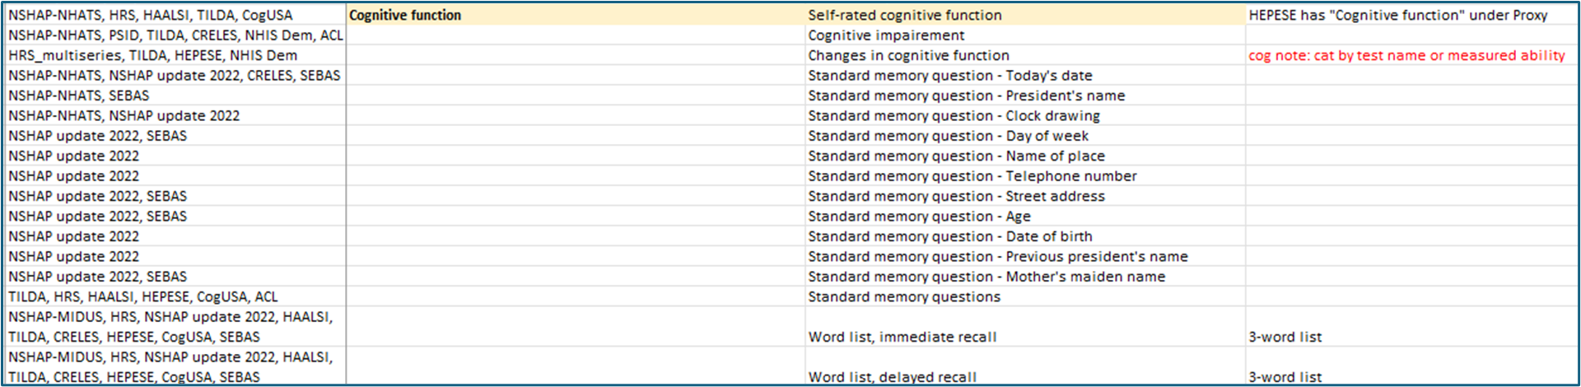
Creating the List
We started compiling a Common Concepts list to use as a standard for all projects on the Portal.
Every topic and subtopic on the Portal is included in the list.
Concept systems use sub/topics from this list when possible.
When we find no good match, we create a new sub/topic.

Slide 33
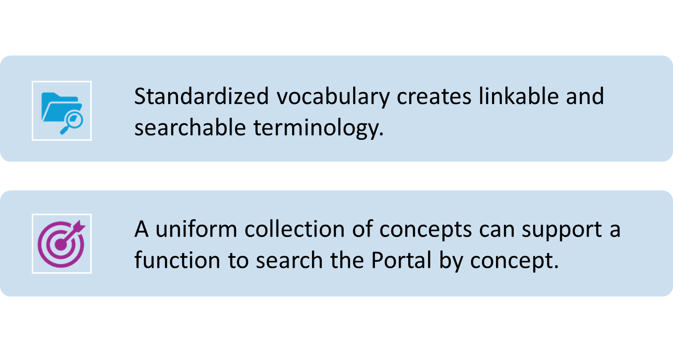
Standardization Makes Data FAIR

Slide 34
More Concepts, More Problems
15 cross-wave, 2 cross-series, and 1 multi-series comparisons later, the list has become unwieldy:
  Topic: Cognitive function grew from 9 subtopics to 62
  Topic: Physical health grew from 10 subtopics to 48
Object | 2022 | 2025
Concept systems on portal | 3 | 19
Topics in List | 32 | 51
Subtopics in List | 110 | 560

Slide 35
Falling Short of Truly Common Concepts
Despite our best efforts, there is still variation across concept systems. Why?
Special Interests
The Study of Women’s Health Across the Nation (SWAN) has many more variables on reproductive health than other series.
Following the Common Concepts list to the letter would put 100s of variables under the subtopic “Fertility and menopause” (Physical health) – making browsing difficult.
Variation in PI documentation
Citing specific scales (e.g. MoCA, MMSE) vs. Naming each discreet test
“Chronic lung diseases” vs. “Asthma,” “Emphysema,” etc.
Medications described by name vs. Medications described by illness treated
Notes:
There are two major reasons. One is a kind of variation we do on purpose – that is, when a series has a heightened focus (and therefore more variables) on a particular concept. SWAN did this with reproductive health. Instead of listing them under “Physical Health: Fertility and Menopause,” we pulled them out of that concept entirely and created a new upper-level concept – Reproductive health – and divided it into a number of relevant subconcepts.
Another reason is less in our control. Different PIs tend to organize their studies differently and often prefer to use different terminology in their documentation. This results in differences in the concept systems we create. For example…

Slide 36
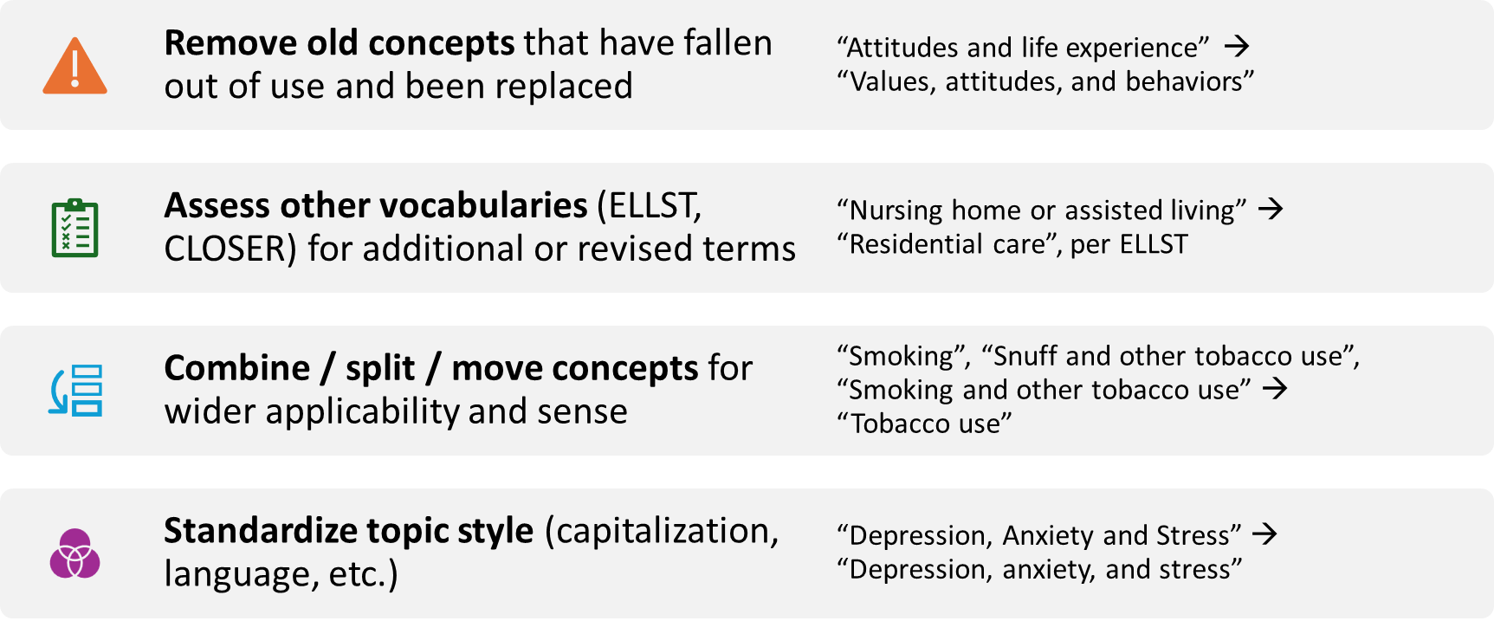
Aspects of List Harmonization

Slide 37
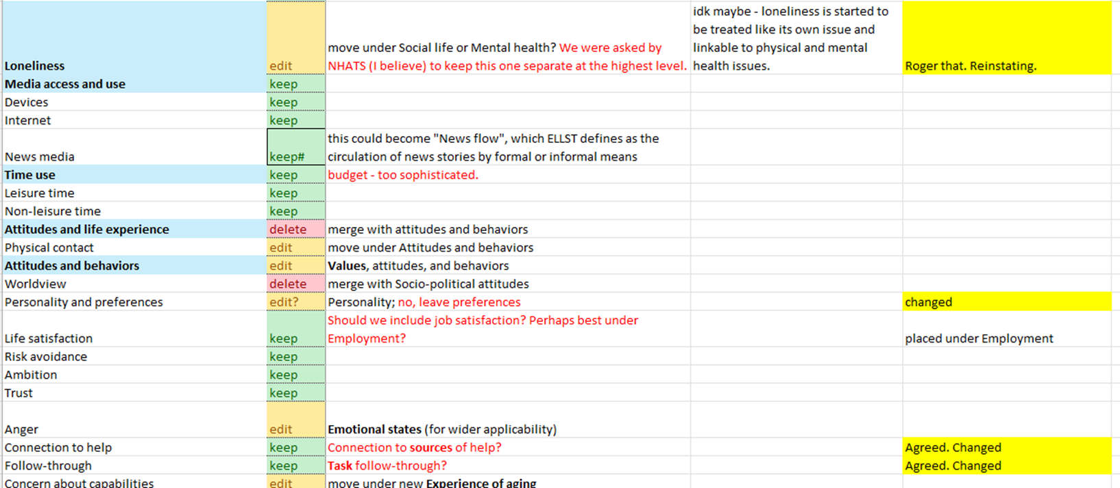
Revision in Action

Slide 38
Next Steps in Concept Harmonization
Common Concept revisions are still being discussed.
Once we have an approved list of concepts, we will update all of the concept systems on the Portal to match.
Eventually, we hope to add a feature to the Portal that allows users to bring up a list of variables by clicking on or searching a particular concept.

Slide 39

Get involved in the DDI Alliance!
13 Working Groups + 2 Governing Committees
Anyone can join
Members can propose new groups
Notes:
Finally, let’s talk about how you can get involved in the DDI Alliance metadata community.
The Alliance is supported by ICPSR, which serves as the Secretariat, providing administrative and organizational support that keeps the Alliance running smoothly. Several ICPSR staff already contribute actively. For example, a portion of my time at ICPSR is spent as the DDI Executive Director coordinating community activities. Sanda chairs the Controlled Vocabulary Working Group, and Kathryn Lavender from PUMUS is co-chair of the DDI Training Working Group.
But the Alliance is truly powered by our community. One of the best ways to participate is through our 14 Working Groups and 2 Governing Committees. These groups span a wide range of activities—from technical development, to training, to communications—and they’re where most of the hands-on work of the Alliance happens.
The great thing is: anyone can join. If you have expertise, curiosity, or just a willingness to help, there’s a place for you in these groups.
And for our members, there’s even more opportunity. Members can propose new groups if they see an unmet need, or want to bring people together around a new initiative. That means the structure of the Alliance can evolve directly from community interest and energy. Two new groups, for instance, were created over this past summer: one for qualitative data, and another for machine-actionable publication of metadata.
So whether you want to dive into technical standards, connect with other metadata experts, or help shape the future direction of the Alliance, there’s a way for you to get involved.

Slide 40
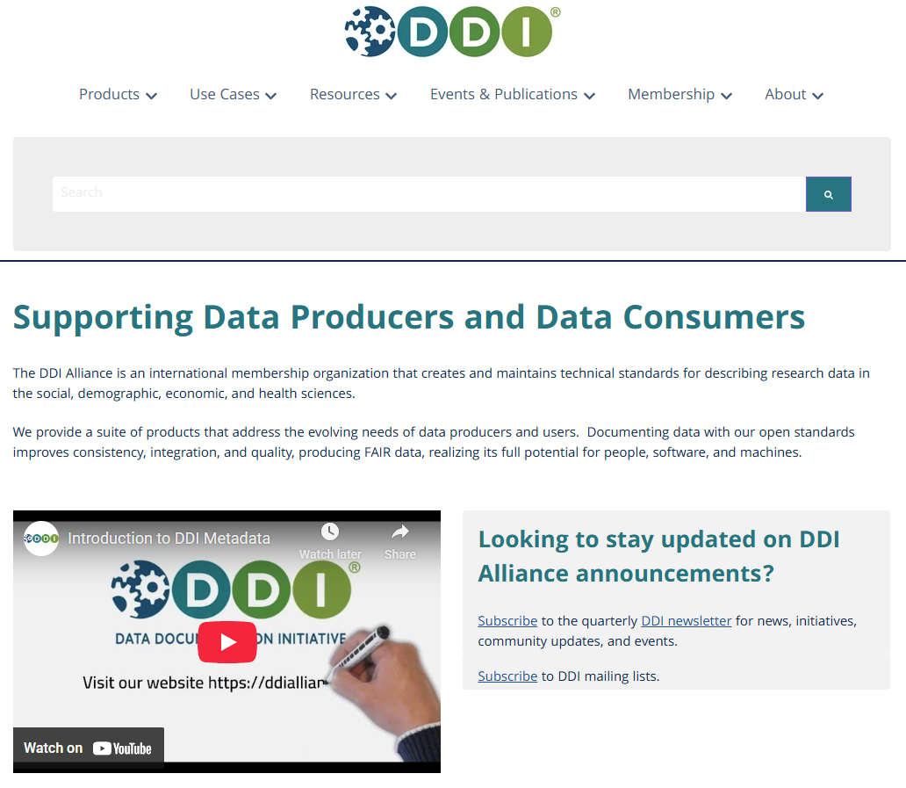
https://ddialliance.org/
Notes:
The website is the main hub for everything related to the DDI Alliance. On the site, you’ll find:
Information about our standards and how they’re used
Resources like documentation, training materials, and working papers
News and upcoming events in the DDI community
And of course, details on how to get involved—whether that’s joining a working group, attending meetings, or becoming a member.
I encourage you to take a look -- it’s the central way to stay connected with what’s happening in the Alliance and to explore how you can contribute.

Slide 41
Thank you!
Notes:
Thank you! We are happy to take questions.

