Slide 1
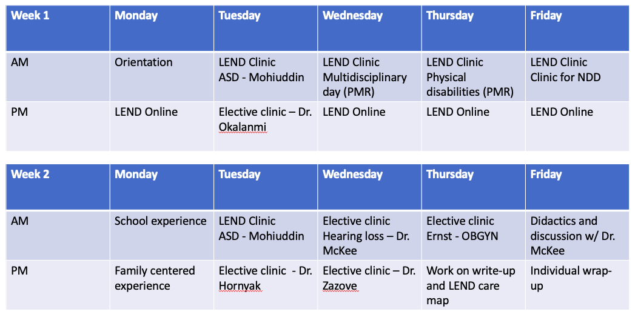



A Proposed Elective for Learning to Care for Patients with Disabilities
William Zhu; Michael McKee, MD
University of Michigan Medical School
Introduction
Results
Conclusions
Patients with intellectual and developmental disabilities are a historically underserved population. Not only do they have limited access to the healthcare system, but they also experience low quality care upon engaging with providers. Oftentimes this is due to lack of comfort and familiarity on the provider’s side. Medical students at Michigan Medicine do not have a systematic or formal way of exploring the ways by which providers may care for this population, such as communication strategies, engagement of multiple community resources, or use of adaptive technologies. Any exposure students have to this underserved population is often sparse and incidental.
We have designed an elective consisting of a two week hybrid elective that would include both clinical and online coursework. Clinical exposures would be interdisciplinary in nature and include rotations through family medicine, pediatrics, and PM&R. Upon completion of the online LEND curriculum, students would receive a certification of competency in caring for those with intellectual and developmental disabilities. Conversations are ongoing for curricular approval of this elective
Patients with disabilities experience many difficulties receiving the care that they need, and many providers are unfamiliar or uncomfortable providing care to this patient population. One reason this could be the case is that current educational models fail to provide sufficient exposure to these patients. Currently, there are no options for interested medical students to formally learn how to best care for those with disabilities at Michigan Medicine. A two week elective could be an effective strategy to give medical students exposure to this underserved population and teach future clinicians strategies in providing quality care to patients with disabilities. However, there are many logistical challenges in setting up a novel curriculum that require a team-based approach to surmount. Future directions should be focused on the practical and administrative steps needed to bring this idea from conception to fruition.
Objectives
To identify caretakers who are comfortable providing care to this population
To utilize existing training resources to teach medical students about this patient population
To develop a hybrid curricular elective to allow students to learn best practices and resources for caring for this population
Reflection
When it comes to medical education, most people would agree that medical students would benefit from seeing as diverse a patient base as possible. However, when it comes to diversity, most people think of socioeconomic, racial, or age diversity. Diversity in ability is often neglected. This impact project could greatly enrich medical students’ education. There are certainly many steps to take before this project can truly reach fruition, but I think that there is high potential for a positive impact. If this elective were made available, engaged medical students should be able to implement their learning to improve the care they can provide to patients with both visible and invisible disabilities, and in turn mentor future generations of learners who demonstrate interest in caring for a truly diverse patient population.
Approach
We reached out to mentors in the medical school organization, the American Academy of Developmental Medicine and Dentistry (AADMD), as well as Dr. Michael McKee, a family medicine physician who is a strong advocate for disabilities care. Through these meetings, we have developed partnerships with physicians across multiple medical disciplines, including family medicine, pediatrics, and PM&R. We have also researched and incorporated an online component to our proposed elective. The Leadership Education in Neurodevelopmental and related Disabilities (LEND) is an interdisciplinary training program that provides an online curriculum to supplement clinical exposure
Figure 1. Sample Schedule.
Contact
William Zhu
University of Michigan Medical School
Email: wizhu@med.umich.edu

