Slide 1
When is a Library No Longer a Library?
The Future of All-Digital Academic Libraries.
Virtual Discussion (WebEx)
March 1, 2018, 2-3pm Eastern / 1-2pm Central
Kate Bernard (Florida Polytechnic University) & Corey Seeman (University of Michigan)
ACRL University Libraries Section (ULS)
Future of University Libraries Virtual Discussion Forum
http://acrl.libguides.com/uls/dgs/programs

Slide 2
When is a Library No Longer a Library?
The Future of All-Digital Academic Libraries.
Passing from ‘traditional’ to modern
Corey Seeman - University of Michigan
Future of University Libraries Virtual Discussion Forum
ACRL University Libraries Section (ULS) - March 1, 2018
http://tinyurl.com/CSEEMAN2018ULS
twitter @cseeman & email cseeman@umich.edu

Slide 3

Introduction
Director, Kresge Library Services (independent library at Michigan reporting to the Ross School of Business) since October 2006
Previously served as an archivist, library software trainer, cataloger, and academic administrator over technical services and collections (a lot of “back office” responsibilities).
Guided Kresge Library through a transformation from a traditional library to a bookless and mostly “space-less” ethereal library (2013-2016)
Spent 3 weeks and 1 day working in the JC Penney Manager Training Program….
In my “other life”, I am passionate about cooking, writing (trying fiction and creative non-fiction), and photography – especially squirrels https://www.flickr.com/photos/cseeman/

Slide 4
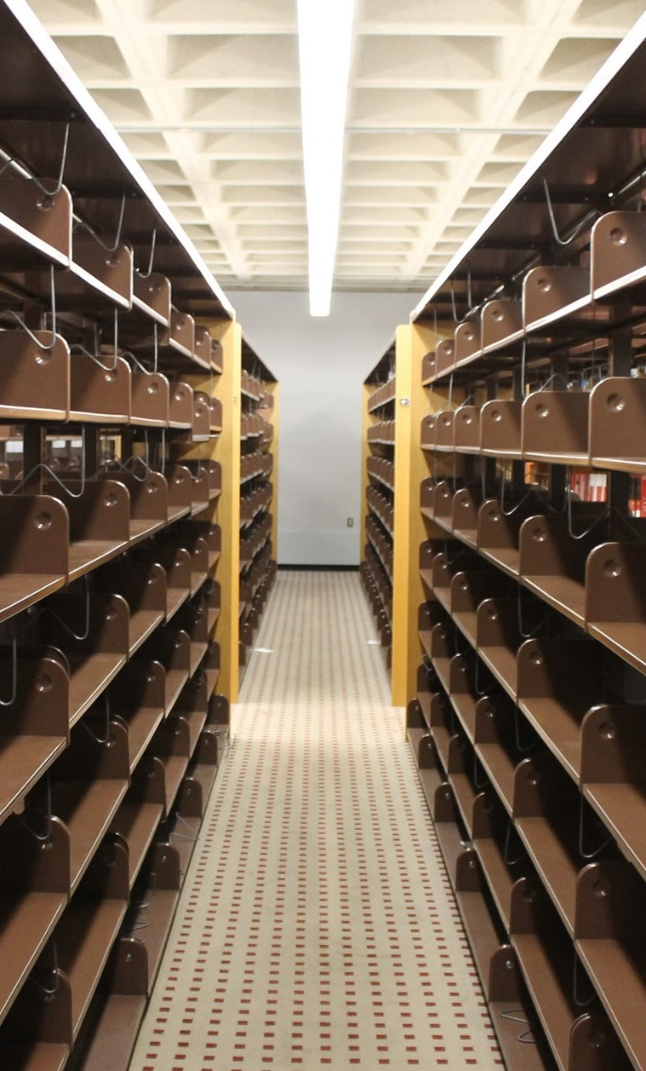
Changing to A “Modern Library”
Let’s think about your current library…
  And take away your print volumes
  Now, take away your book stacks
  Finally, lets move student space out of a library
What do you have left?
These are the elements that are most associated with libraries – its our identity!
These questions are critical as you envision a second act for your library in the post print age
Empty Shelves at Kresge Library After the Books Left

Slide 5
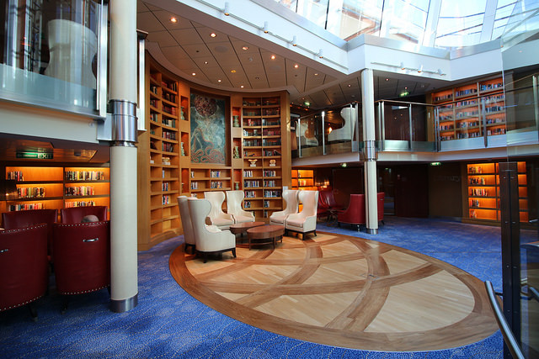
Changing to A “Modern Library”
As we think about libraries today – we are envisioning places that students can relax and work.
Comfortable places where people want to visit.

Slide 6
Changing TO A “Modern Library”
"Business has always been subject to uncertainties and change. It is affected by the elements, by wars, by mass movements, by changes in the wants and desires of consumers and by government regulation. Above all, competition tends continually to modify the business structure. New methods, new products and new processes introduce new elements that undermine the supremacy of one industry or firm or even a whole system of doing business. And the trend toward increasing regulation of business by governmental bodies here and abroad must not be ignored. In short, one generalization that truly applies to all business is: Change is continuous and inevitable." (bold added)
  Quote is from: Coman, Edwin T. Sources of Business Information. New York: Prentice-Hall, 1949.
  However, we have been subjected to change for years and years…and will be subjected to change for years hence

Slide 7
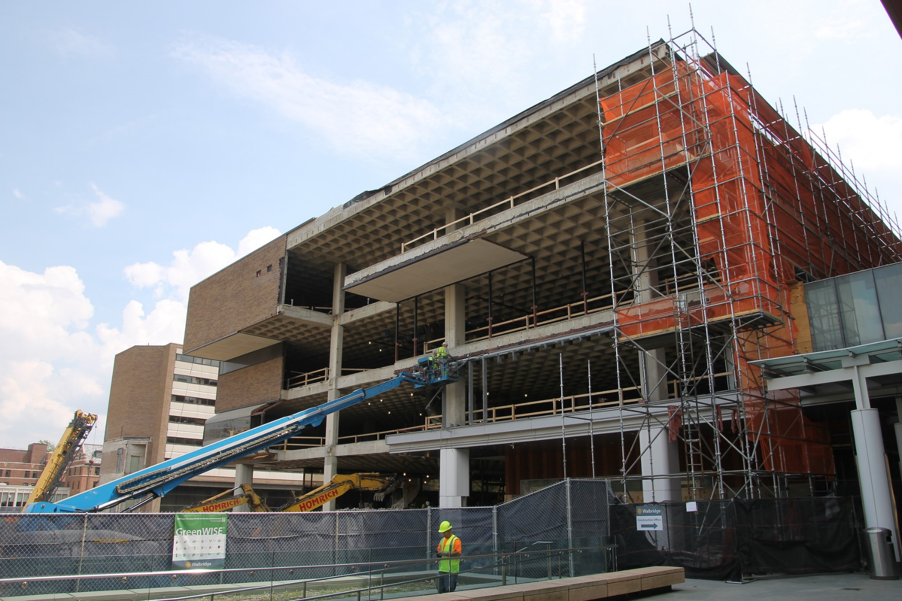
Changing to A “Modern Library”
Librarians are fantastic about envisioning change when they are leading the way
We have done a good job of embracing the new electronic environment in a hybrid fashion with traditional print volumes and physical media
Change in libraries will more likely be a change that is thrust upon us
  Are we ready to manage through real change?
  Are we ready to give up services and resources our space will no longer accommodate?
  Are we ready to embrace the change being asked – or demanded of us?
  Do our campus administrators see the same needs and values in having a traditional library that we have in the profession?

Slide 8
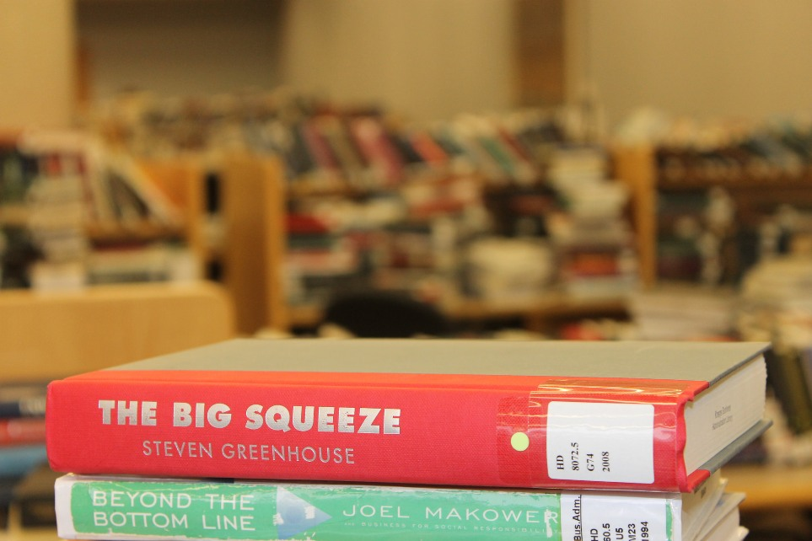
Changing to A “Modern Library”
Summer 2013 – Scope of plans shared
September 2013 – Gift announced
Early 2014 – Plans developed
End of Winter Term – Started vacating the building
June 2014 – Moved to MOtown
July 2014 – Print moved out
Fall 2014 – Rebuilding Kresge Library Services
Winter 2015 – Kresge Value Proposition Meetings Started
Summer/Fall 2016 – Completion and move in to the new space
December 2017 – Addition of new Ref Desk

Slide 9
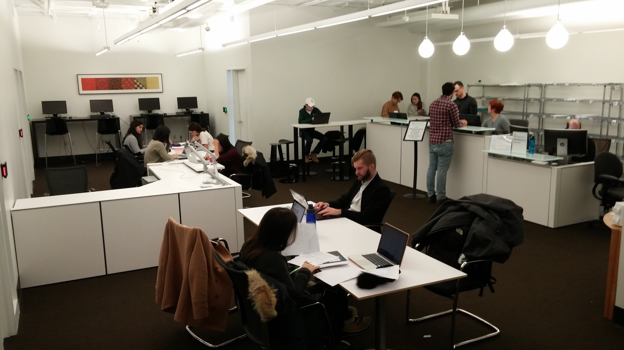
Changing TO A “Modern Library”
“A completely re-thought Kresge Library Services, transitions from a collection of physical reference materials to a full suite of information resources and research services, guided by expert staff.” – Ross Dividend, Fall 2016 (Ross Alumni Magazine)
The library did not close, but become virtually unrecognizable
Library suite features no door – its open the hours of the building giving students more access to this space without needing to staff it
The NEW Kresge Library Services at the University of Michigan

Slide 10
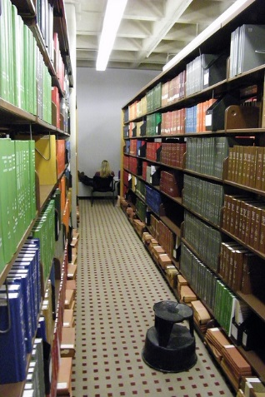
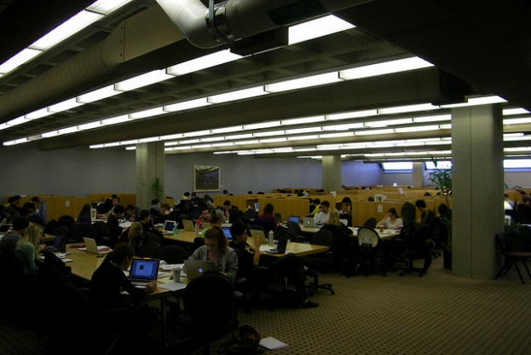
Changing TO A “Modern Library”
An Ethereal Space
    This is where we connect with our community.
    This is where we provide clarity to a complicated information universe.
    This is where we contribute as a “Value-Add.”
  This is where we do ‘library’ work.
  This work cannot be done as well by others.
  This work is not-space dependent.
A Physical Space
  Study
  Print Materials
  Interaction Spaces
  Walk-in Access
  Some of these services may be easily done by others
The OLD Kresge Library

Slide 11
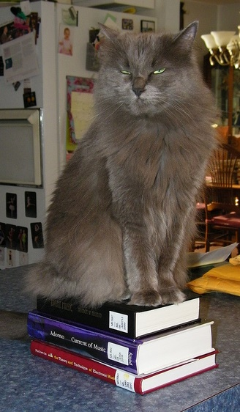
Big Questions for Libraries Transitioning to an All-Digital focus
Identify the opportunities and challenges facing all-digital academic libraries.
  When you lose your print collection – you lose tasks associated with managing that collection.
  Are there new opportunities to provide services with the staff who no longer run circ or shelving?
  At Kresge, we created an Exam and Assignment return and review program – something we could not do if we still managed a print collection.
  No library has everything they need – without physical objects – the resources you are missing will go up.
  Not all subjects lend themselves well to digital-only approach.

Slide 12
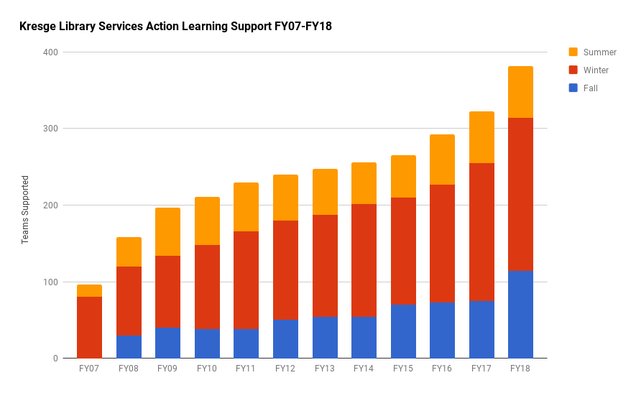
Big Questions for Libraries Transitioning to an All-Digital focus
Examine how an all-digital environment requires a rethinking about how academic libraries contribute to a campus.
  Your future may be hitched to ‘service.’
  We have seen an increase in our support of action-learning or experiential learning programs.
  This is not work that can be done by others – so that is good!

Slide 13

Big Questions for Libraries Transitioning to an All-Digital focus
Discuss what opportunities might be available for other libraries who are encountering these kinds of changes in their environments.
  Every academic institution is unique – though with similar attributes.
  You need to balance between the needs of the faculty and students (if they do not rely on the same items).
  Rather than see what we did at Kresge or what Kate did at Florida Polytechnic – see what services and opportunities might exist on your campus.

Slide 14
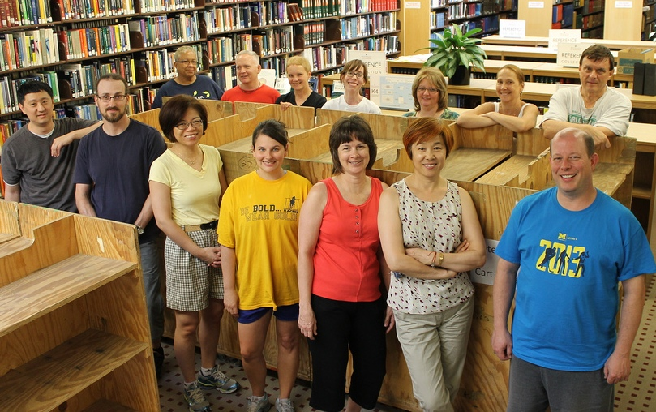
Big Questions for Libraries Transitioning to an All-Digital focus
Develop strategies for supporting library staff through periods of rapid change.
  “Change is continuous and inevitable”
  Administrators have to support the staff first and foremost
  We need to be empathetic to both our staff and our patrons through these changes
  Share information as fast as you can – even if it is incomplete
  ‘Do not get married to the results’
  Support risk taking in solution crafting

Slide 15

Big Questions for Libraries Transitioning to an All-Digital focus
At Kresge, the “Ethereal Library’s” value proposition is:
  Live within the restrictions of virtually no collection space.
  Figure out new collaboration mechanisms to serve our community.
  Focus on what we can do vs. what we have done.
  Forget the dead, take care of the living!
Squirrel at the University of Michigan, Ann Arbor

Slide 16

Thank You
Corey Seeman
cseeman@umich.edu
@cseeman
Slides: tinyurl.com/CSEEMAN2018ULS
Corey’s Web Home:
http://www-personal.umich.edu/~cseeman/
Kresge Home: https://www.bus.umich.edu/kresgelibrary/

