Slide 1

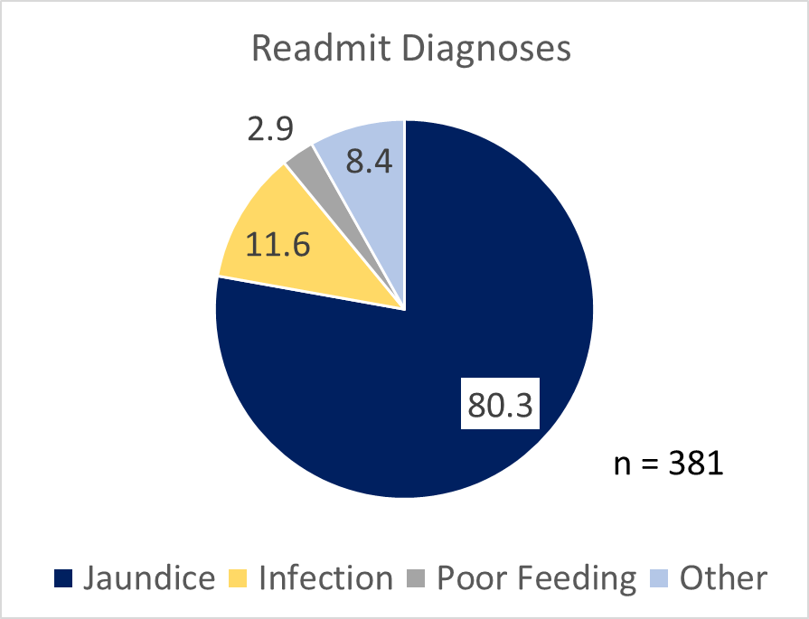
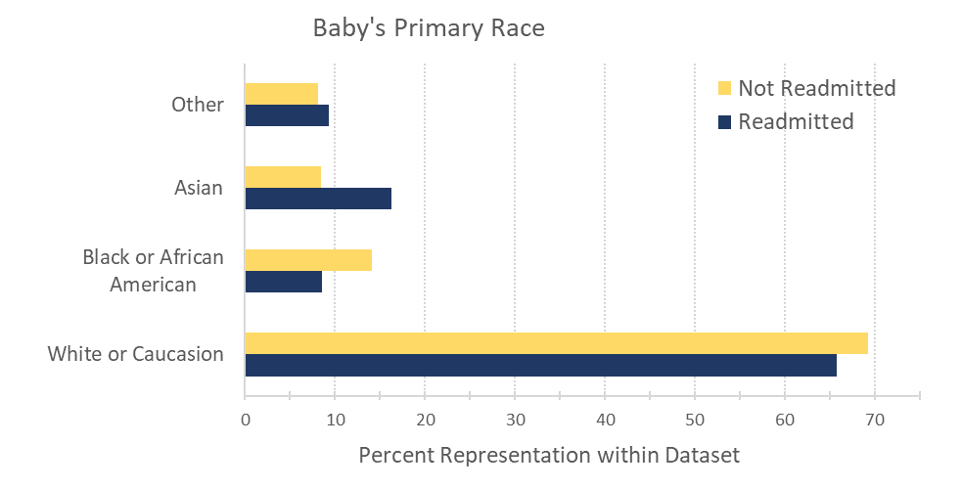
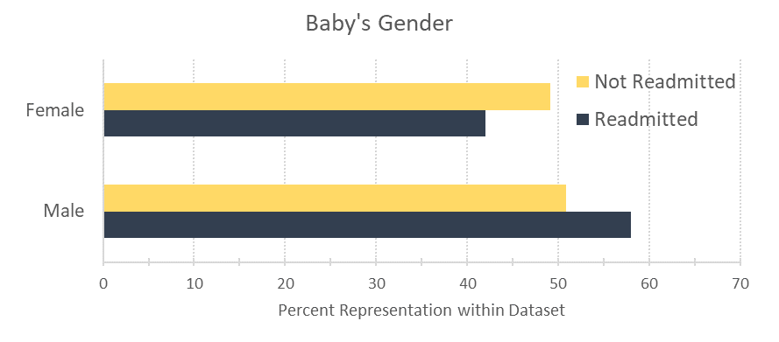
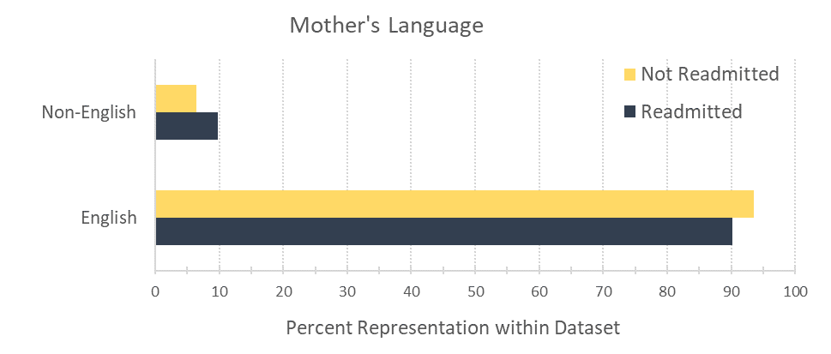
A Machine Learning Based Precision Medicine Analysis of Newborn Readmission
Angela Bailey, MS¹; Sharon Kileny, MD²; Kelly Orringer, MD²; Maria Skoczylas, MD²
¹University of Michigan Medical School
²Division of General Pediatrics; Department of Pediatrics; University of Michigan
Purpose
Results
Postnatal length of stay for mother-newborn has decreased since the 1970s from 4 days to as soon as day-of-birth discharge in recent years, raising concern for mother-newborn safety. Newborn readmission is a key measurement of neonatal morbidity. We analyzed multifactorial characteristics of the mother-newborn dyad to further characterize neonatal readmission at Michigan Medicine.
The dataset was comprised of 12,728 mother-baby pairs. A readmission rate of 3.44% was calculated over the set of newborns delivered within 168 hours of mother’s admission and whose initial hospital stay was up to 168 hours. Top reasons for readmission were jaundice, infection, and poor feeding. 57.9% of readmitted newborns were male while 42.1% were female. 8.5% and 14.2% of non-readmitted neonates were Asian and African American, respectively while 16.3% and 8.5% of readmitted newborns were Asian and African American. 6.3% of mothers of non-readmitted newborns did not speak English as their first language while 9.5% of mothers of readmitted newborns did not speak English as their first language.
Methods
Conclusions
Thirty-seven physiologic, socioeconomic, hospital logistic, and time-based perinatal variables were chosen for medical record survey of mothers and their well-newborn babies (babies with NICU stays or < 35 weeks EGA excluded). Through the Data Office, a query was performed and yielded data on 16 variables for all patients between 2014 and 2017. A large-scale analysis of the data was conducted, including readmission rate and descriptive statistics of variables.
Our well-newborn rate of readmission is comparable to other hospital systems both nationally and internationally. Current literature suggests that Asian race is a risk factor and African American race is protective for readmission. Descriptive statistics of our data suggest that our data is consistent with these well-established trends. Future work includes down-selection of appropriate machine learning techniques to develop individual models for quantifying newborn readmission risk at time of discharge.
References:
Burgos et al., PEDIATRICS 2008, 121:4:e864-869
Harron et al., Paediatric and Perinatal Epidemiology 2017, 31, 221–232
Maranian et al.; SPMC J Health Care Serv. 2015;1(1):2024.
O’Donnell et al., ACADEMIC PEDIATRICS 2014;14:84–91
This study was funded by the University of Michigan Medical School Summer Biomedical Research program and the Charles Woodson Fund for Clinical Research.

