Slide 1

Increasing Parent Involvement at Carver STEM Academy
Priya Desai (Honors Capstone)
Advised by Professor Joi Mondisa, Ph.D.

Slide 2
Agenda
Project Introduction
Literature Review
Methods
Recommendations

Slide 3
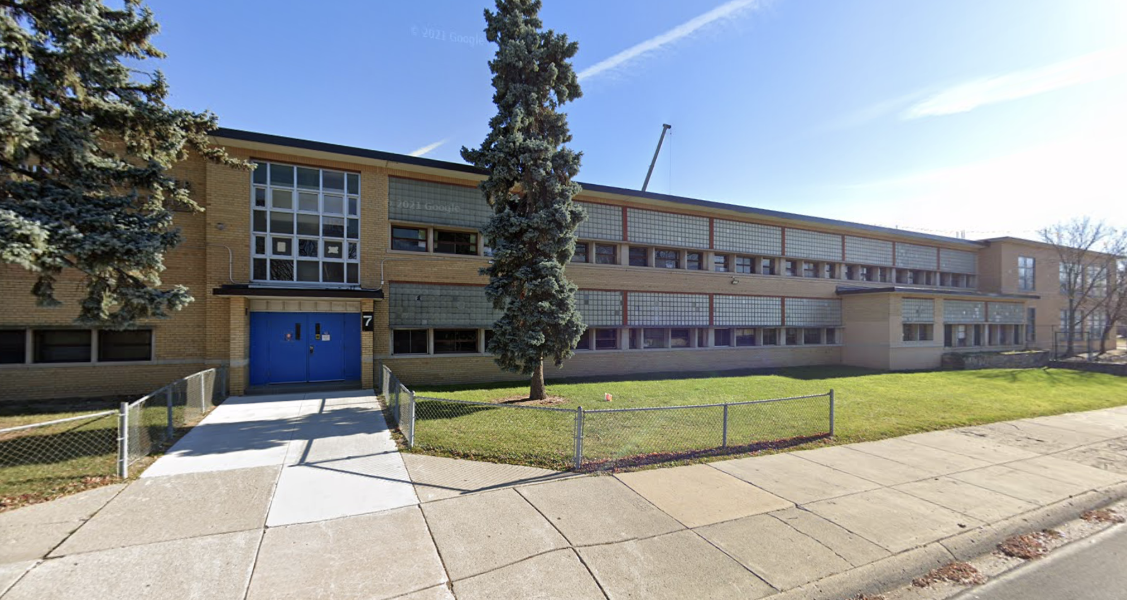
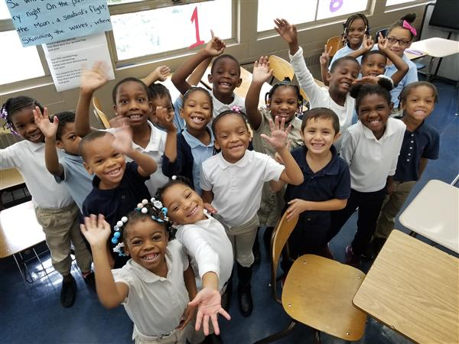
Client Profile
Location
Public School in Detroit, MI
Carver STEM Academy
Grades
Pre-K through 8th Grade
Enrollment
Total of 354 Students
Contact
Nancy Carey, Ph.D.

Slide 4
Project Scope
Parent Involvement
Student Success
Carver STEM Academy would like to increase their parent involvement rates.

Slide 5
Agenda
Project Introduction
Literature Review
Methods
Recommendations

Slide 6
Barriers to Involvement
Demographic
Psychological
School Climate
Inflexible work schedules
Need to care for younger children at home
Lack of transportation to events
Language barriers
Parents’ lack of confidence in their own abilities to help their child
Issues with mental health
Perceptions about racism and poverty
Unwelcoming environment
Issues with conveying information to parents
Lack of access to their child’s teacher

Slide 7
Common Forms of Involvement
Supporting their child by going to performances, games, or award ceremonies
Helping their child with homework
Going to classes or workshops alongside teachers
Assisting in events such as field trips or fundraisers

Slide 8
Methods to Improve Involvement
Meeting the Physical Needs of the Families
Enhancing Involvement in Education
Become a full-service community center
  Provide items like food and clothing
  Hold English and technology classes
Have teachers hold office hours
Teach parents about what their child is learning
Provide constant updates about child progress

Slide 9
Agenda
Project Introduction
Literature Review
Methods
Recommendations

Slide 10
Interview with the Parent Lead
Biggest Barrier
Language Barriers
The school brought in a Spanish translator
Materializing Parent Ideas
Fundraiser
The plans for the fundraiser fell through
Events that Bring in Parents
Child Involvement
Class presentations about what they are learning

Slide 11
Observations of Parent Meetings
January 20th
March 22nd
Agenda: discuss and vote on a shortened school day
Attendance: 60 total on call
Positive, welcoming environment
  Teachers and parents were chatting at the beginning of the call
  Parents felt comfortable discussing vote
Parents mentioned that they would update parents who did not attend meeting
Agenda: Facilitated training on how to help students
Attendance: 7 total people on the call
Staff was complimenting the children of parents on the call
Facilitator of workshop did not come → discussed techniques for improving parent involvement
  Thanked parents for all their ideas

Slide 12
Competitor Analysis
Parent Meetings
Broken up by grade
Biggest attendance occurs at 5pm
Burton International Academy
Dean Fahmi Islam
Personalized Check-Ins
Regular home visits
Personalized wellness check-ins
Form of Communication to Parents
Personalized emails, phone calls, in-person
Broadcasted on social media and through ROBO calls

Slide 13
Agenda
Project Introduction
Literature Review
Methods
Recommendations

Slide 14
Various Forms of Communication
Current
Structure
Recommended
Structure
ROBO calls before meetings
Reliance on child to inform parent of upcoming meetings and events
Personalized emails and phone calls
More frequent parent / teacher check-ins throughout the school year

Slide 15
Parent Meetings by Grade Level
Current Structure
Recommended Structure
Parent meetings are currently conducted for the whole school
  Includes all grade levels in one meeting
  Pre-k through 8th grade
Parents feel like information is not applicable to them
Parent meetings should be conducted by grade level
  Current structure of Burton International Academy
  Helped improve its attendance rate
Parents will feel more inclined to listen to information presented

Slide 16
Child Involvement in Parent Meetings
Current Structure
Recommended Structure
Parents are more likely to attend events where their child is involved
  Examples include sporting events, performances, and award ceremonies
Students are not currently involved in parent meetings
Parent meetings should incorporate student participation
  Examples include student presentations and awards given to students
Foot-in-the-door technique
  Parents will continue to attend meetings

Slide 17
Thank You
Nancy Carey, Ph.D., Carver STEM Academy
Joi Mondisa, Ph.D., Project Capstone Advisor
Jason McCormick, Ph.D., Engineering Honors Program Capstone Advisor
Rachel Armstrong-Ceron, Engineering Honors Program Senior Academic Advisor

Slide 18
Questions?

