Slide 1







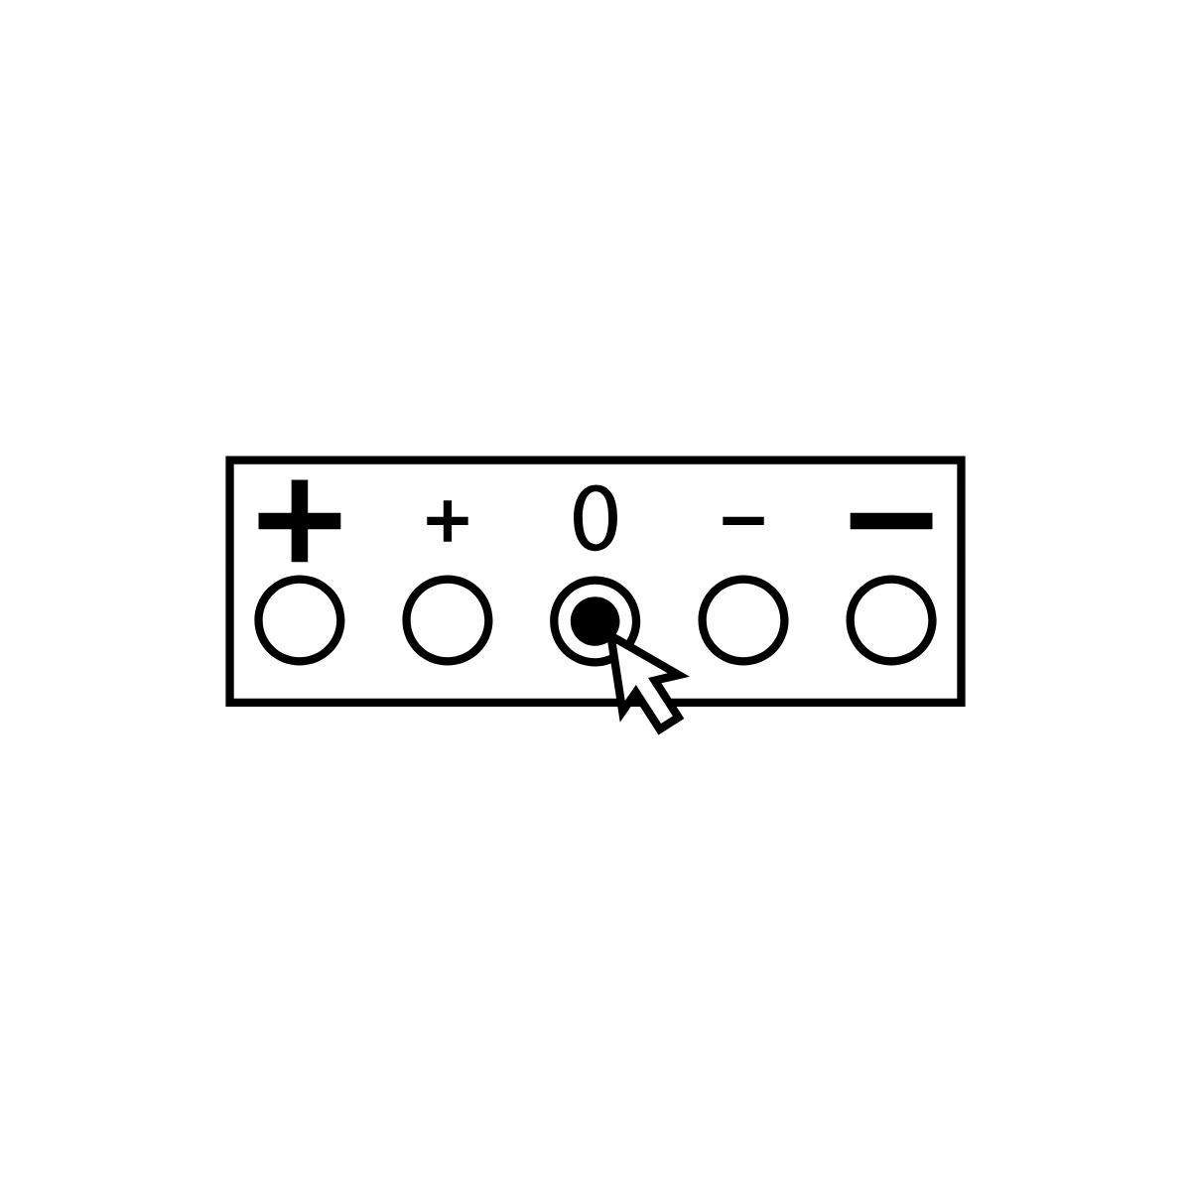












End-of-clerkship written feedback: how do students use it?
An exploratory qualitative study
Josh Kurtz MS4, Kathryn Holt MS4, Seetha Monrad, MD| University of Michigan Medical School
RATIONALE
QUOTES
Written feedback messages are used in medical training to guide improvement.
“I think that when someone is given a piece of feedback that is linked to their grade, it’s hard to guide your learning from that feedback because what you end up thinking about is the grade.””
KEY THEMES
Utility of written feedback depends on students’ perceptions and receptivity.
“…I realized how dangerous these comments can be and, ever since then, instead of seeing them as opportunities for growth, I see them as opportunities to hurt me in the future.”
Improved understanding of medical student perceptions of written feedback is needed.
Conflicting uses for feedback influence how students use it
“..if the number was like an average or lower number, I really expected the written feedback to justify it and to offer some sort of validation as to why they chose that.”
METHODS
“I feel like the numerical score colors the tone in which I read the feedback. Meaning, if the score is really high, because generally you see the score before you read the feedback. So, you go in and read that in a positive light, maybe it's more neutral. If it's a lower score, you'd read it in a negative way if it's more neutral.”
Recruitment
Framework
Quantitative and qualitative feedback interaction influences how students interpret it
170 M4s emailed
23 M4s enrolled
Exploratory qualitative design
“Initially that's where you're gauging what do I need to work on the most. And then later on, after you've gotten the same feedback numerous times of like, "Read more. Good differentials," you start disregarding it more.”
Data Gathering
Data
Analysis
Data
Analysis
Engagement with feedback changes over time
“Because I think at the beginning I took feedback a little more seriously and then throughout I just stopped looking at them altogether.”
3 four-person focus groups
2 additional four-person focus groups
1 additional three-person focus group
FUTURE DIRECTIONS
Applying findings to improve local feedback forms.
Data Analysis
Exploring how students perceive written feedback with and without numerical scores
Recording & Transcription
Iterative Coding
Identification of Common Themes
IRB: Study HUM00162857 reviewed by University of Michigan IRB HSBS and granted exempt status.
Funding: Generously funded by University of Michigan Medical School Capstone for Impact Grant.

