Slide 1

A Real-time Monitor for Nuclear Physics Beams & Radiation Therapy Beams
Daniel Levin (PI), Nick Ristow, Claudio Ferretti, Monica Tecchio ……… University of Michigan Physics, Ann Arbor, MI
Dale Litzenberg ……………………………………………………………………… University of Michigan Hospital, Ann Arbor, MI
Peter Friedman (PI ) ………………………………………………………………….. Integrated Sensors LLC, Palm Beach Gardens, FL
Reinhard Schulte, Vladimir Bashkirov ………………………….…………………….. Loma Linda University, Loma Linda, CA
Tom Ginter ………………………………………………………………………………... Facility for Rare Isotope Beam, MSU, East Lansing, MII

Slide 2
Motivation
Ion beam monitoring
  Beam facilities: > $20K/hr
  multiple instruments required to cover large dynamic range
  Beam tuning requires significant time/effort
  ➔ premium on concise, fast beam monitoring instrumentation
FLASH radiotherapy (emerging modality)
  FLASH is > 40 Gy/s > 1000 × dose rate of conventional RT ➔ first human clinical trials in 2022
  FLASH ultra-high dosing offers reduced toxicity, better tumor response, reduced cost.
  One to three high dose treatments in ~0.1 s vs 10 min daily for ~2 months for conventional RT
  Current instrumentation incapable of true 2D imaging & real-time response at FLASH dose rates
  A FLASH beam monitor that is
    beam transmissive
    Provides analysis every 50 µs as patient is irradiated
    ➔ Is an essential technology for FLASH-RT

Slide 3
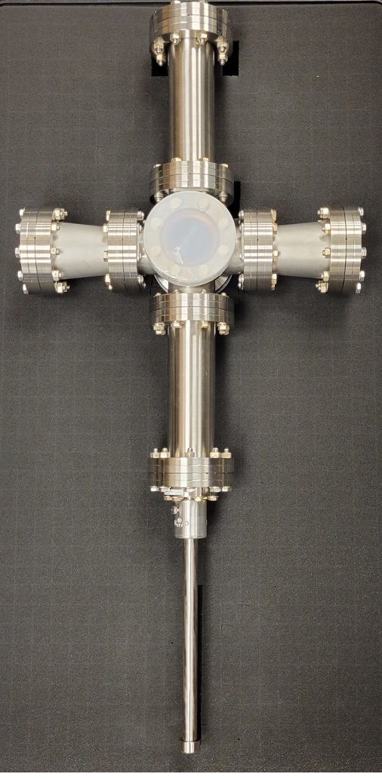
  Ion Beam Monitoring Performance Objectives
Real time beam analysis & display: 1 Hz ✓
Spatial resolution: ≲ 100 𝜇m ✓
Large dynamic range - single particles to nA ✓
2D imaging: directly visualize beam profile and motion ✓
Vacuum system compatibility ✓
Small longitudinal footprint < 30 cm ✓

Slide 4
  FLASH Therapy Monitor Performance Objectives
Safety: monitor in real-time to immediately terminate beam if problems emerge
  deliver < 10% of total dose in case of fault
  For electron/proton FLASH beams: data process at 100 to 20000 FPS ➔ 50 μs
Spatial resolution: ≲ 100 𝜇m on centroids
Dynamic range: beam core to tails spans 2 orders of magnitude
Low mass: < 1 mm WE & small footprint ≈ 12 cm
Large area: > 10 cm X 10 cm up to 30 cm x 30 cm
Radiation tolerant for 1 year of clinical usage: 5 d/wk, 50 wk/yr
Dosimetry: ≲ 4%
✓ = achieved

Slide 5
Common elements
  scintillator target in the beam path
  Image viewed directly or with mirrors (folded optics)
  Image acquired with low noise, CMOS “machine vision” cameras
  proprietary scintillators with high light yield, thin & low mass
  real-time data processing (CPU core or FPGA)
  ➔ Ion beam monitor was development platform for FLASH monitor

Slide 6
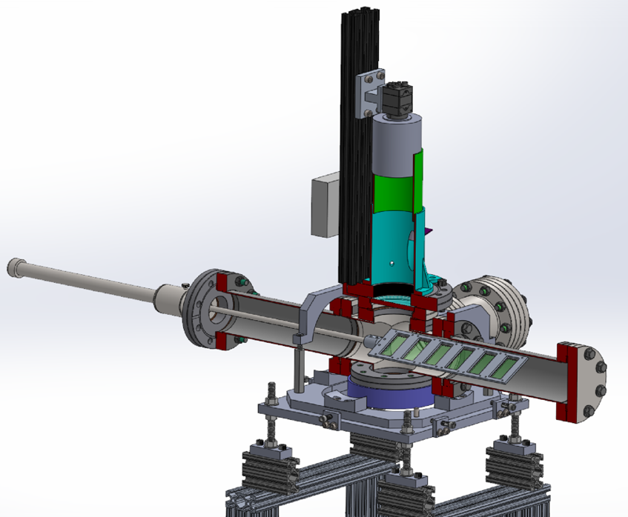
Ion Beam Monitor
Machine Vision Camera:
megapixel CMOS sensor
low noise ~ 1 ADC count (0.3 to 2.4 pe)
Fast, low f-stop lens
“Six Way Cross”
Motorized arm
Scintillator Cassette
Six 2x4 cm² scintillators
moved in/out of beam without breaking vacuum
beam
Alignment target
or 2nd photodetector (for TOF)

Slide 7
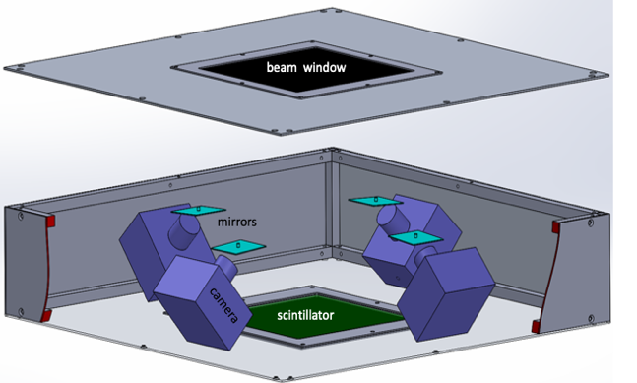
FLASH Beam Scintillator Monitor -- Conceptual Design
Large (30 cm x 30 cm) sensitive area.
quadrants viewed by 4 camera system
12 cm profile using folded optics
Fast, “machine-vision” cameras
Triggered or quasi-free-running modes
FPGA data processing & analysis
Low mass profile < 700 μm WE

Slide 8
Scintillators
Type 1: Hybrid Material (HM) -- inorganic polycrystalline ceramic hybrid
    thin: 300 µm ( 630 µm WE)
Type 2: Polymer Material (PM)-- semicrystalline, organic plastic polymer
    hazy, no internal reflections
    thin: we tested 200 µm to 1 µm ( < 300 WE)
Both types:
    transmissive
    non-hygroscopic
    radiation hard
    high light emittance for their respective class
    available in large sizes
    clean, sharp image - no internal reflections

Slide 9
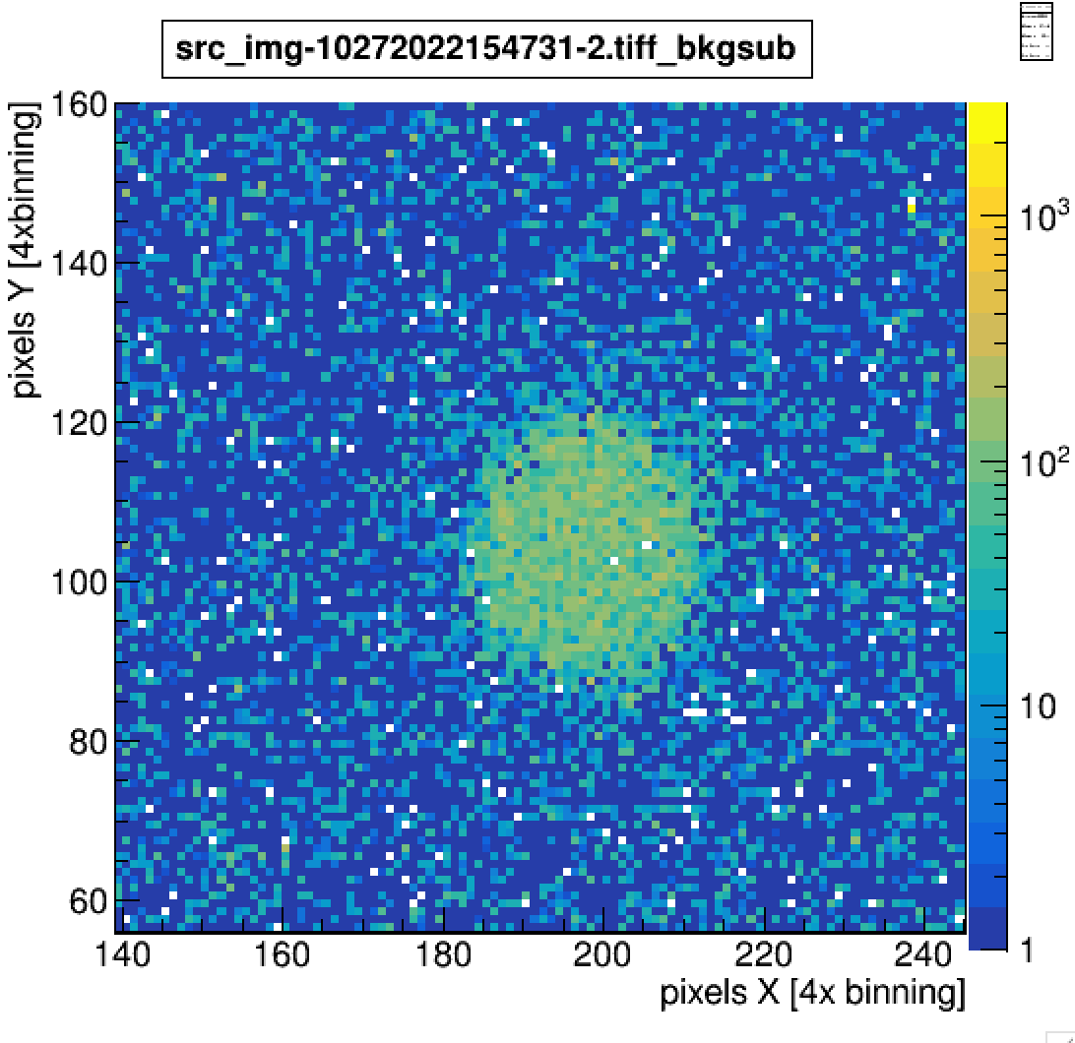
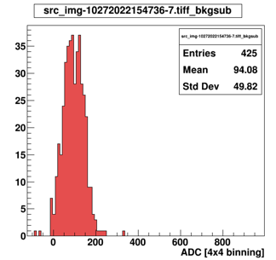
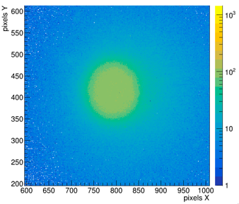
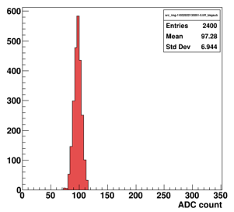
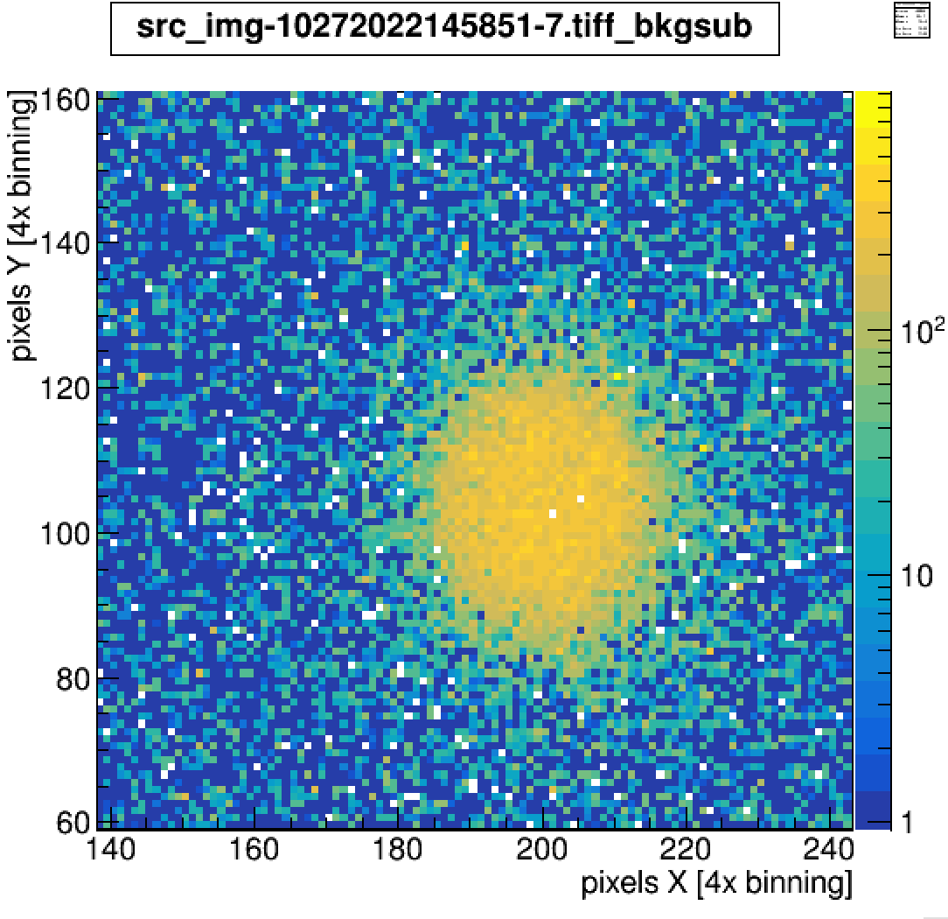
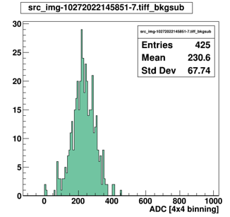
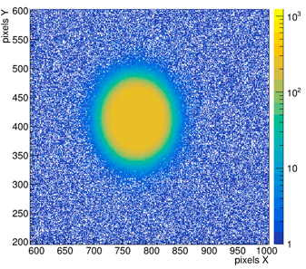
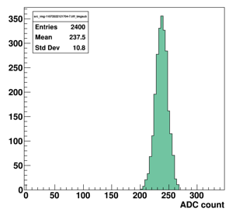
Scintillator Signal Comparisons to Benchmarks
3 mm collimated β⁻ beam
PM type
HM type
BC400 200 𝛍m
CsI 1.25 mm
PM 200 𝛍m
HM 430 𝛍m
gain =24 db: camera 1, 4x4
gain =0 db: camera 3, 1x1

Slide 10
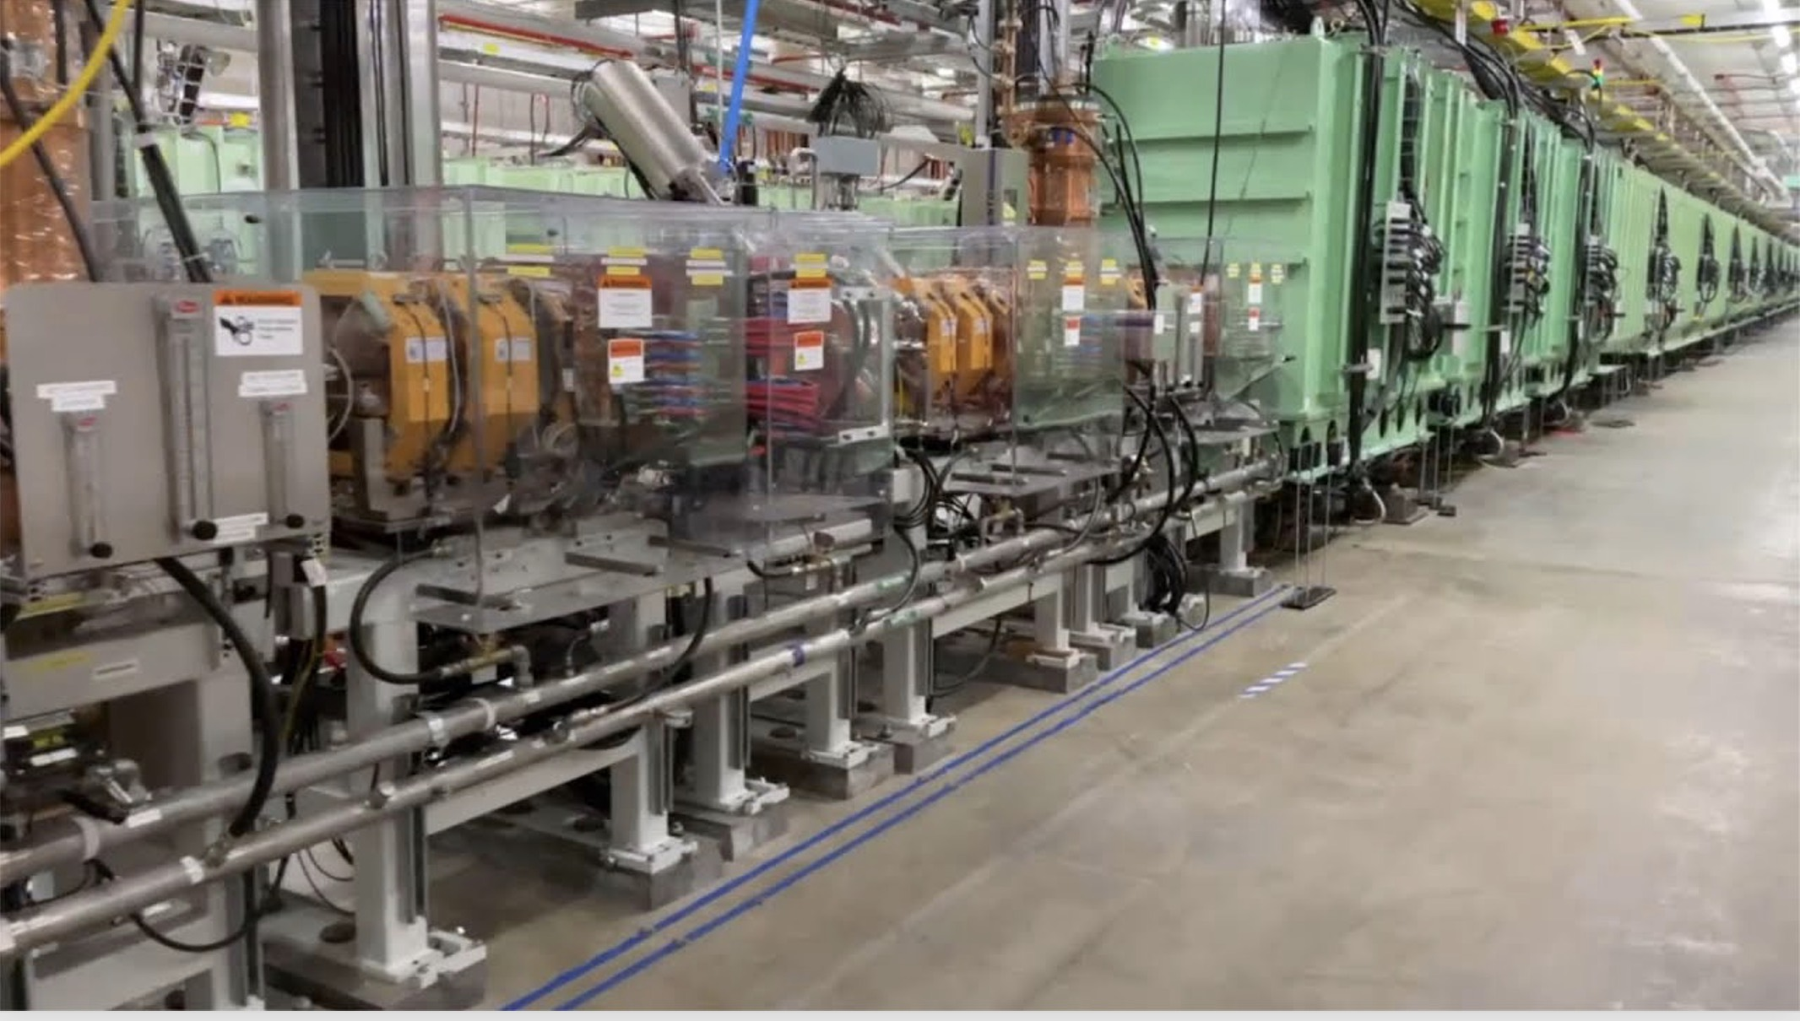
Facility for Rare Isotope Beams (FRIB)
Six Way Cross Results
⁸⁶Kr 2.75 MeV/n, 1-10⁶ Hz

Slide 11
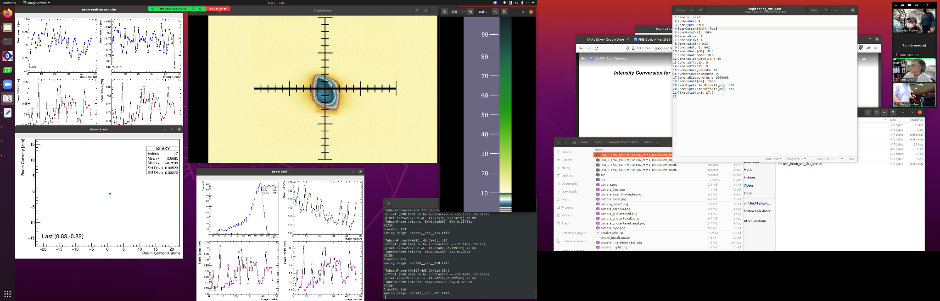
FRIB Results: Six Way Cross
Image processing:
background subtraction
perspective & rotation transformations
Analysis:
beam finding
centroids, widths, amplitude
Display in Beam Coordinates
false color image shows structure
updating display in beam coordinates
1 cm
FRIB screenshot

Slide 12

50 particles/s beam with HM Scint
Full pixel field
Beam finder
Beam radius history
X position history
Y position history
X,Y history

Slide 13
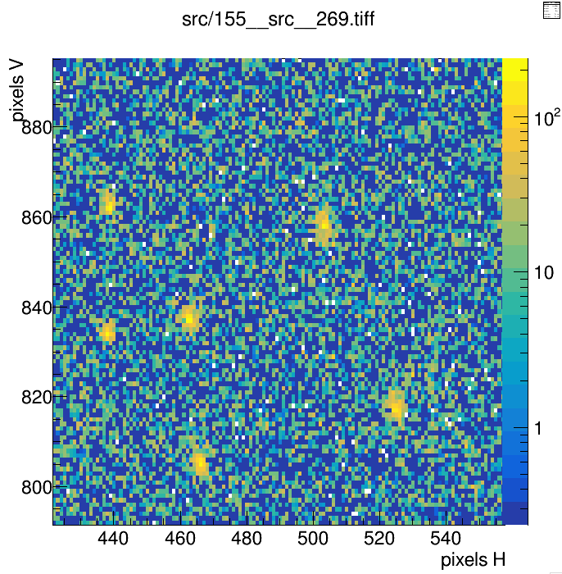
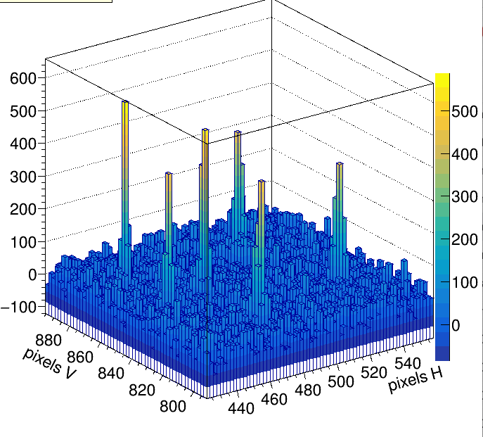
Single Particle Detection
HM Scintillator, Single 1s image, current ∼ 5 particles/s
2 mm

Slide 14
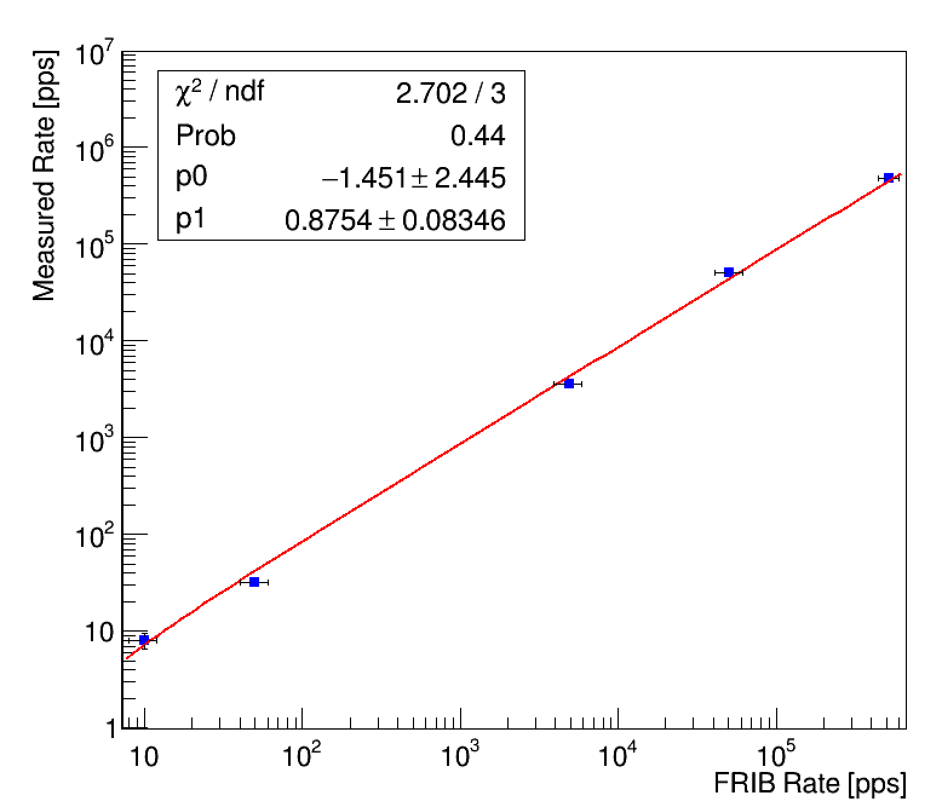
Beam current in HM scintillator
Beam Monitor rate vs FRIB instruments rate
➔ Result 1: Beam monitor measures currents over range covered by four different FRIB devices
  Faraday Cup
  Calibrated beam attenuator
  MCP detector
  Silicon detector
➔ Result 2: linear for 5 decades

Slide 15
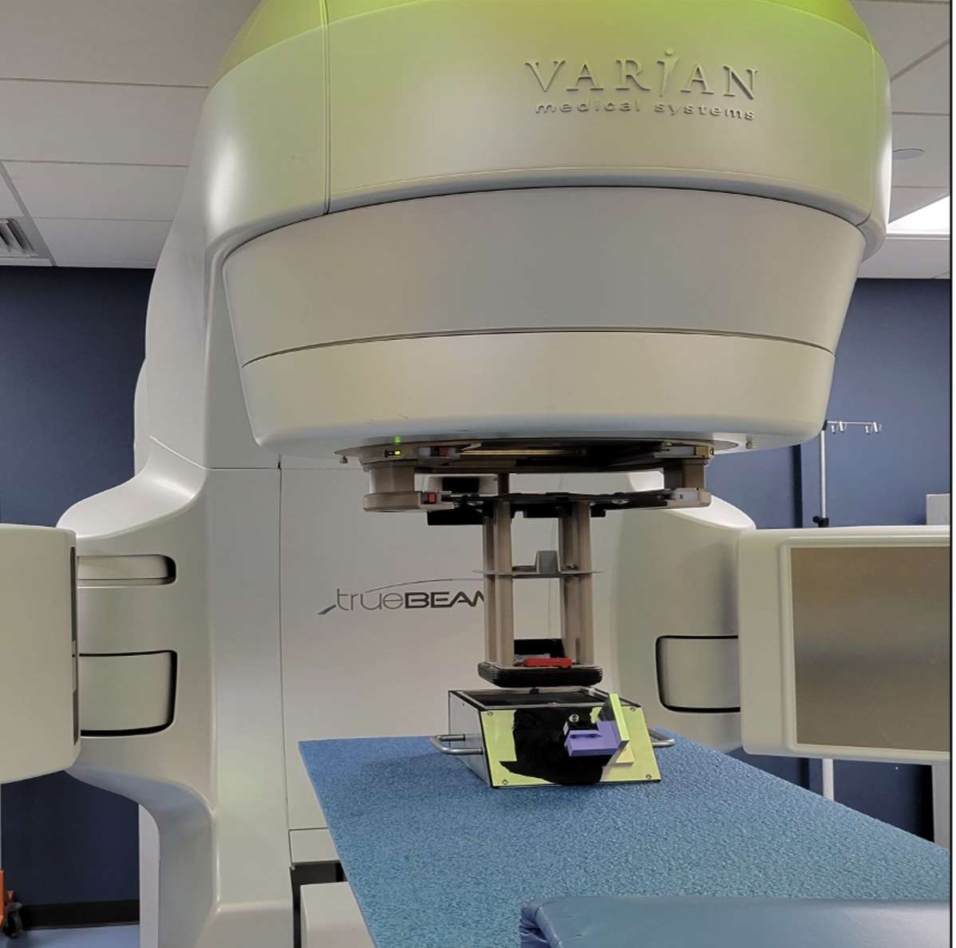
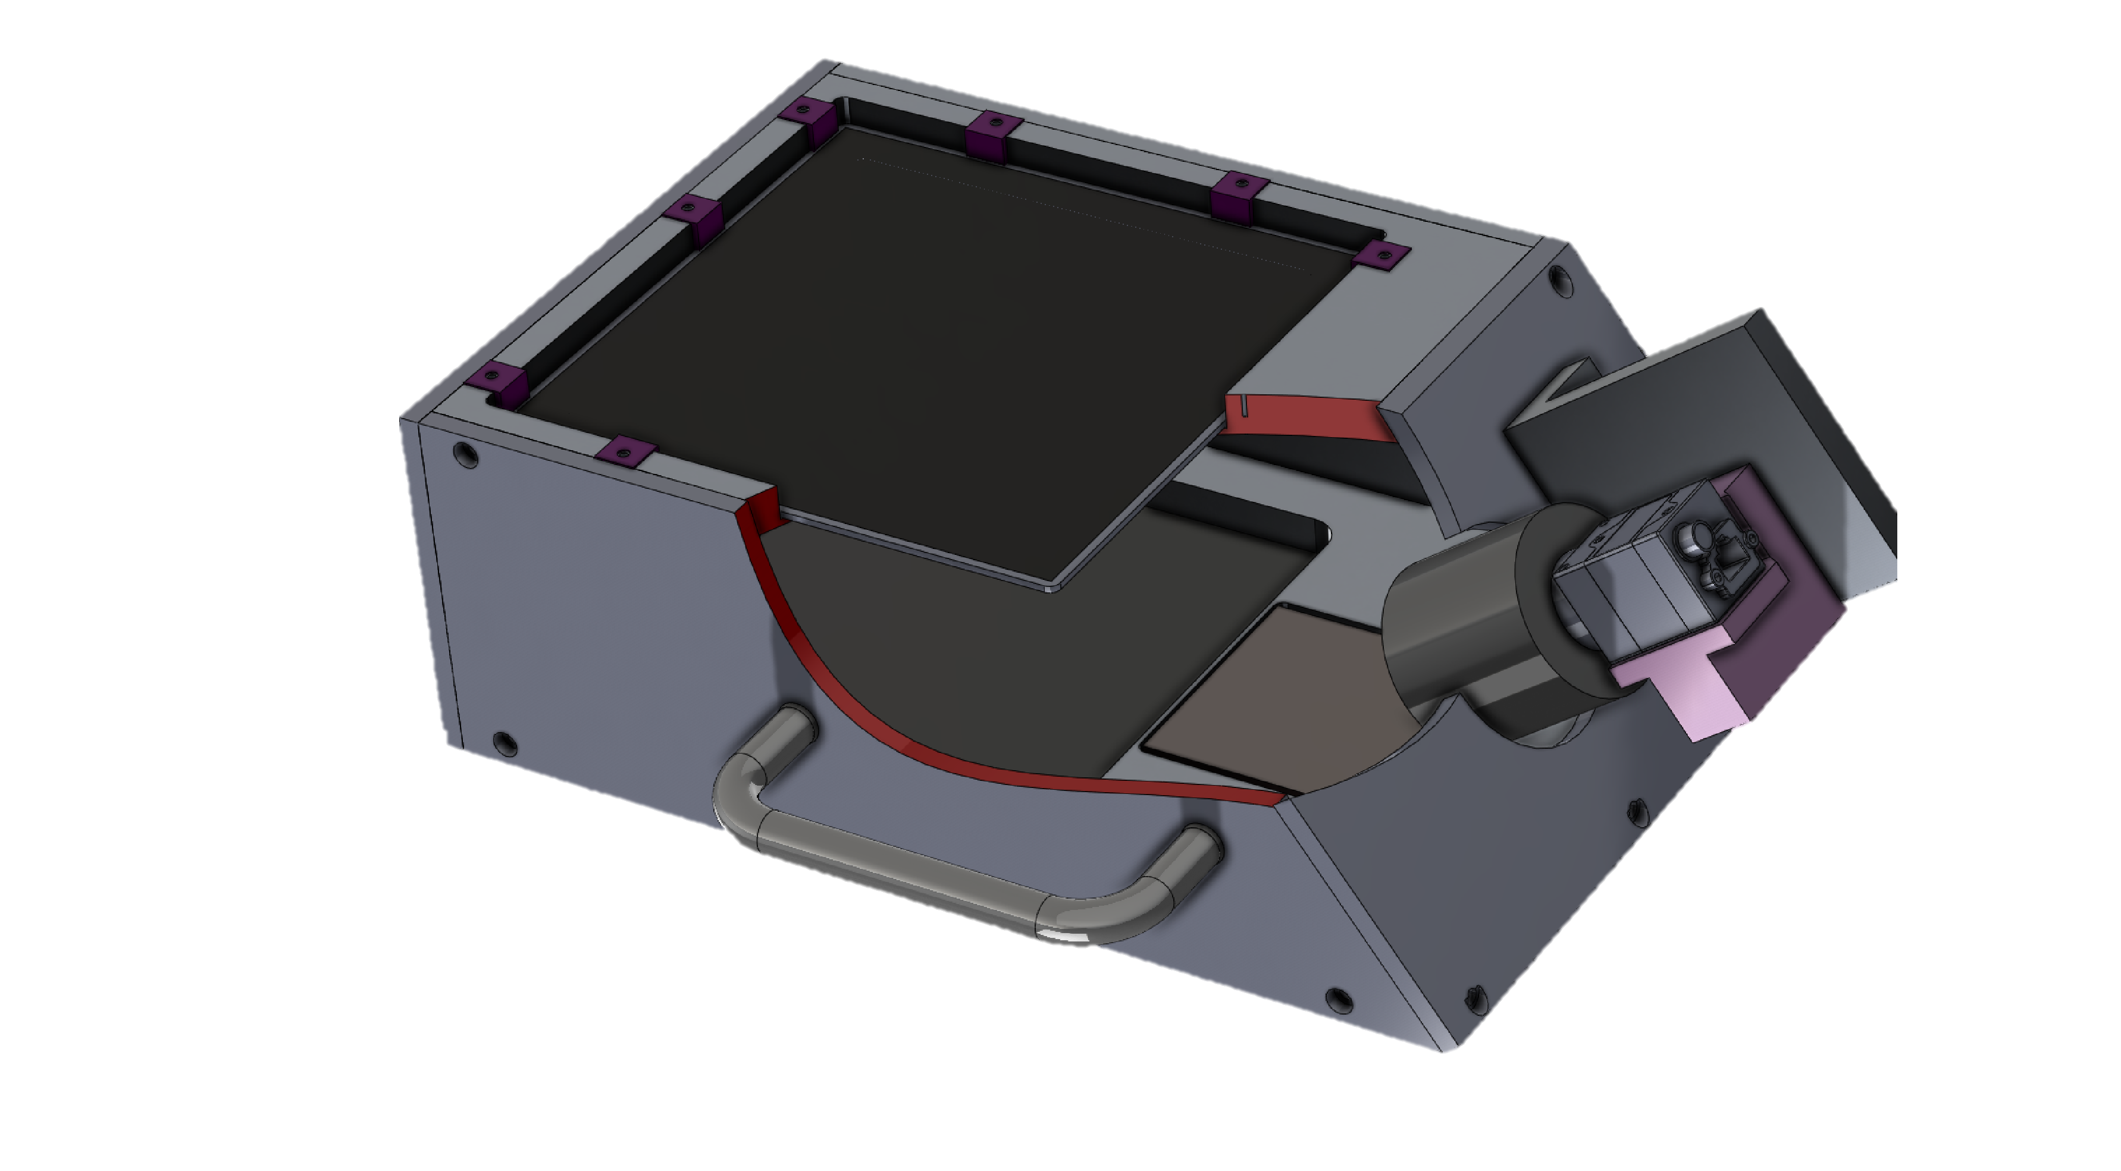
Beam Tests at UM Hospital: Radiation Oncology
Prototype FLASH monitor
15 cm x 15 cm
electron linac: 6-16MeV @ 1 – 10 Gy/min

Slide 16
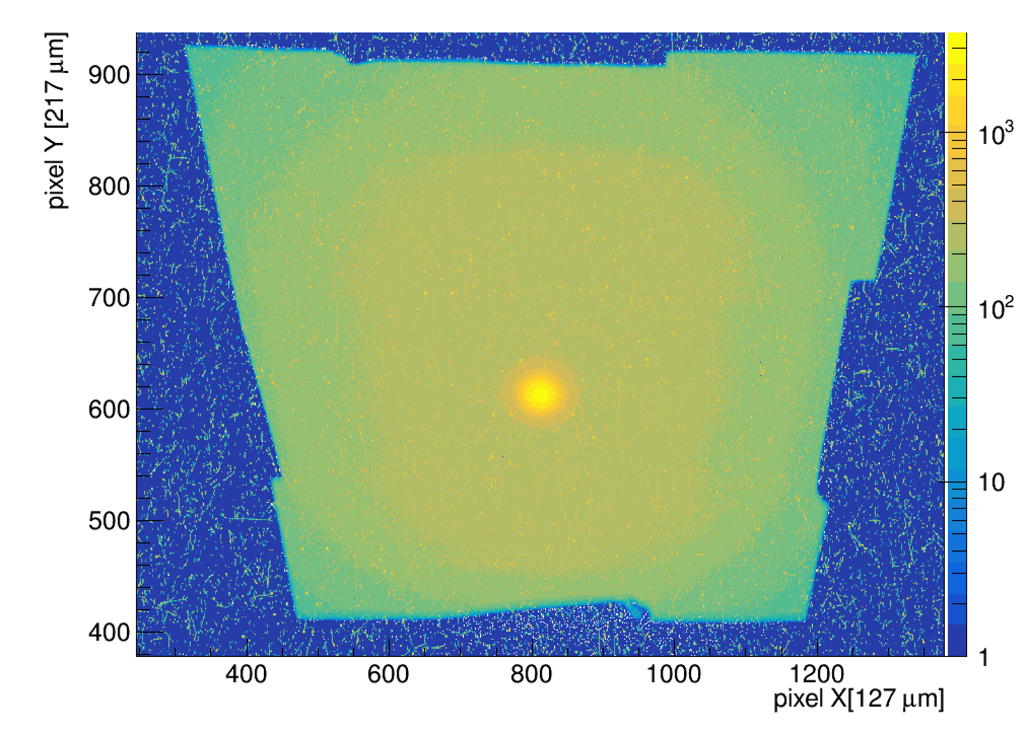
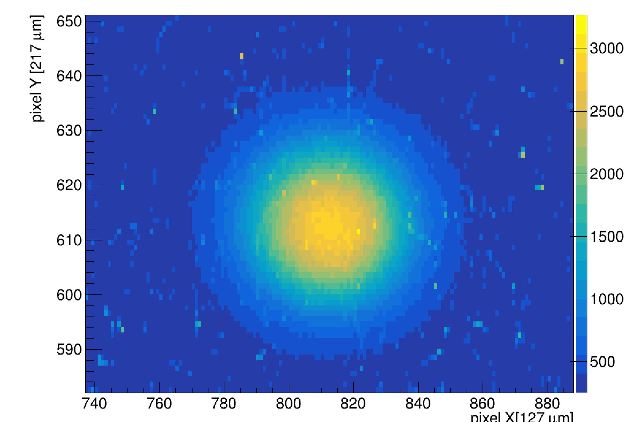
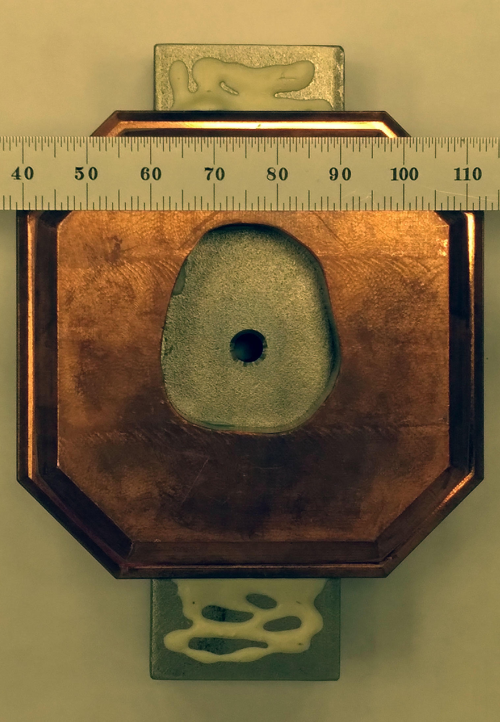
Single frame image from 16 MeV , 0.17 Gy/s (at isocenter) collimated beam
HM scintillator
High resolution of primary beam
Outline of Cu + steel collimator also seen

Slide 17
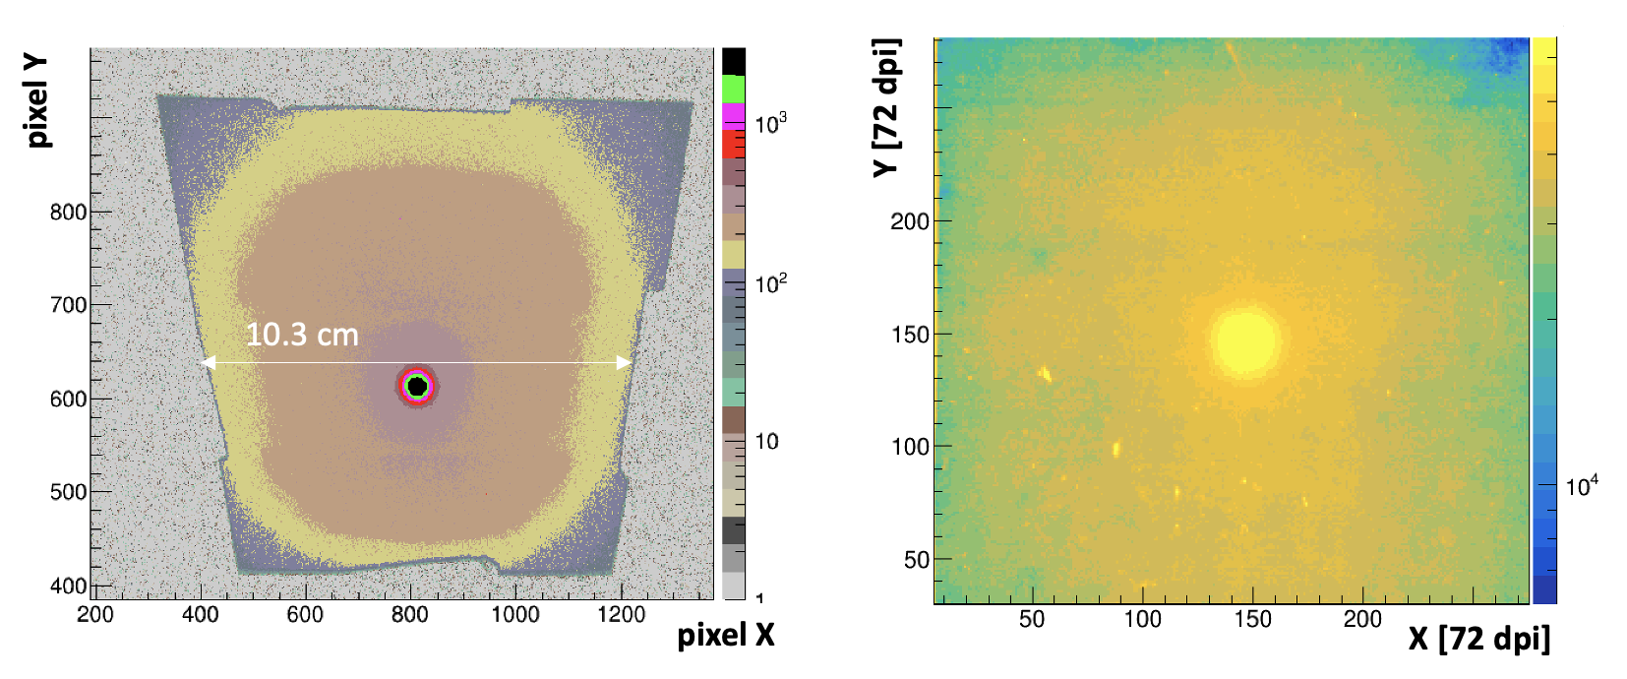
Compare HM Scintillator to Gafchromic film
HM scintillator 16 MeV, 0.17 Gy
Gafchromic XD 16 MeV 20 Gy dose
60 frame avg
primary beam + collimator profile are visible
generated in real-time
Greater sensitivity/dynamic range than Gafchromic
Gafchromic image splotchy, with lint contamination
low sensitivity to collimator structure
many hours to process

Slide 18
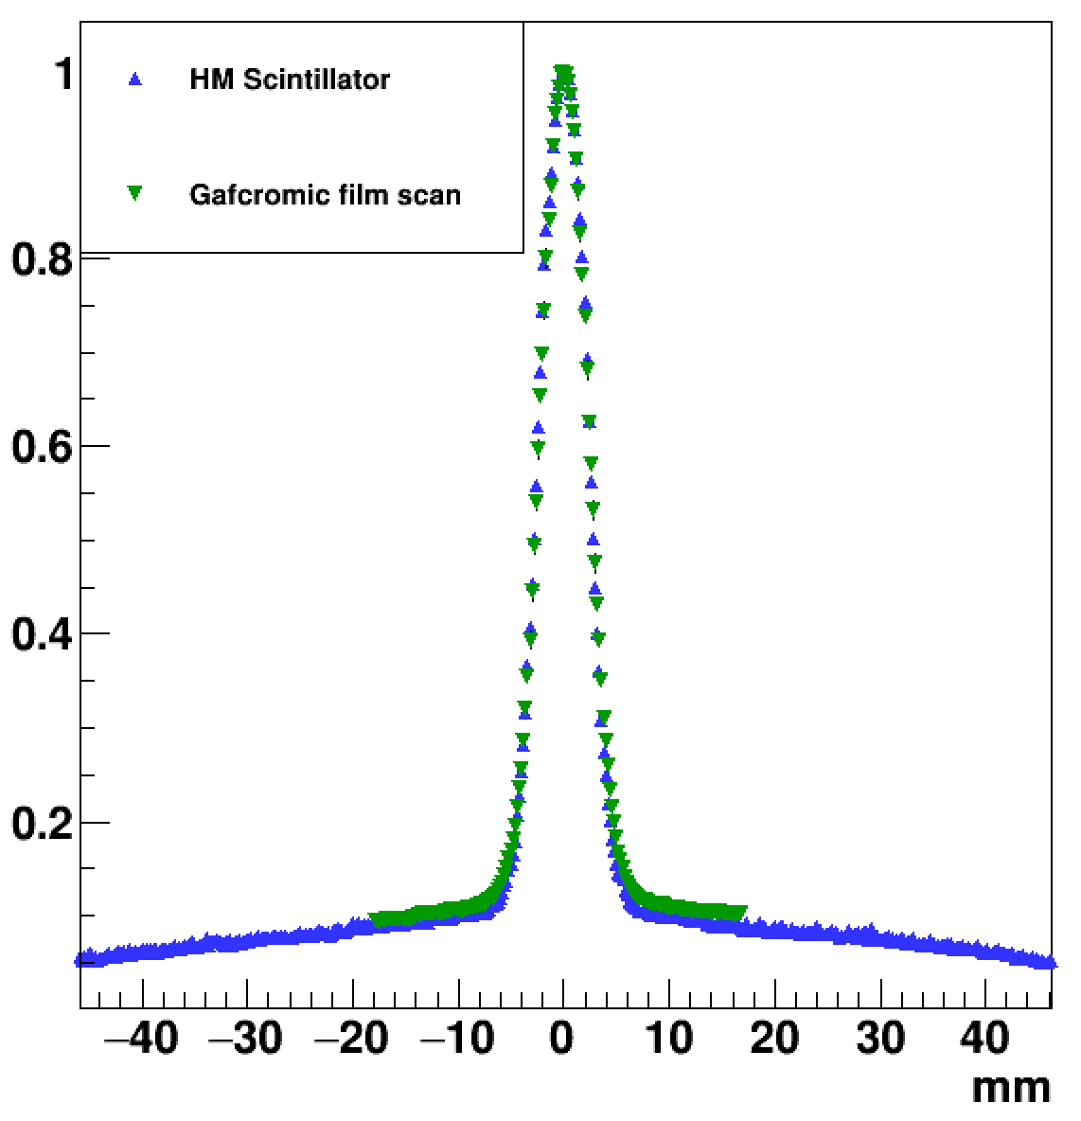
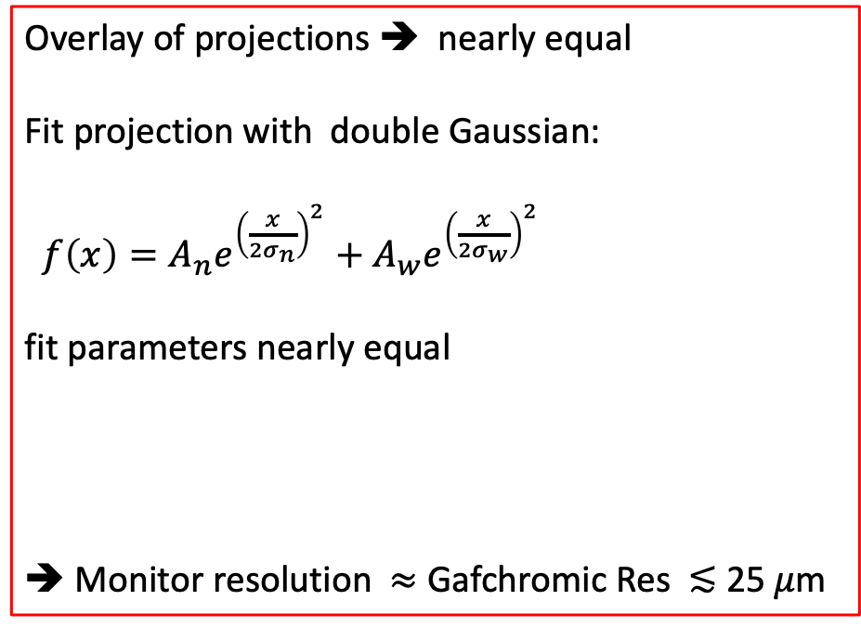
Spatial resolution
X coord beam profile
Beam Monitor
Overlay of projections ➔ nearly equal
Fit projection with double Gaussian:
$f\left(x\right)=A_{n}e^{{\left(\frac{x}{2σ_{n}}\right)}^{2}}+A_{w}e^{{\left(\frac{x}{2σ_{w}}\right)}^{2}}$
fit parameters nearly equal
➔ Monitor resolution $≈$ Gafchromic Res ≲ 25 𝜇m
Gafchromic scan
𝝈_{narrow} = 2.11 mm
𝝈_{wide} = 29.5 mm

Slide 19

Notre Dame University Radiation Laboratory
8 MeV electrons , 1 ns pulse, 30 Hz
dose range 6 - 235 Gy/s
exceed FLASH level dose rates: > 40 Gy/s

Slide 20
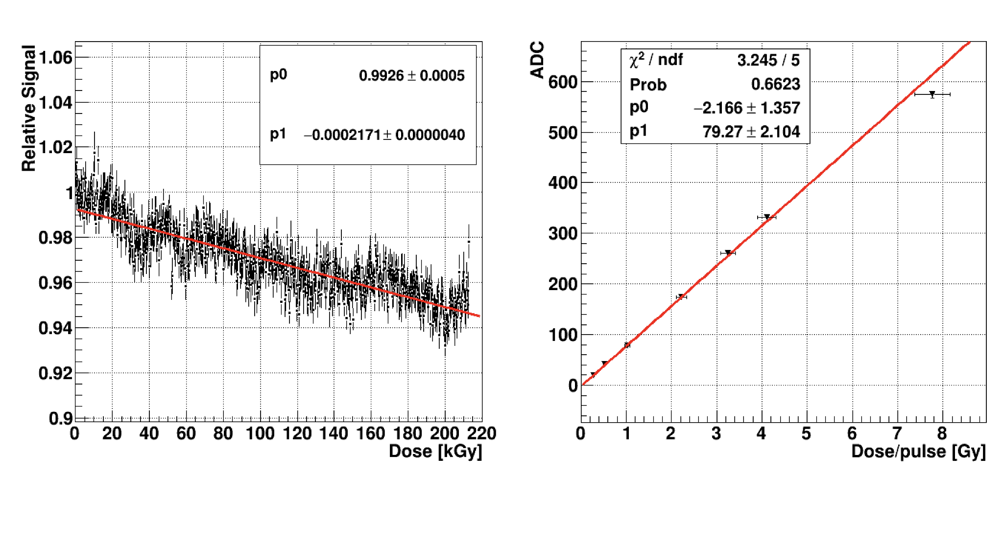
Signal vs dose
0 60 120 180 Avg. Dose Gy/s
Linear response
FLASH average dose rate: 6 – 240 Gy/s
Each data point = avg of 100 pulses.
HM scintillator

Slide 21
Radiation Hardness
Very low signal loss !
𝚫_{Signal} /𝚫_{Dose} = -0.02 %/kGy
> 1 yr clinical use ≈ 1 % signal loss
correctable with internal UV calibration system
HM Scintillator
Slope = 0.02 %/kGy

Slide 22
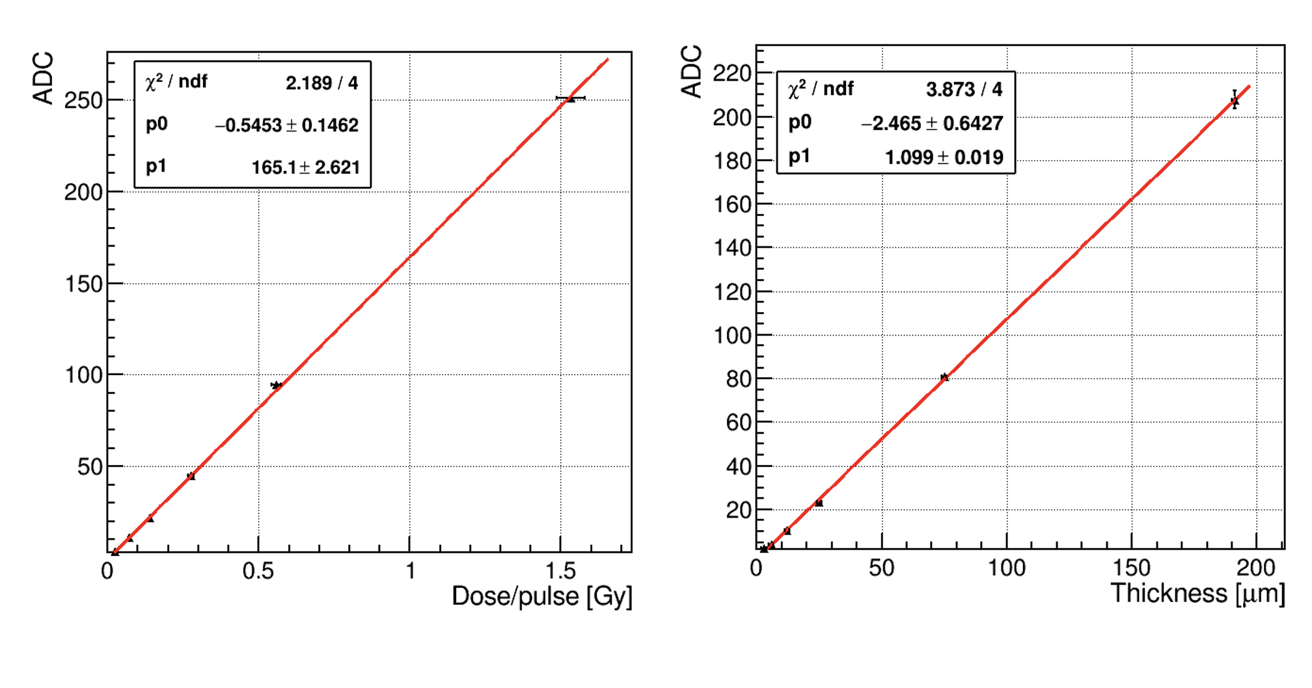
PM scintillator response to dose, thickness
Result 1: signal scales with dose/pulse 0.2-1.5 Gy
(average dose equivalent at 100 Hz = 17-150 Gy/s )
Result 2: signal scales with thickness
from 3 𝛍m to 200 𝛍m

Slide 23


Fast Real-time Operation (in development)
FPGA
Data acquisition, processing, analysis on FPGA
  exposure = 50 𝜇s
  data transfer = 50 𝜇s
  data analysis = 1 𝜇s
  total latency ≈ 100 𝜇s
  update time = 50 𝜇s
control
data
✓

Slide 24
Conclusions
✓ = achieved
We have demonstrated prototype monitors for ion & FLASH-RT beams
2D Imaging with large area 15 cm x 15 cm ✓ 30 x 30 cm in development
Sensitivity: single particles to beyond FLASH level for RT ✓
Linear response for FLASH dose rates ✓
Spatial resolution comparable with Gafchromic : < 25 um ✓
Excellent radiation hardness ✓
  PM scintillator none observed: up to 9 kGy
  HM scintillator– overall -0.02 %/kGy
Transmissive to beams ✓
Real-time operation ✓
  Ion beam monitor: updating at 1 Hz
  FLASH : 1 kHz electrons (in progress) ; 20 KHz protons (achieved)

Slide 25
backup

Slide 26
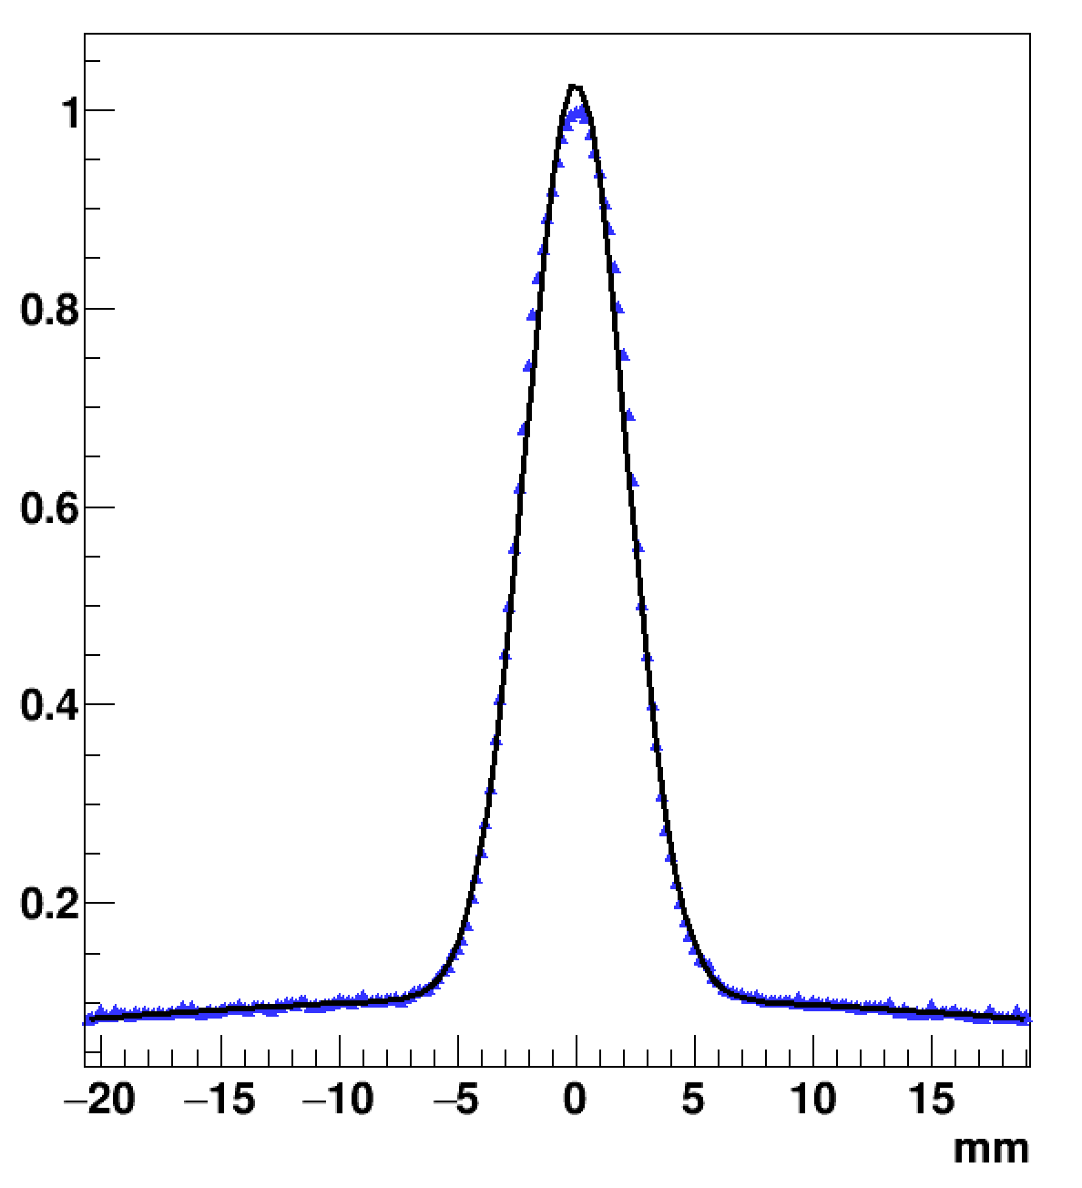
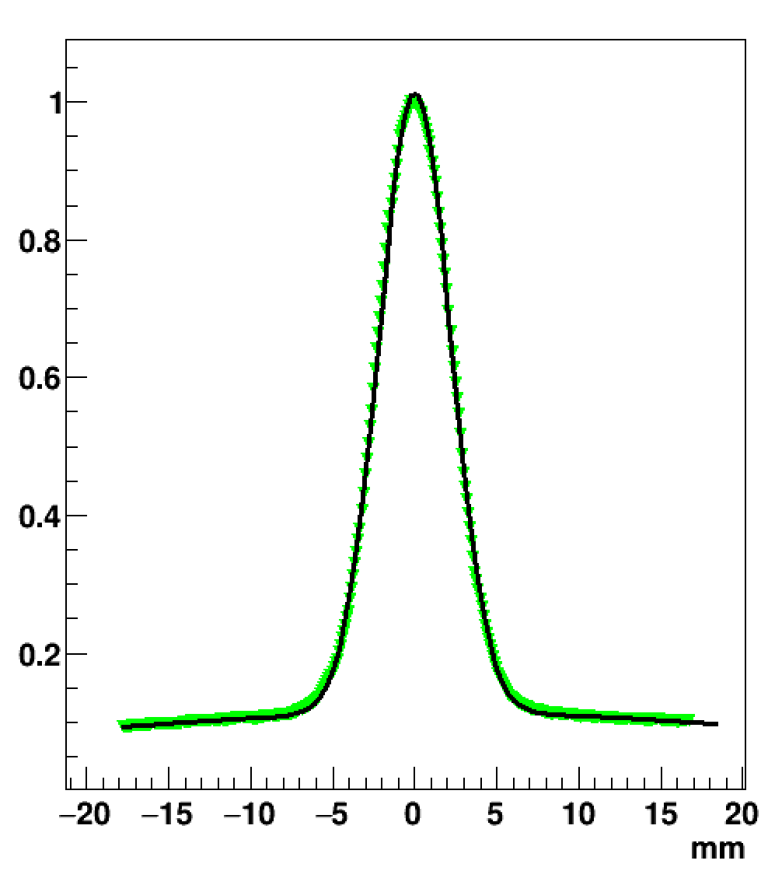
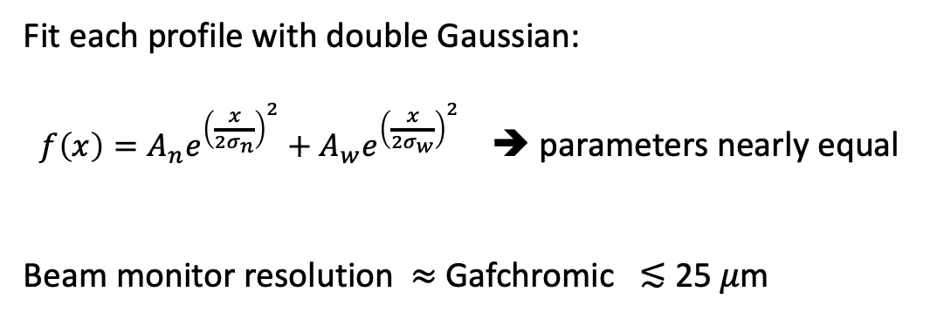
Spatial resolution
HM scintillator
Gafchromic film
X axis beam profile
𝝈_{narrow} = 2.11 mm
𝝈_{wide} = 29.5 mm
𝝈_{narrow} = 2.18 mm
𝝈_{wide} = 30.5 mm
Gafchromic film scan
Fit each profile with double Gaussian:
$f\left(x\right)=A_{n}e^{{\left(\frac{x}{2σ_{n}}\right)}^{2}}+A_{w}e^{{\left(\frac{x}{2σ_{w}}\right)}^{2}}$ ➔ parameters nearly equal
Beam monitor resolution $≈$ Gafchromic ≲ 25 𝜇m

Slide 27
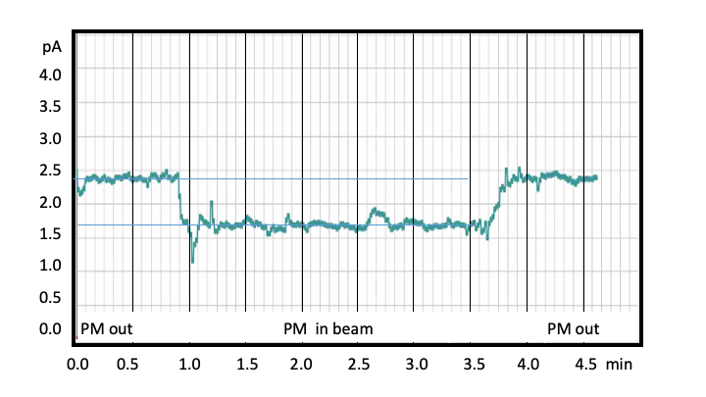
Transmission in 6 µm PM Scintillator
⁸⁶Kr⁺²⁶ ion (2.75 MeV/u) beam current measured with scintillator in/out of beam
67% beam transmission
Current pA

Slide 28
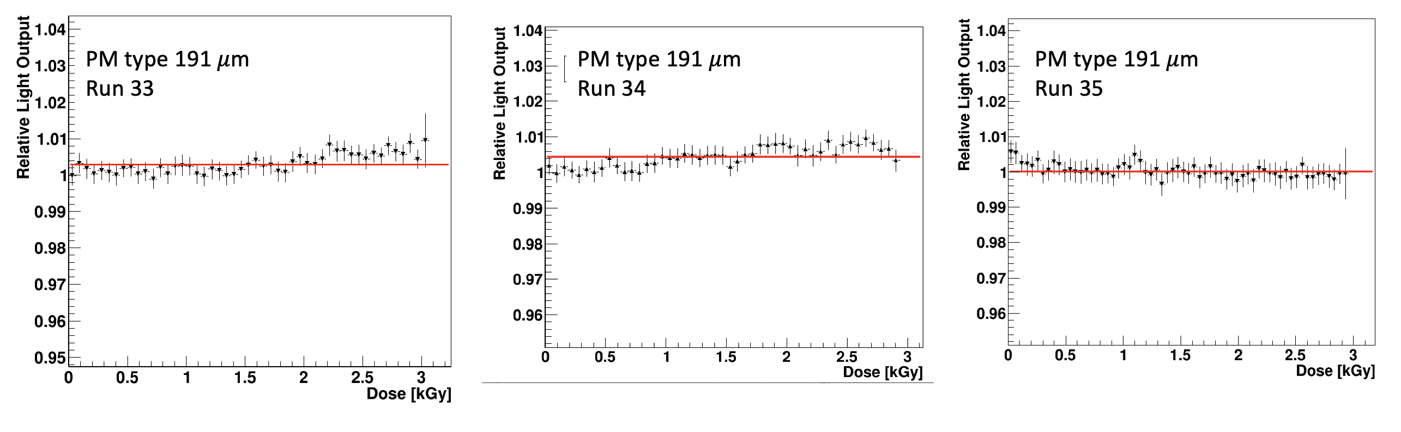
Radiation Hardness PM
PM Scintillator
PM Scintillator
9 kGy total dose in air ➔ No observed degradation observed in air in 30 minutes continuous irradiation in air
at ~400 Gy/s in vacuum ➔ - 1.5%/kGy (10 x FLASH)

Slide 29
Applications
FLASH-RT (electrons, protons, ions, x-rays, neutrons)
Electron – FLASH – IORT (Intraoperative radiation therapy)
Advanced EBRT including heavy-ions (alphas, carbon-ions, etc.)
Beamline Monitoring (medical & scientific applications – e.g., FRIB, ANL-ATLAS)
Boron Neutron Capture Therapy (BNCT)
Spatially Fractionated EBRT (Grid, Lattice, Minibeam, Microbeam)

