Slide 1
An Ethical Framework for
De-Implementation in Health Care
Presented at the 16th Academic Surgical Congress
February 2 - 4, 2021
Alison S. Baskin, BA; Ton Wang, MD, MS; Jacquelyn Miller, MA;
Reshma Jagsi, MD, DPhil; Eve A. Kerr, MD, MPH;
Lesly A. Dossett, MD, MPH, FACS

Slide 2




An ethical imperative to reduce low value health care
Low value care contributes to health care waste and patient harm
Efforts have been made to
de-implement ineffective, unproven, or harmful practices
De-implementation of low value care is necessitated by an ethical obligation to reduce harm
Our aim: To analyze the ethical principles supporting de-implementation within the broader context of the health care system

Slide 3
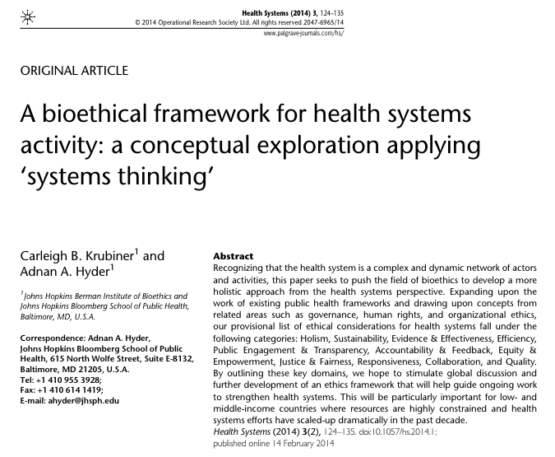



Applying a health systems framework to de-implementation
Applied Krubiner and Hyder’s bioethical framework for health systems activity
Identified 5 ethical principles either calling for or facilitating
de-implementation
Cited examples of these ethical principles in current surgical practice
Krubiner and Hyder. Health Systems (2014)

Slide 4



5 Health Systems Ethical Principles of
De-Implementation
1. EVIDENCE & EFFICACY
2. TRANSPARENCY &
PUBLIC ENGAGEMENT
3. EFFICIENCY
Represents the cornerstone of de-implementation
Increases understanding of low value designations to facilitate decision-making
Allows for increased access to more beneficial or necessary health care

Slide 5


5 Health Systems Ethical Principles of
De-Implementation
4. RESPONSIVENESS
5. COLLABORATION
Answers the call to eliminate wasted health care spending and avoidable patient harms
Coordinates efforts to minimize overuse and target low value practices

Slide 6



Health Systems Ethics: A new perspective for thinking about de-implementation
Allows for greater consideration of the systems-level factors impacting de-implementation of low value surgery
Increases the legitimacy and objectivity of
de-implementation in light of the challenge of defining and designating value
Supports new approaches to overcoming roadblocks preventing the successful reduction of low value health care

