Slide 1


Gram-indeterminate Bacteria -
A Pathogen ID Series
Brian Fagel and Sandro K. Cinti, M.D.,
Department of Internal Medicine,
University of Michigan
Editor: Michael Hortsch, Ph.D., Departments of Cell and Dev. Biology and of Learning Health Sciences, University of Michigan Medical School
©2020 Fagel & Cinti

Slide 2
Disclaimer:
The information in this review resource was developed for educational purposes only. It is not meant to be used for or considered to be diagnostic or therapeutic advice.
Notes:
Chlamydiab.Coxiella burnetiic.Gardnerella vaginalisd.Mycoplasma pneumoniaee.Rickettsia prowazekiif.Rickettsia rickettsii

Slide 3
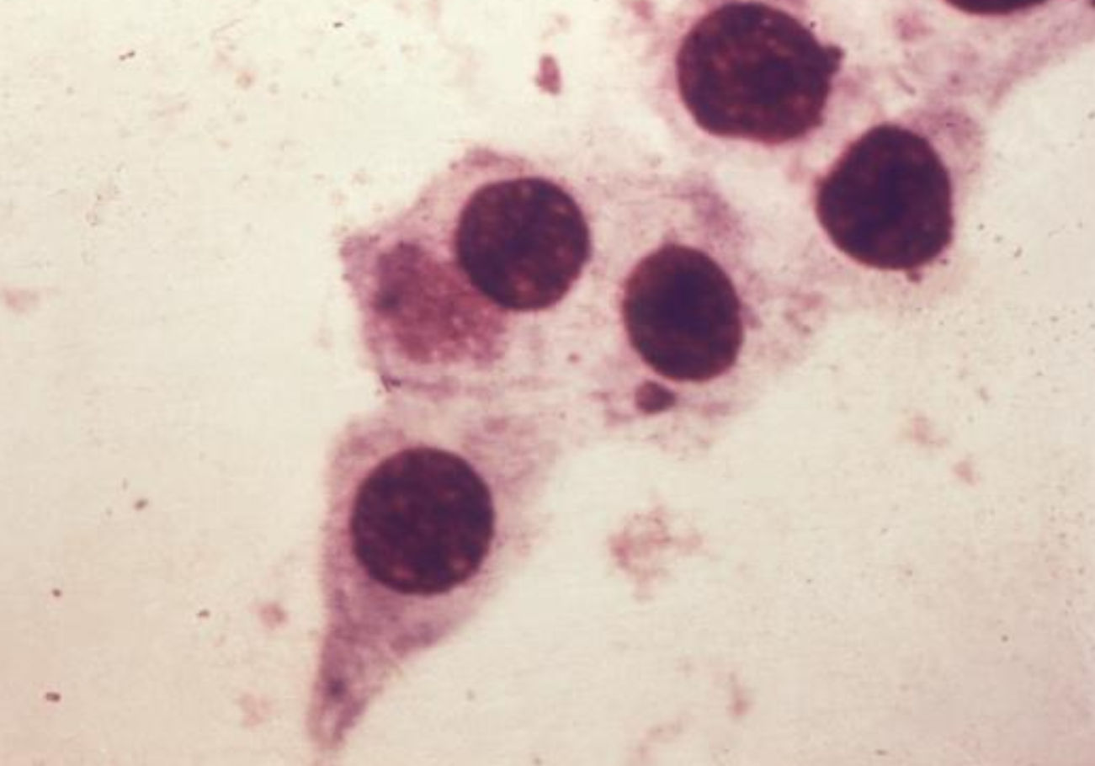

A 25 year-old man with multiple sexual partners develops dysuria and a thin, purulent penile discharge. Gram stain of the discharge reveals no organisms. Urethral scrape (right) shows a large epithelial cell inclusion body. What is likely the causative bug?
Chlamydia trachomatis
What test should be used for diagnosis?
Nucleic acid amplification test
C. trachomatis can’t make their own ____, and are obligate _________
ATP
intracellular
Name the intracellular, replicating form of C. trachomatis that develops inclusion bodies (above):
Reticulate body
Name the extracellular, infectious form:
Elementary body
What immune-mediated, inflammatory condition could develop in this patient due to self-reactive T-cells?
Reactive arthritis
(arthritis, uveitis, conjunctivitis)
What immune haplotype predisposes his to this condition?
HLA-B27
How can this patient be treated?
With doxycycline or azithromycin
Notes:
image:https://phil.cdc.gov/Details.aspx?pid=2295

Slide 4
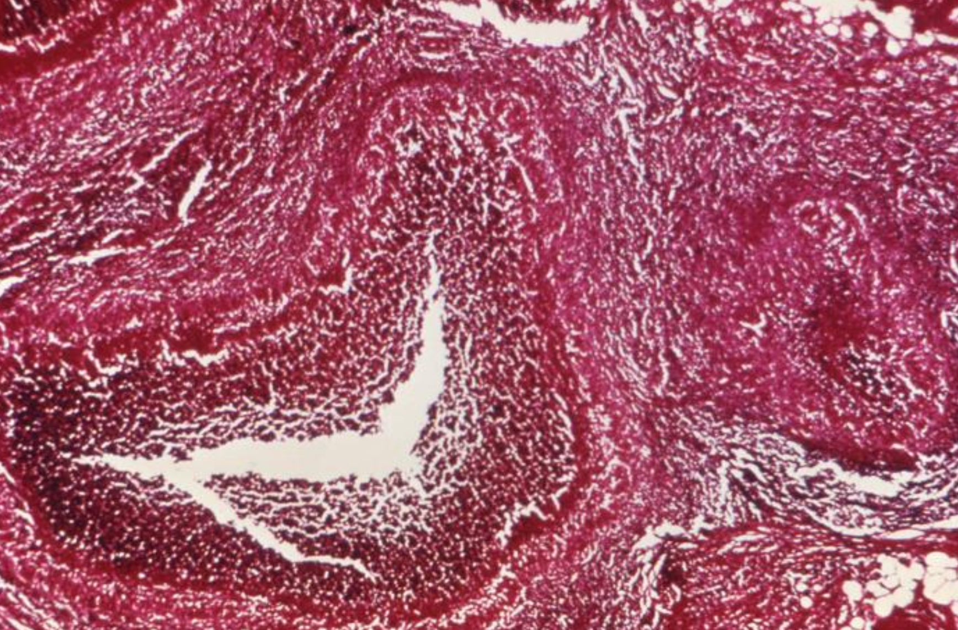
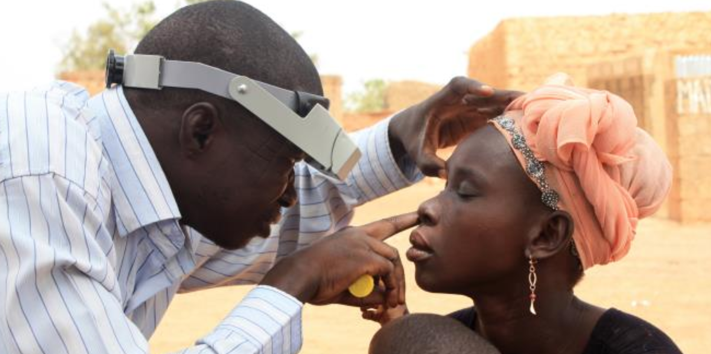
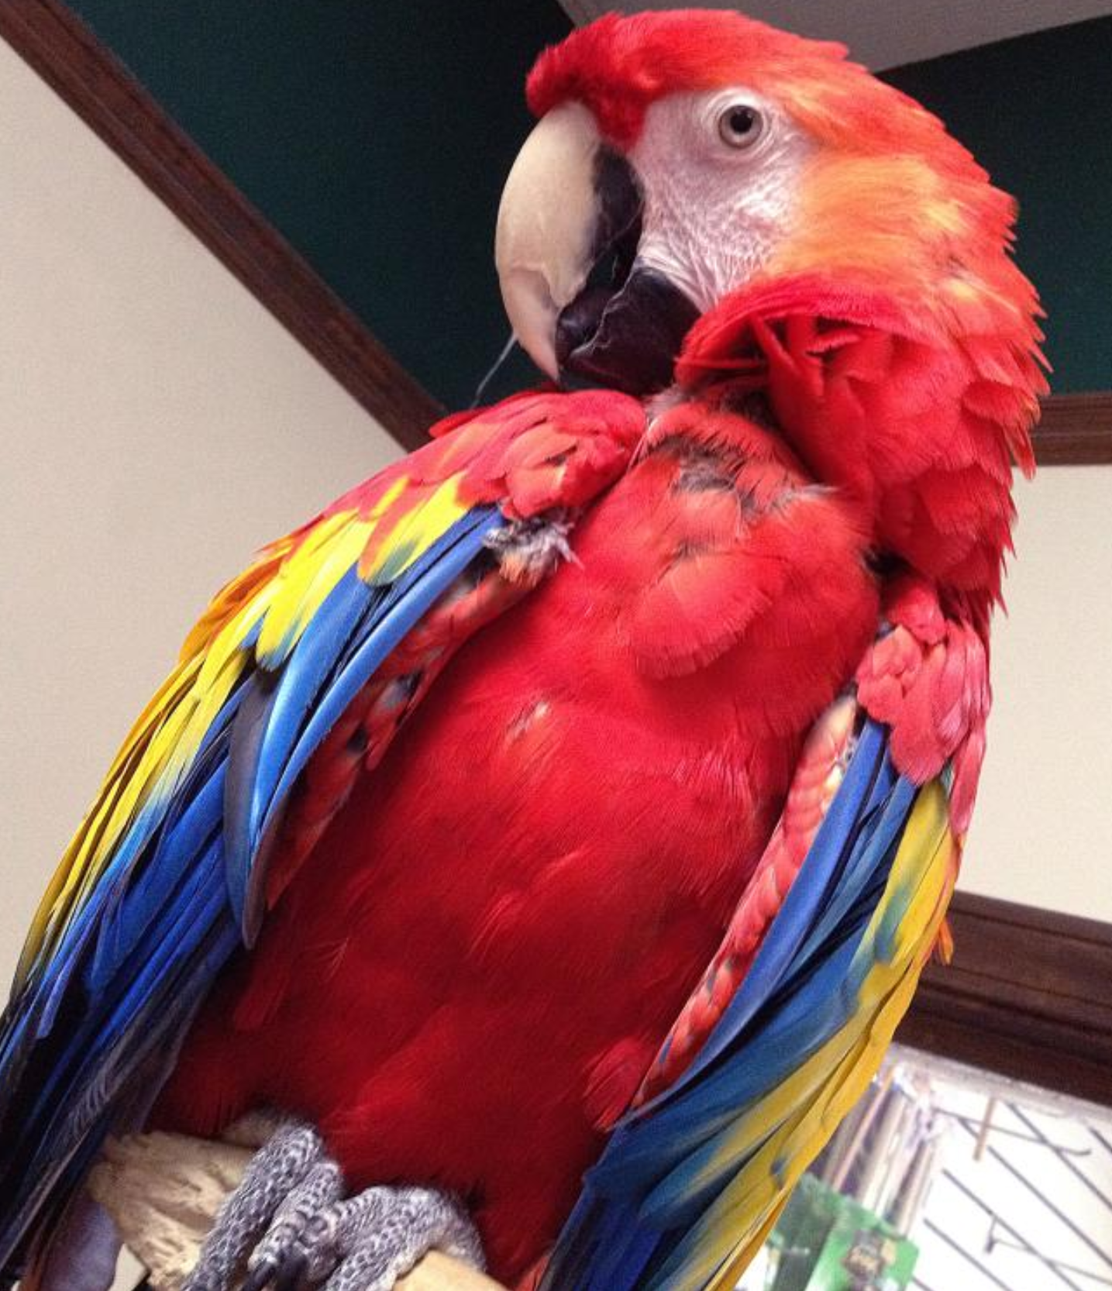
A 30-year-old female in the Caribbean who is sexually active with multiple partners develops several small, painless genital ulcers along with multiple swollen, painful inguinal lymph nodes (biopsy on right). What is the diagnosis?
Lymphogranuloma venereum (LGV)
Name these lymph nodes, which swell and may ulcerate:
Buboes
LGV is caused by the L1, L2, and L3 serotypes of __________________
Chlamydia trachomatis
Serotypes A, B, and C can cause follicular conjunctivitis as well as ________, the leading infectious cause of blindness worldwide.
trachoma
Serotypes D-K causes chlamydial urethritis, PID, and neonatal __________, which typically presents ________ after birth
conjunctivitis
1-2 weeks
What chlamydial species can cause an atypical pneumonia?
Chlamydophila pneumoniae and Chlamydophila psittaci
What reservoir is known to harbor C. psittaci?
Parrots
Notes:
Image 1: https://phil.cdc.gov/Details.aspx?pid=18020
Image 2: https://phil.cdc.gov/Details.aspx?pid=19295
Image 3: https://phil.cdc.gov/Details.aspx?pid=15004

Slide 5
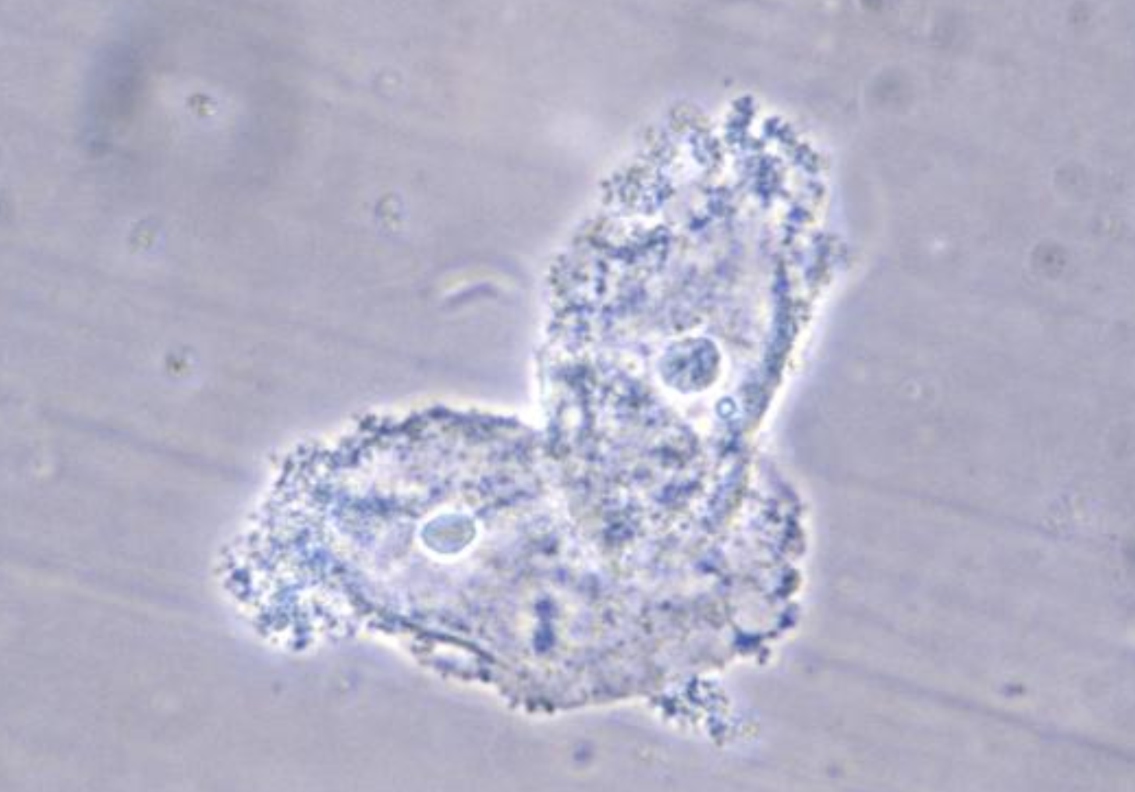
A sexually active woman presents to clinic with a week of malodorous vaginal discharge. Two strange appearing epithelial cells from wet mount of the discharge are shown on right. What is the diagnosis?
Bacterial Vaginosis (BV)
Numerous Gardnerella vaginalis bacteria
What is on the surface of the epithelial cells?
What are these cells called?
Clue cells
Besides the presence of clue cells, what is another diagnostic test for BV?
Amine whiff test – mixing the discharge with KOH enhances the fishy odor
Would you expect the pH of the discharge to be over or under 4.5?
Over – BV occurs at a pH greater than or equal to 4.5
How should this woman be treated?
Metronidazole or clindamycin
Notes:
Image: https://phil.cdc.gov/Details.aspx?pid=3720

Slide 6
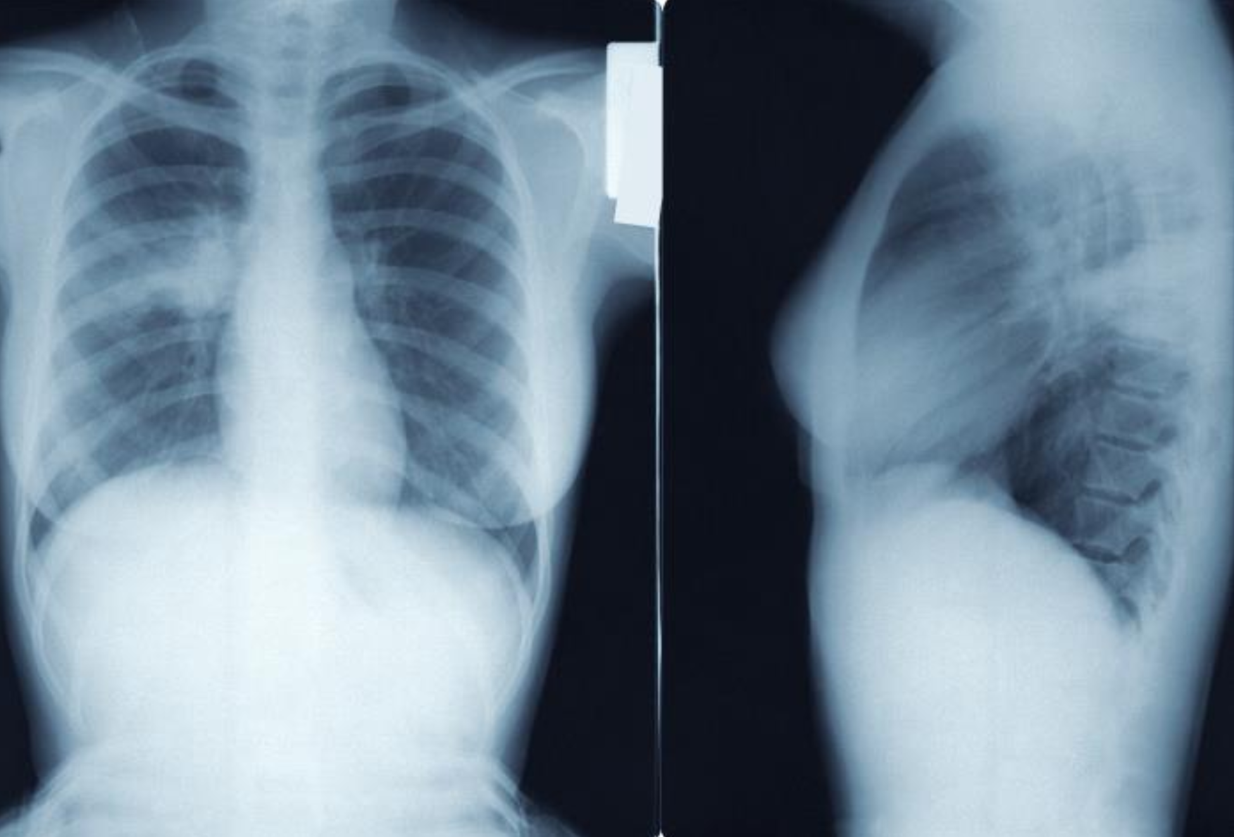
A 22-year-old female develops a headache and dry cough after a month of basic military training. Several bunkmates have had a similar condition. CXR reveals bilateral infiltrates and hilar adenopathy. No organisms are seen on gram stain of a sputum sample. What is the diagnosis and likely cause?
Walking pneumonia due to Mycoplasma pneumoniae
Why is Mycoplasma not seen on gram stain?
It has no cell wall
Sterols in the membrane
How do these bacteria maintain their membrane stability?
This patient reports periodic coldness and blanching of her fingers over the past several days when she is out in the cold. She also has evidence of hemolysis on lab studies. What is occurring?
Cold agglutinin disease due to Mycoplasma-induced elevations in IgM titers
What antibiotic(s) could be used to treat her pneumonia?
Macrolides, doxycycline, or fluoroquinolones
Notes:
image: https://phil.cdc.gov/Details.aspx?pid=21523

Slide 7
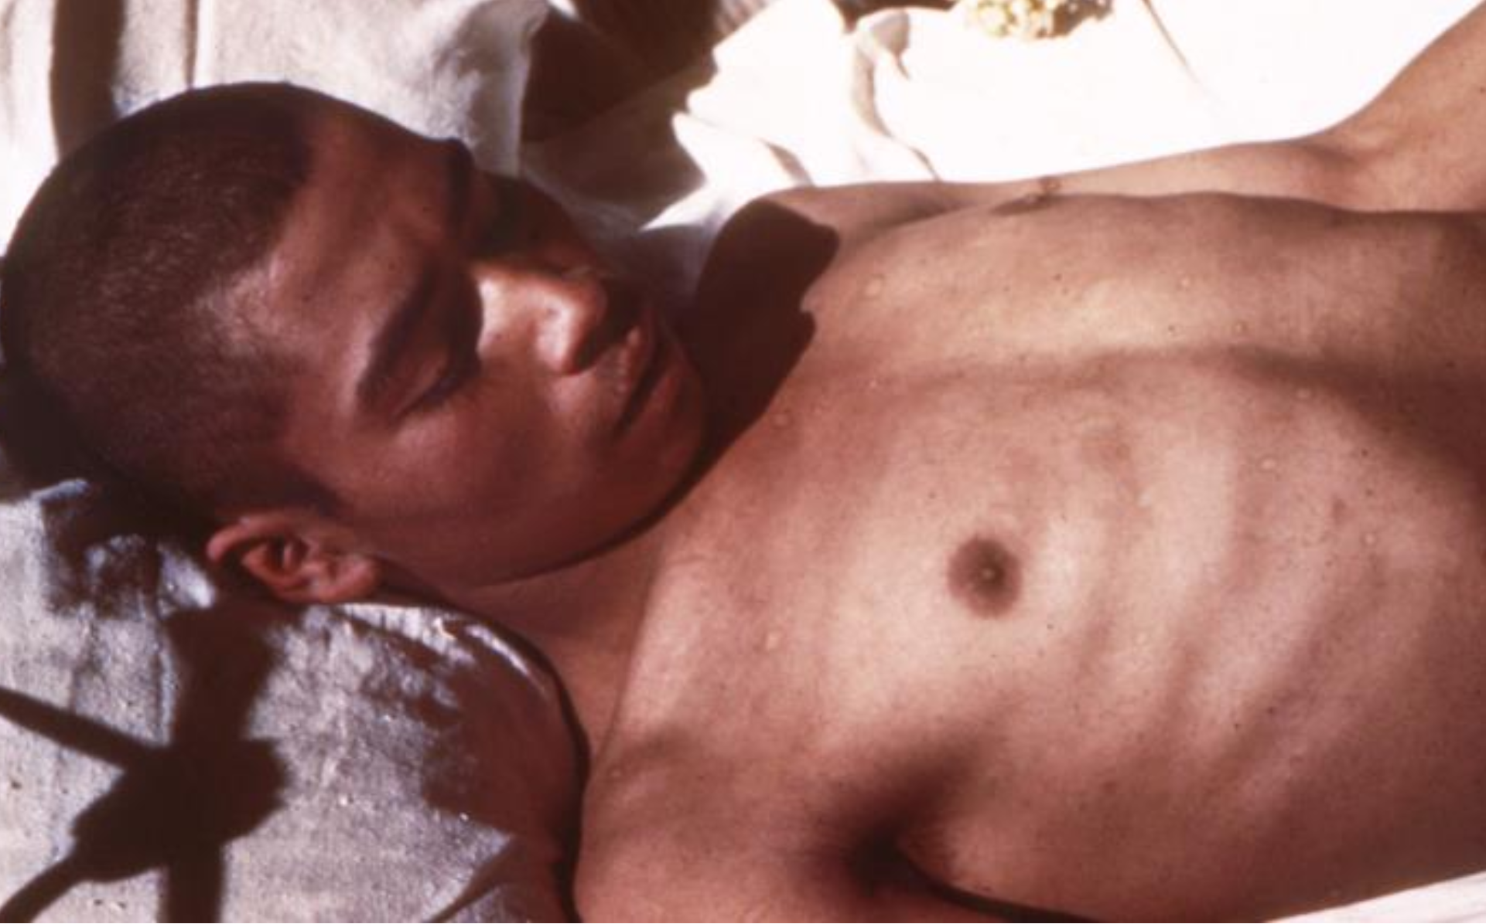
A man living in a Guatemalan refugee camp presents with a fever, an unremitting headache and a maculopapular cutaneous rash over his chest and back that spares his head, hands and feet. What is the likely diagnosis and cause?
Epidemic typhus due to Rickettsia prowazekii
How does typhus spread?
Human to human via body louse
intracellular
R. prowazekii is obligate __________ because it can not make its own _____ and _____
NAD+
CoA
Encephalitis, possible coma
Using the patient, depict the range of symptoms of epidemic typhus:
pneumonia
Vasculitic rash – starts central, spreads outward, spares palms and soles
What antibiotic could be used to treat this patient?
Doxycycline
Notes:
image: https://phil.cdc.gov/Details.aspx?pid=18837

Slide 8
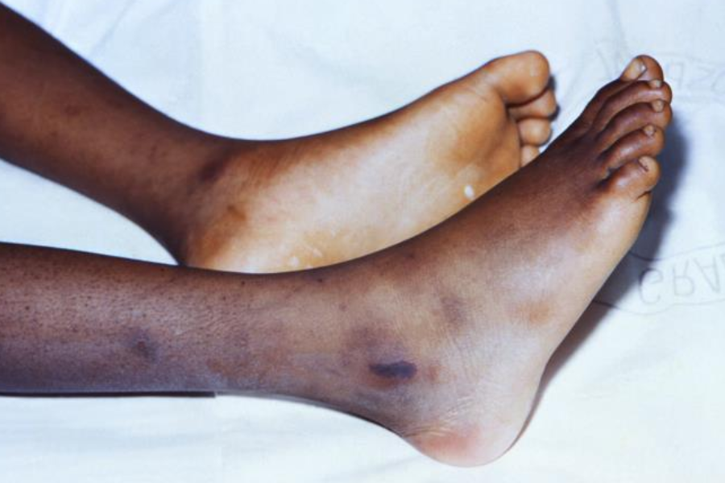
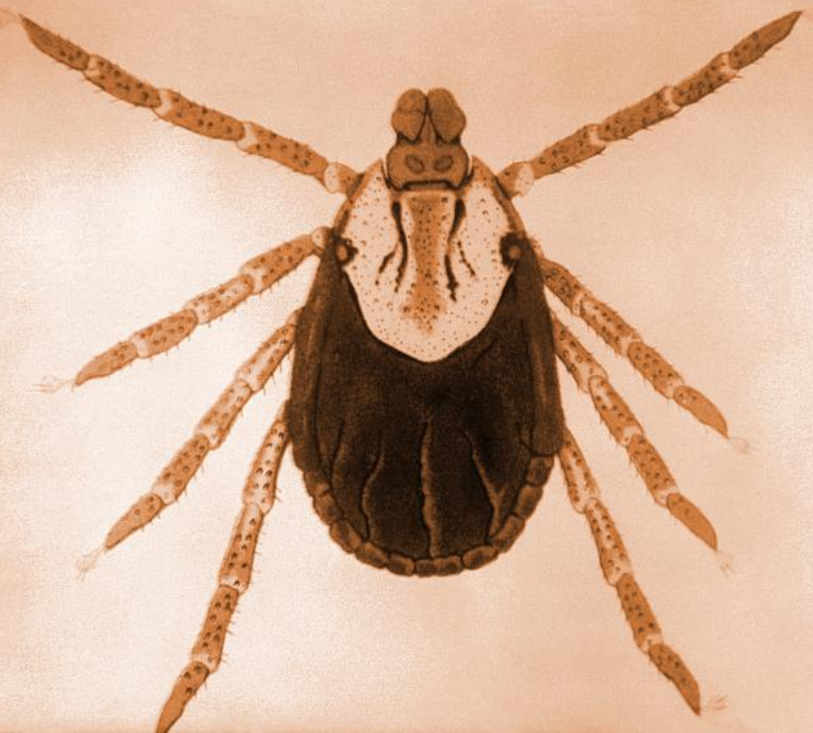


A few days after a hiking trip in North Carolina, a young man presents to the hospital with headache, high fever, and now a macular rash at the ankles that has spread centrally and to his soles. What is the diagnosis?
Rocky Mountain spotted fever (RMSF)
The tick shown was recovered from the patient. What type of tick is this?
Dermacentor – American dog tick
What bug does it transmit to cause RMSF?
Rickettsia rickettsii
Rickettsia spp. cause _________ due to colonization of endothelial cells, leading to a petechial rash in severe disease
vasculitis
intracellular
R. rickettsii is obligate __________ because it can not make its own _____ and _____
NAD+
CoA
Use the map to indicate the distribution of RMSF:
What antibiotic should be used to treat RMSF?
Doxycycline
Notes:
Image 1: https://phil.cdc.gov/Details.aspx?pid=19052
Image 2: https://phil.cdc.gov/Details.aspx?pid=7321

