Slide 1
Beyond the Classics:
Building a diverse Extensive Reading Library
Elizabeth Svoboda
University of Michigan – Flint
MITESOL 2016
October 15, 2016

Slide 2
What is the first thing that comes to mind when I mention extensive reading?

Slide 3
Overview
Concepts of collection development
Historic and recent trends in graded reader (GR) publishing
Newer and less well-known GR series
Non-traditional ESL/EFL literacy materials
Example: UM-Flint’s collection

Slide 4
5 laws of library science
Books are for use.
Every reader his/her book.
Every book its reader.
Save the time of the reader.
The library is a growing organism.
(Raganathan, 1931)

Slide 5
“The librarian’s professional obligation is to develop balanced collections that reflect and meet the educational and recreational needs of these diverse user communities and are not biased by the librarian’s own cultural identity and personal experiences.”
(Johnson, 2009, emphasis mine)

Slide 6
Selecting materials
Students & program’s goals/mission should guide decisions
Selection based on knowledge/data, professional experience, and intuition
Evaluation & Assessment of Materials
  Based on materials’ quality, including: currency, reputation of publisher or reviewer, intended reader, ease of use, physical quality, uniqueness, cost
  Based on collection as whole: Does the item support curriculum or user interests? Does it fill hole in existing collection? Does it duplicate item/subject in collection?
  (Johnson, 2009)

Slide 7
Managing collections
Weeding/Pruning collections is a necessary part of managing a library. Makes space for materials that are up-to-date and new, while disposing of materials that are old, damaged, or not circulating.
Misleading
Ugly
Superseded
Trivial
Irrelevant
Elsewhere
Worn out
Out of date
Rarely used
System cannot support
Trivial
(Johnson, 2009)

Slide 8
Early GR Publishing History
1926 – West introduces New Method series of adapted classics (West 1964)
1960s – Longman, Oxford Univ. Press, Macmillan all have GR series of adapted classics (Broughton, 1962)
1980s & 1990s – GR use prevalent according to scholarly literature, scholars taking critical look at effects of ER & GR
Late 2000s & early 2010s – Resurgence in interest in ER & rebranding of GR series

Slide 9
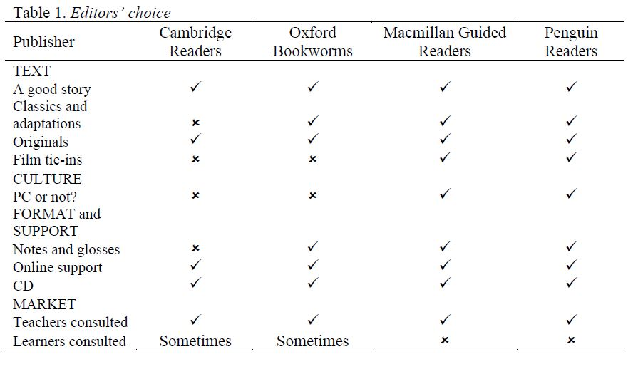
Recent GR Publishing Trends
(Claridge, 2012)

Slide 10
Recent GR publishing Trends
 | Oxford | Cambridge | Cengage Heinle | Macmillan | Pearson Longman
Fiction | 79% | 63% | 62% | 70% | 83%
Nonfiction | 21% | 37% | 38% | 30% | 27%
Classic | 32% | 0% | 28% | 26% | 32%
Pop Culture Adaptation | 11% | 0% | 0% | 9% | 33%
Original | 57% | 100% | 72% | 65% | 35%
(Data calculated from Extensive Reading Foundation, ERF Graded Reader Lists, October 2016)

Slide 11
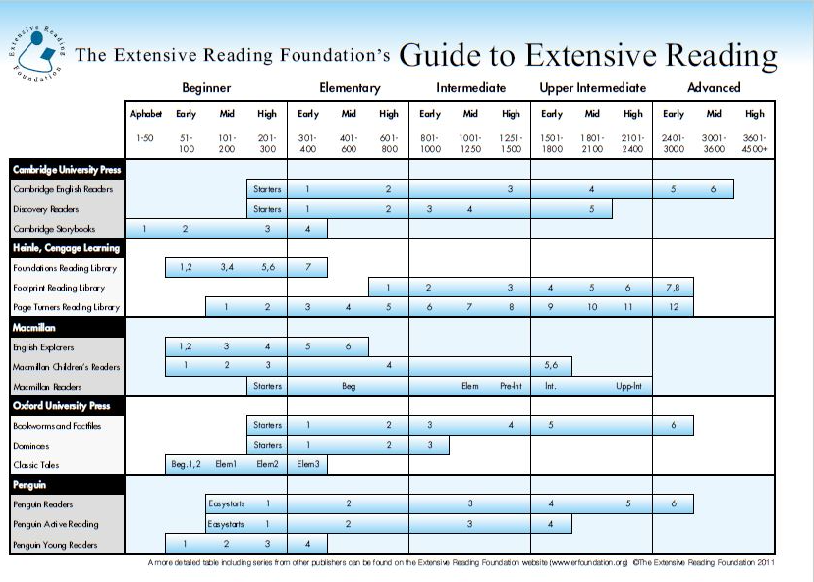

Slide 12
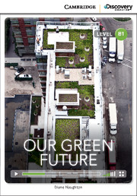

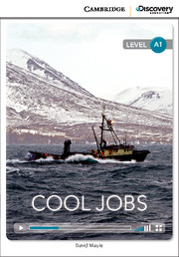


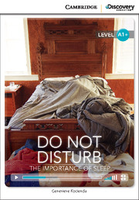

Non fiction GR series
Cambridge Univ. Press “Discovery Education Interactive Readers”
6 levels: 200 – 2100 headwords
Science, culture, human interest
Print w/ online videos; ebook version

Slide 13



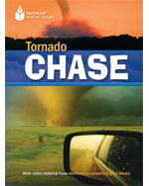

Non fiction gr series
Heinle/Cengage “Footprint Reading Library”
8 levels: 800 – 3000 headwords
5 subject categories: Incredible Animals, Fascinating Places, Remarkable People, Exciting Activities, & Amazing Science
DVD w/audio book & supplementary videos

Slide 14
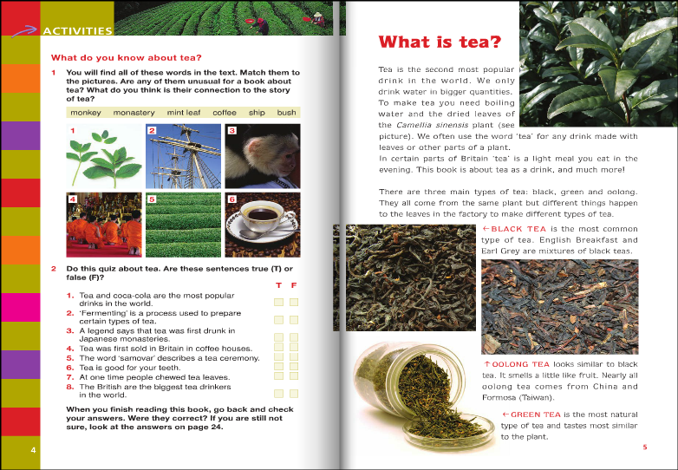
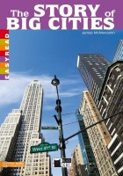

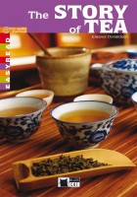
Non fiction GR series
Black Cat – Cideb “Easyreads”
2 levels for beginners: 200 – 400 headwords
Culture, history, biography
Online audio tracks

Slide 15
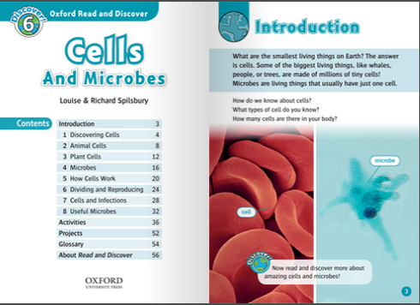

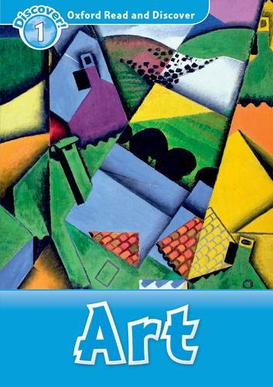


Non fiction GR series
Oxford Univ. Press “Read and Discover”
6 levels: 300 - 1050 headwords
8 years old and up
Mainly science, some culture
Audio CDs available

Slide 16


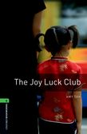




Original & “Newer” Fiction
Oxford Univ. Press
Upping number of original fiction titles in Dominoes & Bookworms series, esp. lower levels
Starting to adapt more recent books

Slide 17




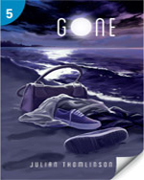


Original fiction
Cengage/Heinle
“Foundations Reading Library”
  7 levels: 50 – 400 headwords
  Human interest, teenage characters
“Page Turners Reading Library
  12 levels: 100 – 3000 headwords
  Human interest, romance, mystery/thriller, sci-fi/fantasy

Slide 18
Holes in GR series
Fewer numbers of books @ lowest & highest levels
Non-fiction books on limited number of topics
  Lot of biographies, culture/geography, and animal/life science
  My kingdom for some books w/business topics!
Slow to incorporate current (& American) popular culture
Academic vocabulary & academic writing

Slide 19





Hi/Lo Books
High interest/low literacy books
  Started appearing in the early 1970s, resurgence in recent years
Written for native speakers
  Adapted grammar structures
  More authentic vocabulary than GRs
Multiple genres, mainly fiction
Teenagers & adults
Slightly more responsive to pop culture than GRs
Major publishers
  Saddleback
  Orca
  (Bates, 1977; Sullivan, 2012)

Slide 20



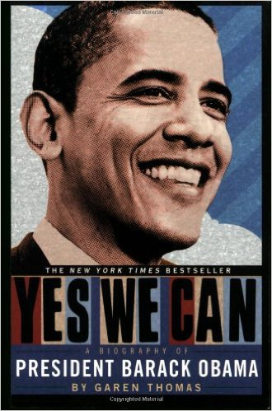

Young adult books
Part of cultural zeitgeist
Multicultural stories on the rise
Booming market right now
Young Adult Library Services Association (YALSA)
  Lists of award winning books
  Lists for reluctant readers
  www.ala.org/yalsa

Slide 21
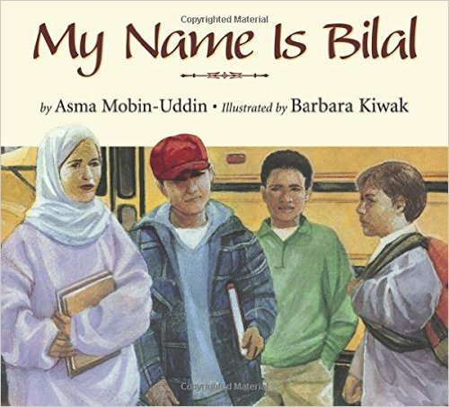

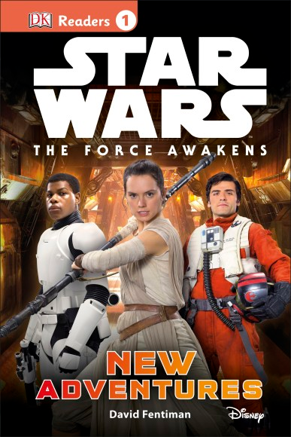
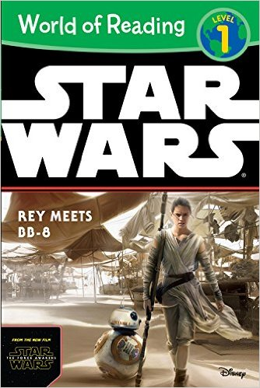
Children’s books
Multicultural literature is becoming more readily available
Association for Library Services for Children (ALSC)
  Lists of award-winning and notable books
  www.ala.org/alsc
More responsive to popular culture
Emerging reader series, adapted English but more authentic vocabulary

Slide 22

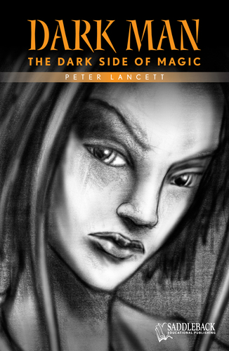
GRAPHIC NOVELS
Evolving trend on literacy learning (Cary, 2004)
Multiple genres, both fiction & non-fiction
Readily available from ELL & non-ELL publishers
  Macmillan and Heinle/Cengage have series
  Saddleback has hi/lo series
Caveats:
  Some mature content
  Artwork is subjective
  Series: do you need all of them?

Slide 23
UM-Flint collection
Collection
Circulation

Slide 24
UM-Flint collection
Collection
Circulation

Slide 25
UM-Flint collection
Collection
Circulation

Slide 26
resources
The Extensive Reading Foundation
  Graded Reader Lists (starting to incorporate other series found in ER collections)
  Graded Reader Scale
  Language Learner Literature Award
  www.erfoundation.org
Young Adult Library Services Association (YALSA)
  www.ala.org/yalsa
Association for Library Services for Children (ALSC)
  www.ala.org/alsc

Slide 27
My Contact Information
Liz Svoboda
Reference Librarian & Interim Head of Circulation
Liaison to English Language Program
University of Michigan - Flint
esvoboda@umflint.edu

Slide 28
REFERENCES
Bates, B. S. (1977). Identifying high interest/low reading level books. School
  Library Journals, 24(3), 19-21.
Broughton, G. (1962). Don't shoot the editor. ELT Journal, XVI(4), 199-204.
doi:10.1093/elt/XVI.4.199
Cary, S. (2004). Going graphic: Comics at work in the multilingual classroom.
  Portsmouth, NH: Heinemann.
Claridge, G. (2012). Graded readers: How the publishers make the grade. Reading in a
  Foreign Language, 24(1), 106-119. Retrieved October 4, 2015, from http://nflrc.hawaii.edu/rfl
The Extensive Reading Foundation. (2011). The Extensive Reading Foundation's Guide
  to extensive reading. Retrieved May 9, 2016, from http://erfoundation.org/ERF_Guide.pdf
The Extensive Reading Foundation. (n.d.). ERF graded reader list. Retrieved October 14,
  2016, from https://sites.google.com/site/erfgrlist/
Johnson, P. (2009). Fundamentals of collection development and management. Chicago:
  American Library Association.
Ranganathan, S. R. (1931). The five laws of library science. Madras: Madras Library
  Association. Retrieved October 14, 2016, from http://hdl.handle.net/2027/uc1.$b99721
Sullivan, M. (2012). Never a Dull Moment. School Library Journal, 58(2), 30-34. Retrieved
  from http://libproxy.umflint.edu:2048/login?url=http://search.ebscohost.com/login.aspx?direct=true&db=eft&AN=71417810&site=ehost-live&scope=site
West, M. (1964). Criteria in the selection of simplified reading books. ELT Journal, 18(4),
  146-153. doi:10.1093/elt/XVIII.4.146

