Slide 1
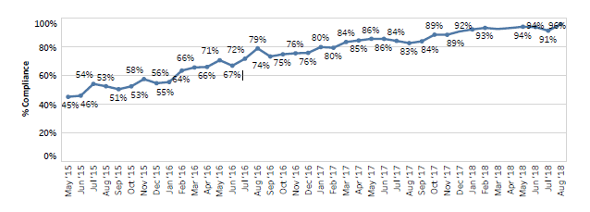
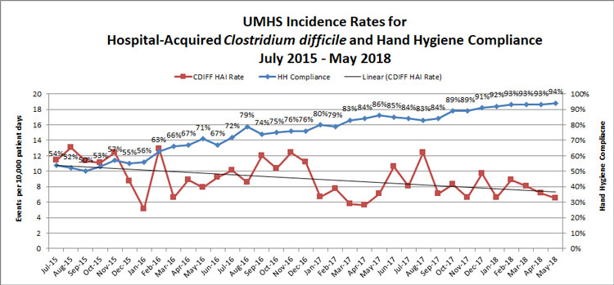
Michigan Medicine Hand Hygiene Initiative – Rough Draft
Jacqueline Vidosh
University of Michigan
Abstract
Methods and Materials
Methods
Results
TBD
Phase 1: Project Rollout - “Clean, Remind, Thank
Leaders of each unit were educated on the behaviors determined to be vital for hand hygiene success: To clean hands in and out of patient care areas and between clean and dirty tasks based on the WHO guidelines, to provide reminders to staff observed forgetting to clean their hands, and to thank anyone who provided a reminderLeadership were encouraged to educate their staff on the vital behaviors of hand hygiene as well as to work together to identify barriers to compliance that could be addressed . It was emphasized to unit leaders that following the vital behaviors was the expectation and essential for safe patient care.
Clear definitions for “patient care areas” where hand hygiene must be performed were established in various areas, including bays, procedural areas, operating rooms, and inpatient rooms. For rooms with doors, the threshold was the doorway. For bays without doors, the threshold was defined as the curtain track. To assist staff at remembering to clean their hands, standard visual cues were implemented around the areas without clear thresholds. In the medical ICU, red tape was placed on the floor to provide allow staff to recognize when they had crossed the threshold into a patient room and should clean their hands. Stop signs were placed at the entrances to many units to draw the attention of both staff and visitors to remind them to perform hand hygiene. These steps set up the success of improving hand hygiene compliance by providing education to staff on the vital behaviors of hand hygiene, reducing barriers to cleaning hands, and providing visual cues for individuals.
At the same time the “Clean, Remind, Thank” Campaign began, IPE hired several “Hand Hygiene Observers.” These individuals were trained in the details of the hand hygiene guidelines, including the basics of cleaning in and out as well as expectations for scenarios involving staff entering or leaving a room with their hands full, or instances where there were contact precautions in place necessitating use of soap and water. The trained observers were placed in every unit across the hospital system to perform covert observations, spending a maximum of 20 minutes per day on a single unit. They recorded the shift during which the observation took place, whether the observation was before or after a patient care encounter, and whether there was compliance with guidelines. They also recorded the role of the individual being observed. These observations were hand-written on paper forms (Figure 1). This data was tracked and posted on the institutional dashboard in real-time, allowing each unit to see their compliance rates.
Phase 2 - Incentives and Improvement Plans
In the year following the rollout of the “Clean, Remind, Thank” Campaign, with data on hygiene compliance rates being reported to the IPE, a rewards and incentives program was started for high performing units. All units with >90% monthly compliance received a treasure chest filled with $100 worth of treats. All units with >90% monthly compliance were placed on the ‘Honor Roll’ and were entered into a quarterly drawing for a $300 prize. High performing units were also recognized with unit-wide celebrations and were recognized at an institutional level .
Phase 3 - Exceeding the Goal and Sustaining Improvements
As the institutional compliance rate reached the original goal of 90%, the goal was re-evaluated and increased to 95%. The major change that was made during this phase was to decentralize both hand hygiene coaching and accountability for maintaining high compliance rates. Rather than being assigned by IPE, unit-based coaches were selected and trained for all units. Every unit and ancillary department was also made responsible for monitoring hand hygiene compliance and ensuring their units met or exceeded the institutional goal, although they continued to report their compliance data to the IPE. Rewards and recognition were given to units with perfect compliance. Low performing units, now defined as those with less than 95% compliance, continued to submit action plans for improvement, with IPE follow-up.
When the initiative to improve hand hygiene began in May 2015, institutional compliance was measured at 45% for that month.
Following rollout of the “Clean, Remind, Thank” campaign, which included hiring covert observers to gather and report data and overt hand hygiene coaches in each unit, compliance increased to an average of 70% across the institution by May 2016.
Following implementation of the rewards program for high performing units and action plan requirement for those that were low performing, compliance further increased to 85% by May 2017.
After this time period, improvement in compliance appeared to stagnate or slightly decrease over the course of the next several months; however, with recurrent implementation of action plans for low performing units and rewards and incentives for high performing units, this number again began to increase, reaching 91% by December 2017.
With decentralization of the hand hygiene coaches, compliance rates continued to improve, reaching 95% compliance by August 2018. As of August 2019, the institution has been successful at sustaining compliance rates at or above 95% each month for over a year.
Cdiff has also decreased as HH has increased.
Introduction
Healthcare-associated infections (HAIs) are a major issue affecting all patient care settings across the United States. The World Health Organization reports that approximately 7% of hospitalized patients in developed countries will contract a HAI during hospitalization; (WHO 2011 ) This contributes to increased patient morbidity and mortality; more than 1 of every 17 patients who contract a HAI die as a result (Klevens). It also contributes to increased health care costs across institutions; studies have estimated these costs ranging between $9.8 billion (Zimlichman) to $45 billion (Scott) annually across all US hospitals.
Hand hygiene compliance is possibly the most simple and cost-effective method of reducing HAIs through reduction of cross contamination of pathogenic bacteria between patients in a health care setting. Multiple studies have shown a reduction in HAIs in institutions that have improved adherence to hand hygiene guidelines (Pittet, Lee). Furthermore, through reducing the rates of HAI, hand hygiene compliance can effectively decrease the amount of antimicrobials administered in the healthcare setting, reducing the development of antibiotic resistance and the spread of MDROs as well as the morbidity and mortality related to both these organisms and the agents necessary to treat them (WHO 2015).
Improving hand hygiene compliance is an integral part of the mission of the departments of infection prevention and control of major hospitals and health care centers across the United States. Evidence-based guidelines published by the World Health Organization in 2002 endorsed the use of alcohol-based hand rub before and after the majority of clinical interactions (Boyce). Based on these guidelines there have been major systems changes across the United States to ensure alcohol-based sanitizers are readily available throughout health care centers (Mody). However, consistent and proper usage of these products by health care workers and associated staff has remained poor, with hand hygiene compliance hovering around 40% throughout United States health systems (reported range of 5-89%) (WHO 2009; Bischoff; Boyce .) However, the majority of initiatives put into place to improve the rates of hand hygiene compliance have not been shown to produce a sustained impact (Luangasanatip.)
Chart 1. Institutional Rate of Hand Hygiene Compliance from May 2015-August 2019.
Discussion
Relationship between communication openness and hand hygiene compliance – changing the culture – There is a graph in one of the PowerPoints that shows how as hand hygiene compliance improved, staff felt that communication was more open – we could discuss that making Michigan Medicine an environment where people felt valued and comfortable when speaking up about hand hygiene was vital for the success of this initiative.
Although “Clean Remind Thank” was the cornerstone of the initiative, each unit was allowed the flexibility to strategize to identify strategies that they could implement on their own unit in order to improve compliance. The Influencer Model was what they used to do so, which makes this a unique initiative among other institutions who have had similar hand hygiene initiatives.
Throughout all of these initiatives, hand hygiene has been at the forefront of people’s minds – from hearing unit data at staff huddles, seeing the celebrations, getting the emails from IPE, it has been clear that hand hygiene has become part of the culture here at Michigan Medicine. Keeping it in people’s minds has helped them to build habits they did not have before, and established habits right away in new staff and students before any bad habits could form. Making it part of the culture has also made it a lot easier for people to speak up in a lighthearted way to ensure the hand hygiene guidelines are followed.
Chart 1. Institutional Rate of Hand Hygiene Compliance from May 2015-August 2019.
Contact
References
Jacqueline Vidosh
jvidosh@umich.edu
Boyce JM, Pittet D. Guideline for Hand Hy giene in Health-Care Settings: Recommendations of the Healthcare Infection Control Practices Advisory Committee and the HICPAC/S HEA/APIC/IDSA Hand Hygiene Task Force. Infect Control Hosp Epidemiol2002;23(Suppl.),S 1-S40. 2.Boy ce JM, Potter-By noe G, Chenevert C, King T. Environmental contamination due to methicillin-resistant Staphylococcus aureus; possible infection control implications. Infect Control Hosp Epidemiol 1997;18:622-627.
Boyce JM, Pittet D. Guideline for Hand Hygiene in Health-Care Settings. Recommendations of the Healthcare Infection Control Practices Advisory Committee and the HICPAC/SHEA/APIC/IDSA Hand Hygiene Task Force. Society for Healthcare Epidemiology of America/Association for Professionals in Infection Control/ Infectious Diseases Society of America. MMWR Recomm Rep 2002;51(RR-16): 1–45.
CDC. Guideline for Hand Hygiene in Health-care Settings. MMWR 2002; vol. 51, no. RR-16.
Facts and Figures about Michigan Medicine: http://www.med.umich.edu/pdf/2019-Annual-Report.pdf
Klevens RM, Edwards JR, Richards CL. Estimating health care-associated infections and deaths in U.S. hospitals, 2002. Public Health Rep. 2007;122(2):160–166.
Lee YT, Chen SC, Lee MC, et al. Time-series analysis of the relationship of antimicrobial use and hand hygiene promotion with the incidence of healthcare-associated infections. J Antibiot (Tokyo)2012;65:311-6.
Mody L, Saint S, Kaufman SR, et al. Adoption of alcohol-based handrub by United States hospitals: a national survey. Infect Control Hosp Epidemiol 2008; 29(12):1177–80.
N. Luangasanatip, M. Hongsuwan, D. Limmathurotsakul, Y. Lubell, A. Lee, S. Harbarth, et al. “Comparative efficacy of interventions to promote hand hygiene in hospital: systematic review and network meta-analysis” BMJ, 351 (2015), p. h3728
Pittet D, Allegranzi B, Sax H, et al. Evidence-based model for hand transmission during patient care and the role of improved practices. Lancet Infect Dis 2006; 6:641-52.
Scott DR; Center for Disease Control and Prevention. The direct medical costs of healthcare-associated infections in US hospitals and the benefits of prevention. http://www.cdc.gov/HAI/pdfs/hai/Scott_CostPaper.pdf. Accessed November 13, 2019.
W.E. Bischoff, T.M. Reynolds, C.N. Sessler, M.B. Edmond, R.P. Wenzel. Handwashing compliance by health care workers: the impact of introducing an accessible, alcohol-based hand antiseptic. Arch Intern Med, 160 (2000), pp. 1017-1021
World Health Organization “WHO guidelines on hand hygiene in health care” (2009). Available at: https://apps.who.int/iris/bitstream/handle/10665/44102/9789241597906_eng.pdf
World Health Organization Report on the burden of endemic health care–associated infection worldwide (2011). Available at: https://apps.who.int/iris/bitstream/handle/10665/80135/9789241501507_eng.pdf
World Health Organization. Global action plan on antimicrobial resistance (2015). Available at: https://www-who-int.proxy.lib.umich.edu/antimicrobial-resistance/publications/global-action-plan/en/
Zimlichman E, Henderson D, Tamir O, et al. Health Care–Associated Infections: A Meta-analysis of Costs and Financial Impact on the US Health Care System. JAMA Intern Med. 2013;173(22):2039–2046. doi:https://doi.org/10.1001/jamainternmed.2013.9763

